Slide 1
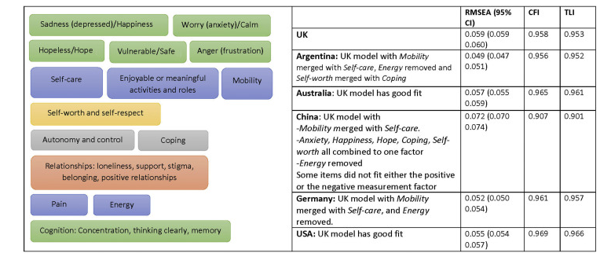
Chinese EQ-HWB does fit the international factor structure after all!!!
A replication of the original confirmatory factor analysis in a better sample Guangjie Zhang1*; Zhihao Yang1,2; Nan Luo3; Tessa Peasgood4, Jan Busschbach1
Introduction
In the E-QALY project, the Chinese online sample misfitted UK CFA Bifactor model
The Chinese sample was highly educated
Did the Chinese online sample contained sufficient variance?
Method
We set out to refit the model in a sample with more variance
Including low education
Face-to-face interviews in more than 500 people
Tested the Bi-factor model in original online sample and face-to-face
Results
553 respondents;
96 Lung cancer; 125 Diabetes; 102 depression; 113 Schizophrenia; 16 other diseases; 101 healthy
Much better results!
Online sample: RMSEA 0.072; CFI 0.907; TLI 0.901
Face-to-face: RMSEA 0.052; CFI 0.943, TLI 0.939
Conclusion
Most deviation of the UK EQ-HWB model seems related to a lack of variance in the Chinese online data
Beter data set supported a comparable factor structure in China related to the international comparisons
Original table can be changed
Should be read as
China: UK model with
- Mobility and Self-Care combined and Energy removed, like the models of Argentina and Germany.
- Self-Worth and Coping combined like Argentina. - Only in China: Happiness, Hope combined into the Anxiety.
Peasgood et al, Developing a New Generic Health and Wellbeing Measure: Psychometric Survey Results for the EQ-HWB. Value Health. 2022 Apr;25(4):525-533
Should be read as:
RMSEA 0.052; CFI 0.943, TLI 0.939
¹
²
³
⁴

