Slide 1
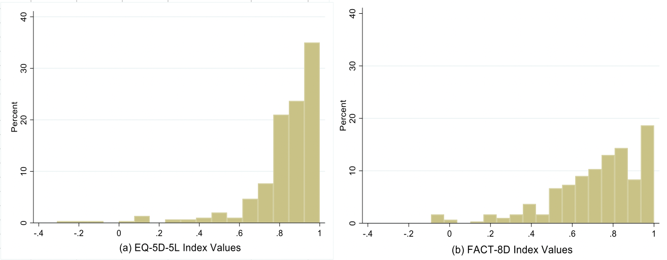
COMPARISON OF THE MEASUREMENT PROPERTIES OF EQ-5D-5L TO
CANCER-SPECIFIC PREFERENCE-BASED MEASURE (FACT-8D) AMONG WOMEN WITH BREAST CANCER
Hari Setyowibowo¹, Fredrick Purba¹, Stevanus Pangestu², Clara Mukuria³, Fanni Rencz²
¹ Universitas Padjadjaran, Indonesia ² Corvinus University of Budapest, Hungary ³ University of Sheffield, England, UK
Contact: h.setyowibowo@unpad.ac.id
BACKGROUND
One of the most prevalent generic preference-based measures (PBMs) is the EQ-5D-5L. The FACT-8D is a relatively new cancer-specific PBM derived from the Functional Assessment of Cancer Therapy-General (FACT-G) questionnaire. So far, no studies have compared the measurement performance of the EQ-5D-5L and FACT-8D in breast cancer, which is the most common form of cancer worldwide.
RESULTS
Final sample of 300 patients completed the baseline questionnaires. The highest ceiling was found in the self-care dimension of the EQ-5D-5L (90.0%) and the lowest in pain/discomfort dimension (45.33%). For FACT-8D, the highest ceiling was in support from family/friends (73.3%) and the lowest in work (24.3%). Patients who reported no problems in all dimensions was 35% for EQ-5D-5L but 5% for the FACT-8D. Almost no floor effect (0-2%) was observed in any dimension of EQ-5D-5L, but FACT-8D dimension of sleep shows the highest percentage of floor (8%) among its dimensions. | Known-group validity analyses showed that EQ-5D-5L index was able to show significant differences between patients based on their education, metastasis, and number of comorbidities. The FACT-8D index scores was able to differentiate between education and comorbidities, while EQ VAS was only for comorbidities. However, these significant differences showed small effect size for the three measures. EQ-5D-5L pain/discomfort strongly correlated with FACT-8D pain and moderately with other six dimensions. The other EQ-5D-5L dimensions were moderately correlated with four to six FACT-8D dimensions. The EQ-5D-5L and FACT-8D index values were strongly correlated (0.58).
AIM
To compare the measurement properties of the EQ-5D-5L and FACT-8D among women with breast cancer.
Table 1. Description of patients and scores of EQ VAS, EQ-5D-5L index and FACT-8D index
Characteristics |  | Mean | SD | EQ VAS Mean | EQ-index Mean | FACT-index Mean
Total sample |  |  |  | 81.18 | 0.85 | 0.72
Age |  | 51.3 | 10.3
 |  | N | %
Education | Low (no - primary) | 92 | 30.67 | 78.80 | 0.81* | 0.67*
 | Mid (high school) | 157 | 52.33 | 81.53 | 0.87* | 0.73*
 | High (diploma above) | 51 | 17.00 | 84.41 | 0.84* | 0.77*
Residence | Rural | 179 | 59.67 | 79.89 | 0.84 | 0.71
 | Urban | 121 | 40.33 | 83.10 | 0.85 | 0.74
Caregiver | Yes | 184 | 61.33 | 81.68 | 0.83 | 0.70
 | No | 116 | 38.67 | 80.39 | 0.87 | 0.75
Cancer stage at diagnosis** | Stage I | 26 | 8.67 | 78.27 | 0.84 | 0.78
 | Stage II | 186 | 62.00 | 82.07 | 0.86 | 0.71
 | Stage III-IV | 86 | 29.00 | 80.47 | 0.81 | 0.72
Metastasis | No | 276 | 92.00 | 81.38 | 0.86* | 0.73
 | Yes | 24 | 8.00 | 78.96 | 0.70* | 0.59
Comorbidity | 0 | 80 | 26.67 | 84.56* | 0.87* | 0.76*
 | 1 | 123 | 41.00 | 81.99* | 0.86* | 0.73*
 | 2 or more | 97 | 32.33 | 77.37* | 0.81* | 0.68*
Figure 1. (a) EQ-5D-5L and (b) FACT-8D index values distribution
METHODS
A cross-sectional, single-centre study to validate several HRQOL and wellbeing measures in women with breast cancer population was conducted in Bandung, Indonesia from September to December 2023. Ethical approval was received from the Research Ethics Committee of Dr. Hasan Sadikin General Hospital Bandung. Patients in active treatment provided demographic data (e.g., age, education, marital status, caregiver availability) and completed the interviewer-administered versions of the EQ-5D-5L and FACT-G. Nurses provided clinical data (e.g., metastasis status, comorbidity, type of treatment) based on patients’ medical record. Index values were derived using the Indonesian EQ-5D-5L value set and the Australian FACT-8D value set. Floor and ceiling effects were determined per dimension and per measure. Known groups’ validity was determined by comparing the EQ-5D-5L index value, EQ VAS, and FACT-8D index value between several characteristics (e.g., education, metastasis status, etc.) using Mann-Whitney U and Kruskal-Wallis H tests, where applicable. Follow-up calculation of effect size using Cohen’s d was done for significant findings. Convergent validity was examined by Spearman’s correlations between the EQ-5D-5L dimensions and their conceptually similar FACT-8D dimensions and between index values of the two instruments.
Table 3 Correlation between dimensions of EQ-5D-5L and FACT-8D
*: P-value<0.05; **: 2 unknown data
Dimensions | Mobility | Self-care | Usual Activities | Pain/ Discomfort | Anxiety/ Depression
Fatigue | 0.251 | 0.204 | 0.350 | 0.329 | 0.279
Nausea | 0.147 | 0.128 | 0.185 | 0.301 | 0.171
Pain | 0.327 | 0.279 | 0.292 | 0.569 | 0.352
Support | -0.026 | -0.099 | -0.103 | 0.041 | 0.120
Sadness | 0.265 | 0.205 | 0.293 | 0.310 | 0.465
Worry | 0.172 | 0.162 | 0.196 | 0.289 | 0.338
Work | 0.257 | 0.272 | 0.404 | 0.277 | 0.208
Sleep | 0.280 | 0.173 | 0.231 | 0.226 | 0.256
Correlation (Cohen, 1988): moderate: 0.2-0.5; strong-very strong: >0.5
Table 2. Relative frequencies (%) of EQ-5D-5L responses
Level of problems | Mobility | Self-care | Usual Activities | Pain/ Discomfort | Anxiety/ Depression
No | 78.67 | 90.00 | 80.00 | 45.33 | 69.67
Slight | 17.33 | 6.00 | 13.33 | 41.67 | 23.33
Moderate | 3.67 | 2.00 | 4.00 | 8.00 | 5.67
Severe | 0.33 | 0.67 | 0.67 | 4.00 | 1.33
Unable/Extreme | 0.00 | 1.33 | 2.00 | 1.00 | 0.00
DISCUSSION
EQ-5D-5L shows a higher ceiling effect than the FACT-8D, but lower floor effect. EQ-5D-5L (i.e., index score) showed a tendency towards a better known-group validity than FACT-8D.
This study was funded by the EuroQol Research Foundation (1644-RA)

