Slide 1
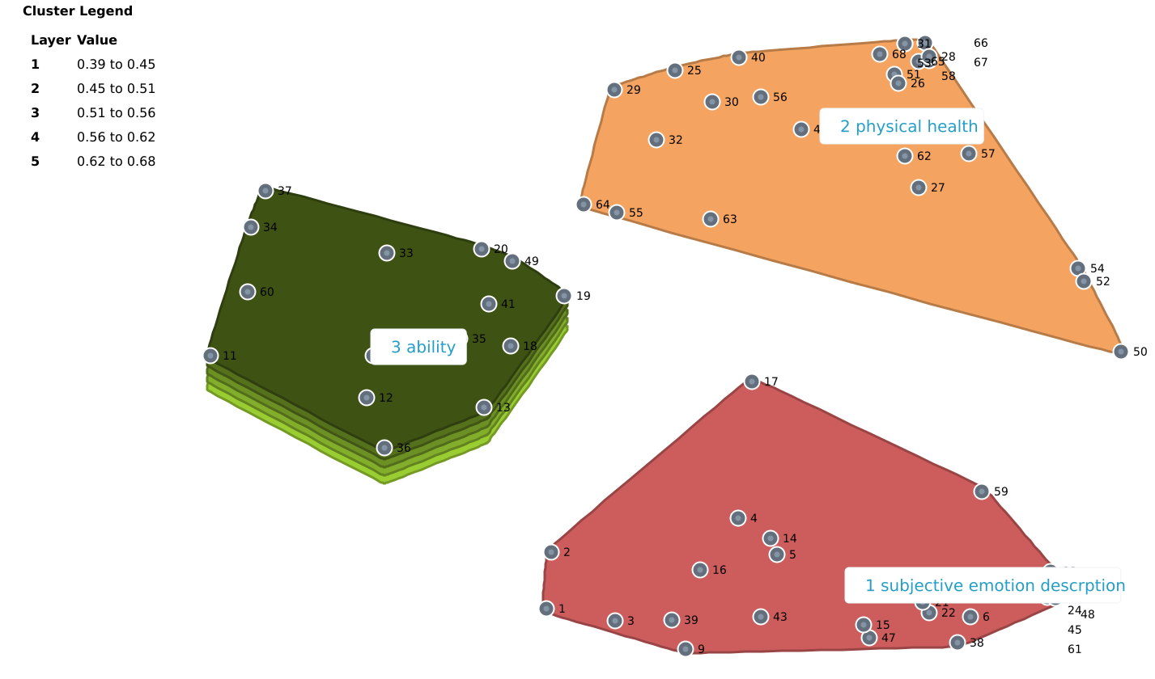
Perceptions of Health-related Quality of Life in the General Population of China: A Concept Mapping Analysis including EQ-5D and EQ-HWB dimensions
Yifan Ding ¹, Zhuxin Mao², Zhihao Yang³, Jan Busschbach¹
1 Erasmusmc Medical Center ; 2 University of Antwerp; 3 Guizhou Medical University
Objectives
METHOD
The debate surrounding whether the Chinese perspective on Health-Related Quality of Life (HRQoL) warrants an indigenous questionnaire is ongoing within and outside the EuroQol Group.
The present study aimed to provide insight into the hierarchical clustering of HRQoL dimensions within the Chinese cultural context.
A concept mapping approach was used to group 68 HRQoL-related items, as found in an earlier systematic review.
Multidimensional scaling analysis and cluster analysis were conducted to categorize sorted interventions using Groupwisdom™.
By comparing Chinese literature items with EQ-5D and EQ-HWB items, we can assess how Chinese and EuroQol facets relate.
RESULTS
The multidimensional scaling analysis, comprising 11 iterations, yielded a ‘stress value’ of 0.2, indicating that the results were interpretable.
A total of 68 statements were categorized into three clusters: (1) ability, such as ‘social interactions’, ‘regularity in daily life’ and ‘ability to make decisions’. (2) physical health, and (3) subjective emotion description.(See Figure 1)
The cluster exhibiting the highest thematic coherence was identified as ‘subjective emotion description’.
The physical and mood clusters typically hold the physical and mental facets of the EQ-5D, while the EQ-HWB appears in all three clusters.
Conclusions
EQ-5D facets align well with two significant clusters of HRQoL as identified by Chinese-speaking experts in the field.
The EQ-HWB is also well represented in the third cluster.
The EQ-HWB seems, therefore, to be more closely related to the Chinese facets of quality of life found in the systematic review than the EQ-5D is.
Figure 1 Cluster map of the 68 statements.

