Slide 1
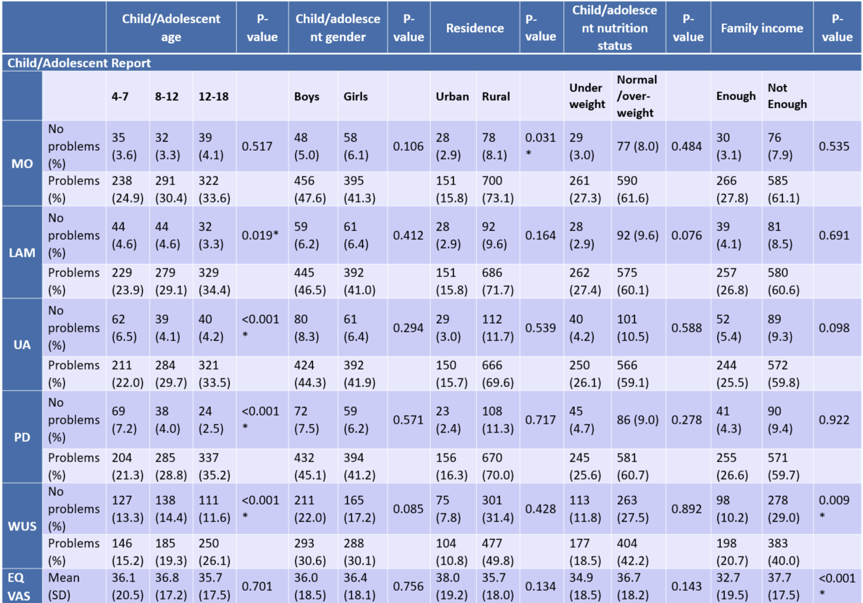
Assessment of HRQoL of sick children admitted to paediatric inpatients in an Ethiopia University Hospital: a comparative analysis of proxy-child dyad responses in repeated measures using the EQ-5D-Y-3L
Begashaw Melaku Gebresillassie^{1,2}, Yared Belete Belay³, Ning Yan Gu⁴
1 The University of Newcastle, NSW, Australia; 2 University of Gondar, Ethiopia; 3 Monash University, Australia; 4 University of San Francisco, California, U.S.A.
OBJECTIVES
- Inadequate income associated to more problems in 'Worried, Sad, or Unhappy' (Child p=0.009, caregiver p<0.001)
- Rural residency associated to more problems in mobility (p=0.031).
EQ-5D-Y Index & EQ-VAS Scores:
- ICC: 0.498 to 0.676 indicating moderate agreement.
Agreement analysis
- Weighted kappa: 0.15 to 0.38, indicating poor to fair agreement.
- Lowest in 'Worried, Sad, or Unhappy' dimension at discharge.
Subgroup analysis:
- Higher agreement in boys, in the 7-15 age group, and in the rural residents observed.
To examine proxy-child agreement on children/adolescents’ HRQoL measures over time and to explore variations in health status based on socio-demographic characteristics.
METHODS
Design & Participants:
- Repeated measures in a cross-sectional study, University of Gondar Comprehensive Specialized Hospital;
- 957 dyads of children/adolescents (aged 4-18) and their parents/caregivers were recruited.
Measures:
- Amharic versions of EQ-5D-Y-3L self-complete (child/adolescent) and proxy version 1 (parent/caregiver) administered at admission and at discharge.
Statistical Analysis:
Chi-square, t-test, weighted Cohen’s kappa, and ICC.
Table 1. Problems by respondent characteristics
Table 2. Child-caregiver agreement at baseline and discharge measures
EQ-5D-Y-3L Dimensions | Time point | Percent exact agreement | Weighted kappa coefficient | P-value
Mobility | Baseline | 78.9 | 0.38 | <0.001
 | Follow up | 88.4 | 0.34 | <0.001
Looking After Myself | Baseline | 79.0 | 0.38 | <0.001
 | Follow up | 88.3 | 0.29 | <0.001
Usual activity | Baseline | 74.4 | 0.28 | <0.001
 | Follow up | 86.9 | 0.31 | <0.001
Pain/discomfort | Baseline | 74.0 | 0.28 | <0.001
 | Follow up | 84.5 | 0.26 | <0.001
Worried, Sad or Unhappy | Baseline | 72.8 | 0.36 | <0.001
 | Follow up | 89.5 | 0.15 | <0.001
RESULTS
Participant Characteristics: out of 985 dyads, 957 (97.1%) dyads included in analysis: 52.7% boys; age 10.7±4.3 years; common illnesses included pneumonia, meningitis, and malnutrition; median LOS 10 days (IQR 7-15 days).
Reported problems by demographics:
- Increase in problems as age advances: specifically, 'Looking After Myself' (p=0.019), 'Doing Usual Activities' (p<0.001), 'Pain/Discomfort' (p<0.001), 'Worried, Sad, or Unhappy' (p<0.001).
- Oldest age group (12-18) reported the highest frequency of problems.
CONCLUSIONS
The study revealed the influence of demographics in child and parent reports, and variable agreement levels alongside demographic influences.
This calls for further study to understand the variations and influencing factors.
Acknowledgments
This study was funded by the EuroQol Foundation: 436-RA

