Slide 1
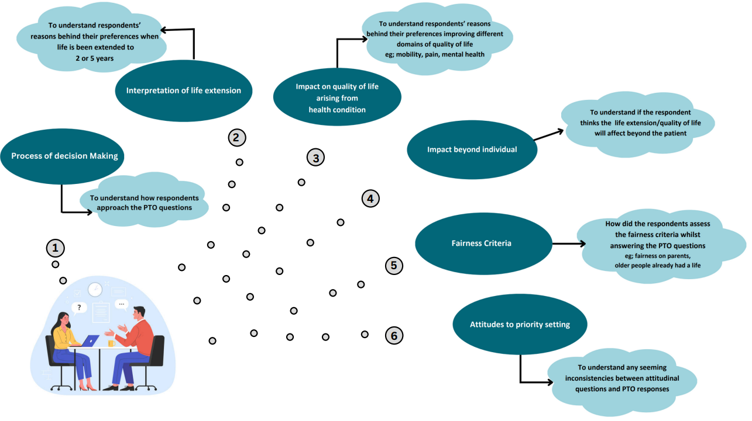
Understanding people’s views on the relative value of health gains for children, adolescents and young adults compared to adults
Ashwini De Silva¹, Cate Bailey¹, Nancy Devlin¹, Richard Norman², Tianxin Pan¹ , Tessa Peasgood¹
¹Centre for Health Policy, Melbourne School of Population & Global Health, The University of Melbourne ²Curtin University
In collaboration with the Quality Of Life in Kids: Key evidence to strengthen decisions in Australia (QUOKKA) project team
OBJECTIVES
Standard methods for economic evaluation typically assume that units of health outcome (e.g. QALYs) have equal value regardless of the age of those treated.
Existing evidence suggests that people prefer to give priority to children (1,2).
The difference in age-related social value may be driven by both fairness(equity) and efficiency considerations.
This study aims to explore what drives people’s preferences towards valuing health gains when they are experienced by different age groups, explore difference in views according to respondent characteristics and understand differences between attitudinal and choice-based questions.
Peasgood, T., Howell, M., Raghunandan, R., Salisbury, A., Sellars, M., Chen, G., Coast, J., Craig, J. C., Devlin, N. J., Howard, K., Lancsar, E., Petrou, S., Ratcliffe, J., Viney, R., Wong, G., Norman, R., Donaldson, C., & Quality Of Life in Kids: Key evidence to strengthen decisions in Australia (QUOKKA), Tools for Outcomes Research to measure, value Child Health (TORCH) project teams (2024). Systematic Review of the Relative Social Value of Child and Adult Health. PharmacoEconomics, 42(2), 177–198. https://doi.org/10.1007/s40273-023-01327-x
Peasgood, Tessa on behalf of the QUOKKA project team. The value of health gains in children compared to adults: results from Person-Trade-Off study in Australia. Health Economics Study Group, Exeter 2024.
Participants’ Characteristics | Sample
Number of participants Female Age Range | 41 23 (56%) 16-86 years
Some adults objected to the act of prioritizing healthcare between age groups and felt it was not fair to prioritize based on age.
Adolescents tended to prioritize children/ adolescents and articulated very clear views.
Children and young people (aged≥ 4) were prioritised over adults aged 40 or 55 whereas children one month old-2years were given less weight since ambiguity linked to the health condition.
Respondents prioritized all children including those under 2 years in averting pain and felt no child should be under pain.
Respondents use the same rationale, but it is linked to different ages.
eg; respondents use the rationale of the patient being able to understand the health issue but chooses different age groups
RESULTS
29 sub themes were mapped onto 6 main themes from the framework analysis.
Based on our analysis the 6 main themes were:(1) process of decision making, (2) interpretation of life extension by age, (3) impact on quality of life arising from health conditions by age, (4) impact beyond the individual, (5) fairness criteria and (6) attitudes to priority setting.
METHODS
Think-aloud interviews were conducted with 41 members of the Australian public aged 16 and above, whilst they performed valuation tasks using Person Trade-Off (PTO) questions. These interviews will complement the wider quantitative PTO project.
Interviews took place in April-July 2023.
Participants watched an instructional video which included a practice task. They then answered seven PTO questions and were invited to ‘think aloud’ while they answered and responded to semi-structured questions to further probe their thinking.
The PTO tasks involved different aspects of health improvement, including life extension of 2 and 5 years, and improvements in mental health, mobility and pain or discomfort questions. Participants were asked to make choices between pairs of interventions, one impacting an adult group (either 40 or 55 years old) and the other younger group (between one month and 24 years old).
Interviews were recorded and transcribed verbatim.
Interview scripts were uploaded to MAXQDA and coded based on a Framework analysis approach (Gale et al, 2013).
The analysis framework was agreed between three researchers and revised as new codes emerged.
CONCLUSION
The preliminary findings suggest widely varying views, with differences between parents, non-parents, adolescents’ and adults’ perspective regarding allocating healthcare resources and trading off life years between children/ adolescents vs adults.
The lower weight given to very small children for life extension, mobility and mental health gains (findings from the quantitative PTO data) by some of our participants was explained by their perception of young childrens’ limited self-awareness and the reduced impact those health problems would have on their lives relative to older children or adults.
Funding: EuroQol Research Foundation – EQ-348-PHD, Ethics: The University of Melbourne human ethics committee [Reference number: 2023-24869-37630-4]

