Slide 1
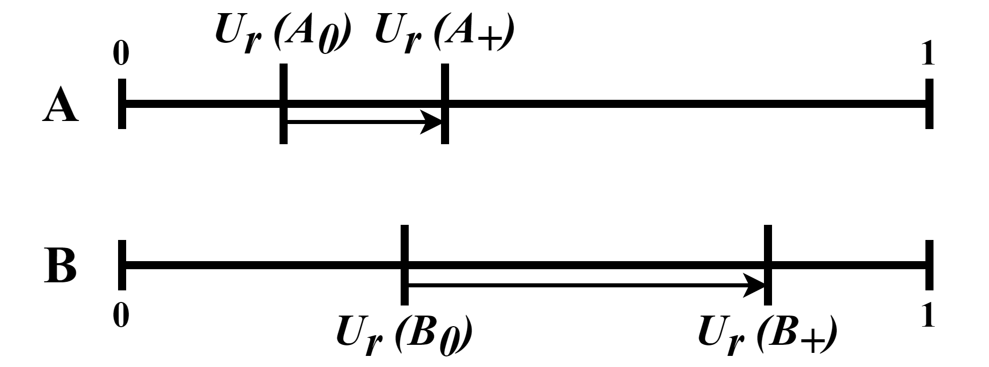
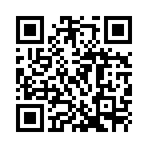
A preference for the better-off? A discrete choice experiment using individually calibrated EQ-5D-5L health state values
Participants chose to treat the patient group that was better-off, even when there was little additional health benefit by doing so
Figure 1 - DCE example task structure
Schematic representation of the DCE options A (worse-off) and B (greater total health) on a health utility scale where $U\left(HS\right)$ represents the individual utility values for health states $A_{0},A_{+},B_{0} ,$ and $B_{+}$
Marius L Torjusen¹ , Kim Rand¹, David GT Whitehurst² Knut Stavem^{1,3}, Mathias Barra¹
Objectives
To examine the assumed public preference to prioritise the worse-off in terms of health, even if this leads to a smaller total health gain
Observe priority setting over known individual health utilities for EQ-5D-5L health states, to accommodate heterogeneous health state evaluation.
Methods
Discrete choice experiment (DCE), using individual computer-assisted interviews with members of the Norwegian general population
The choice was between treating two patient groups, the trade-off being to prioritise the worse-off against a greater total health gain (Fig. 1)
Treatments were framed as improvements in EQ-5D-5L health states (Fig. 2), and individual-level health utility values were obtained prior to the DCE by using time trade-off
Analysis employed mixed-effects models with task and respondent properties
Results
The DCE was given to 468 respondents, each completing four tasks.
Respondent’s choices were not influenced by initial severity, but with the size of the health improvement (Fig. 3, Table 1)
Choice behavior was influenced by gender, religion and age (Fig. 3, Table 1)
Conclusion
We found no support for a preference for prioritising the worse-off when using individually-calibrated health state utilities
Figure 2 - DCE screenshot from the data collection software
Example of a DCE task, as displayed to the participants. Initial EQ-5D-5L health states to the left and treatment health state to the right.
Table 1 - Mixed effects models for respondents prioritising the worse-off
 | Task properties only |  |  | Task and respondent properties
Characteristic | OR¹ | 95% CI¹ | p-value | OR¹ | 95% CI¹ | p-value
(Intercept) | 0.57 | 0.39, 0.81 | 0.002 | 0.74 | 0.47, 1.15 | 0.2
Difference in initial health utility | 1.05 | 0.85, 1.31 | 0.7 | 1.06 | 0.85, 1.31 | 0.6
Difference in gain in health utility | 0.77 | 0.65, 0.91 | 0.003 | 0.76 | 0.64, 0.90 | 0.002
Gender (ref = Female) |  |  |  | 0.53 | 0.35, 0.82 | 0.004
Religion (ref = Non-religious) |  |  |  | 1.67 | 1.09, 2.56 | 0.018
Age group (ref = 18–31)
31-50 |  |  |  | 0.72 | 0.44, 1.18 | 0.2
51+ |  |  |  | 0.56 | 0.33, 0.96 | 0.036
¹ OR = Odds Ratio, CI = Confidence Interval
Figure 3 – Illustrative choice predictions based on the mixed-effects model
The lines show the predicted probability of prioritising the worse-off patient group in the discrete choice experiment, based on coefficients from our mixed-effects model. The X-axis shows how much additional health would be gained if participants prioritised the better-off group. Stratifications by gender and religion.
1
2
3
More info and app demo: sevqol.com/ECR2024poster

