Slide 1
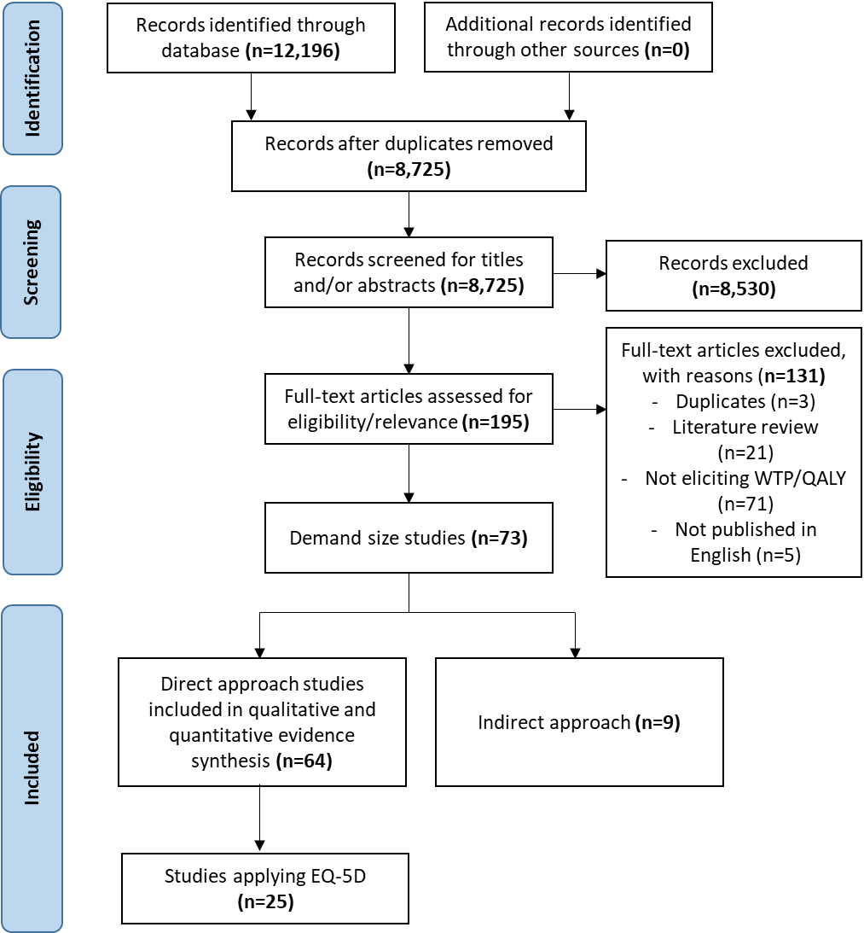
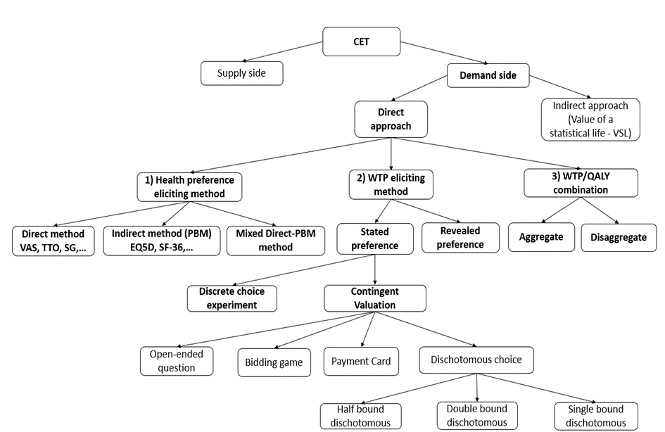
The role of the EQ-5D in accessing the national threshold value
Anh Nu Vu*, Minh Van Hoang, Lars Lindholm, Klas Göran Sahlen, Cuc Thi Thu Nguyen, Sun Sun.
*Contact: vu.anh@umu.se or nuanh.vu@gmail.com
OBJECTIVE
To increase knowledge on how EQ-5D has been applied in accessing the national cost-effectiveness threshold value, i.e., willingness to pay (WTP) per QALY
RESULTS
Difficult to identify whether 3 L or 5 L was more popular.
Approximately 52% (n=13) of studies applied both the EQ-5D index and EQ VAS, 28% (n=7) presented WTP for both.
6 studies also mixed EQ-5D with other methods: the TTO, SG or rating scale.
PRISMA flow diagram of article identification and selection procedure
CONCEPTUAL FRAMEWORK
Characteristics of studies
Publication year | After 2010 (92%), before 2010 (8%)
Region | Asia (52%) and Europe (48%)
Number of countries/study | One country
Type of country income | High-income (56%) and middle-income countries (44%)
Stated preference | Contingent valuation (96%), other (4%)
Perspectives | Individual perspectives (92%), societal (4%) and a mix of societal and individual perspectives (4%)
Study sample | General population (72%), other (28%)
Mode of administration | Face-to-face interviews (40%), web-based surveys (40%)
Through the results of hypothetical scenarios designed, EQ-5D health states were selected and the duration attached to the state will be further investigated.
Despite the county’s income level, WTP/QALY < 1 GDP/capita. The average WTP/QALY is 0.75.
Characteristics of methods to elicit health preference
Percentage of methods for eliciting health preference in relation to estimating WTP/QALY
METHODOLOGY
A sub-analysis from a systematic review on direct approaches for estimating WTP per QALY were performed for studies that applied the EQ-5D to estimate WTP/QALY
Studies researched from seven databases & from January 2000 to March 2022
Monetary values converted international dollar (i$) values in 2021 by using the country’s consumer price index (CPI) and purchasing power parity (PPP)
CONCLUSION
EQ-5D is commonly applied in estimating WTP/QALY
Methods for eliciting threshold values vary considerably. There is no standardized recommendation
This may suggest EuroQol Group for future investigations, i.e., how EQ-5D shall be applied in such studies
Department of Epidemiology and Global Health

