Slide 1
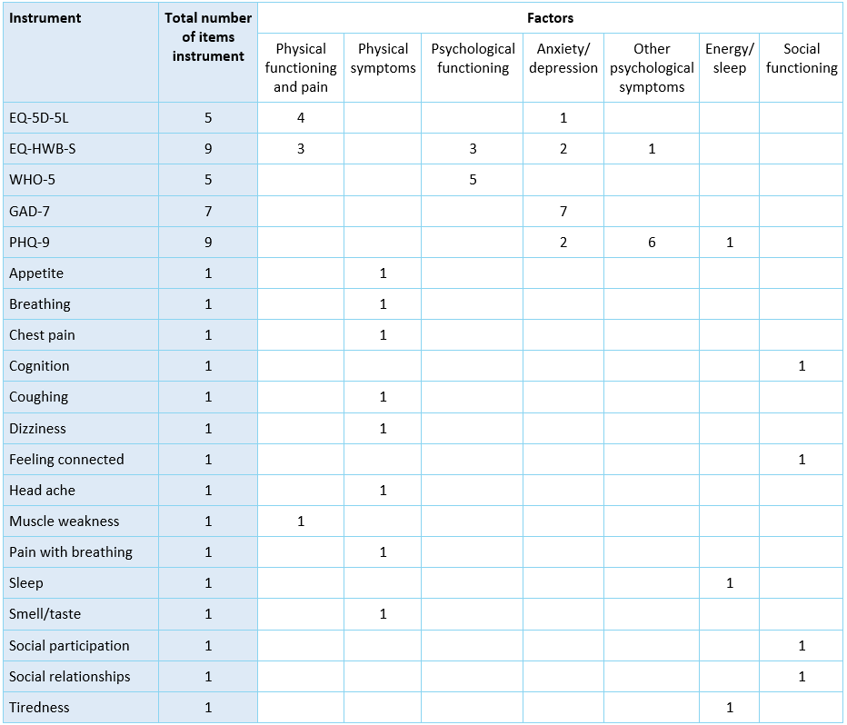
Dimensionality of the EQ-5D-5L, WHO-5, GAD-7, PHQ-9, EQ-HWB-S and fifteen bolt-ons
Juanita Haagsma¹, Fanni Rencz², Bas Janssen^{1,3}
1 Erasmus MC, The Netherlands, 2 Corvinus University of Budapest, Hungary 3 EuroQol Office. Contact: j.haagsma@erasmusmc.nl
Objective To determine the dimensionality of the EQ-5D-5L, WHO-5, GAD-7, PHQ-9, EQ-HWB-S and 15 bolt-ons.
Methods
Study design: Secondary analysis of cross-sectional POPCORN study data
Data collection: Web-based survey among general population samples from Italy (n=1784) and the United Kingdom (n=1452).
Outcome measures: EQ-5D-5L, EQ-HWB-S, WHO-5, PHQ-9, GAD-7 and 15 bolt-ons (see Table 1).
Data-analysis: We performed content analysis of the instruments and bolt-ons to provide a theoretical framework for results interpretation and principal component analysis (PCA) to determine dimensionality.
Results
PCA resulted in seven components with an Eigenvalue greater than one. These factors explained 66% of total variance. For each instrument, the number of items per factor are shown in Table 1. 14 of 15 bolt-ons loaded on a separate factor than any EQ-5D-5L item. The PCA by country results showed that the EQ-5D-5L, WHO-5, GAD-7, PHQ-9, EQ-HWB-S and bolt-ons together measure six factors among respondents from the UK and eight factors among respondents from Italy.
Conclusions
The EQ-5D-5L, WHO-5, GAD-7, PHQ-9, EQ-HWB-S and bolt-ons measure seven factors. Results differ across respondents from Italy and the UK.
Funding
The POPCORN study was funded by the EuroQol Research Foundation (grant number 238-2020RA).
Table 1. Number of items per factor, by instrument* (n=3236)
*EQ-5D-5L: items MO, SC, UA, PD loaded on factor “Physical function and pain”; item AD loaded
on factor Anxiety/depression”.
*EQ-HWB-S: items mobility, daily activities, physical pain loaded on factor “Physical functioning
and pain”; items exhaustion, loneliness and control loaded on factor “Psychological
functioning”; items anxiety and sadness/depression loaded on “Anxiety/depression”;
item cognition loaded on factor “Other psychological problems”.

