Slide 1
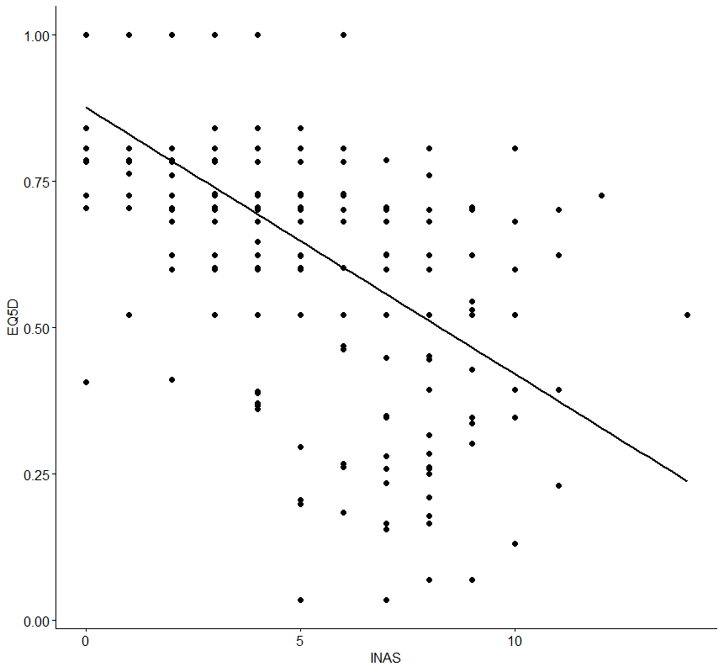
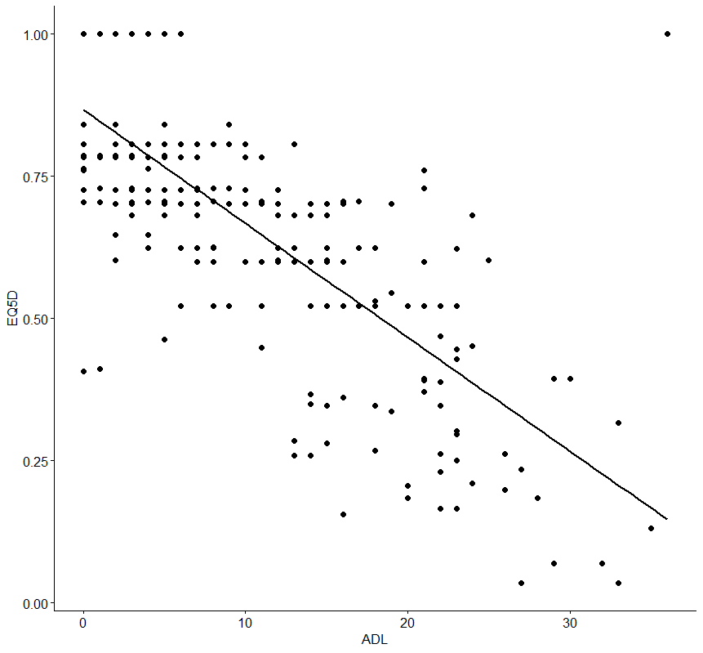
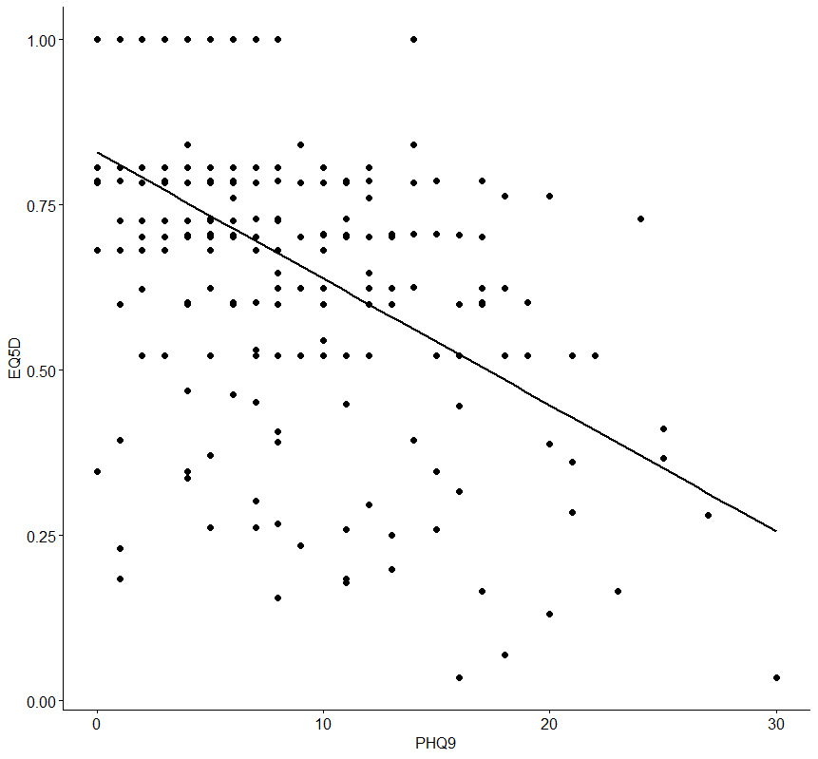

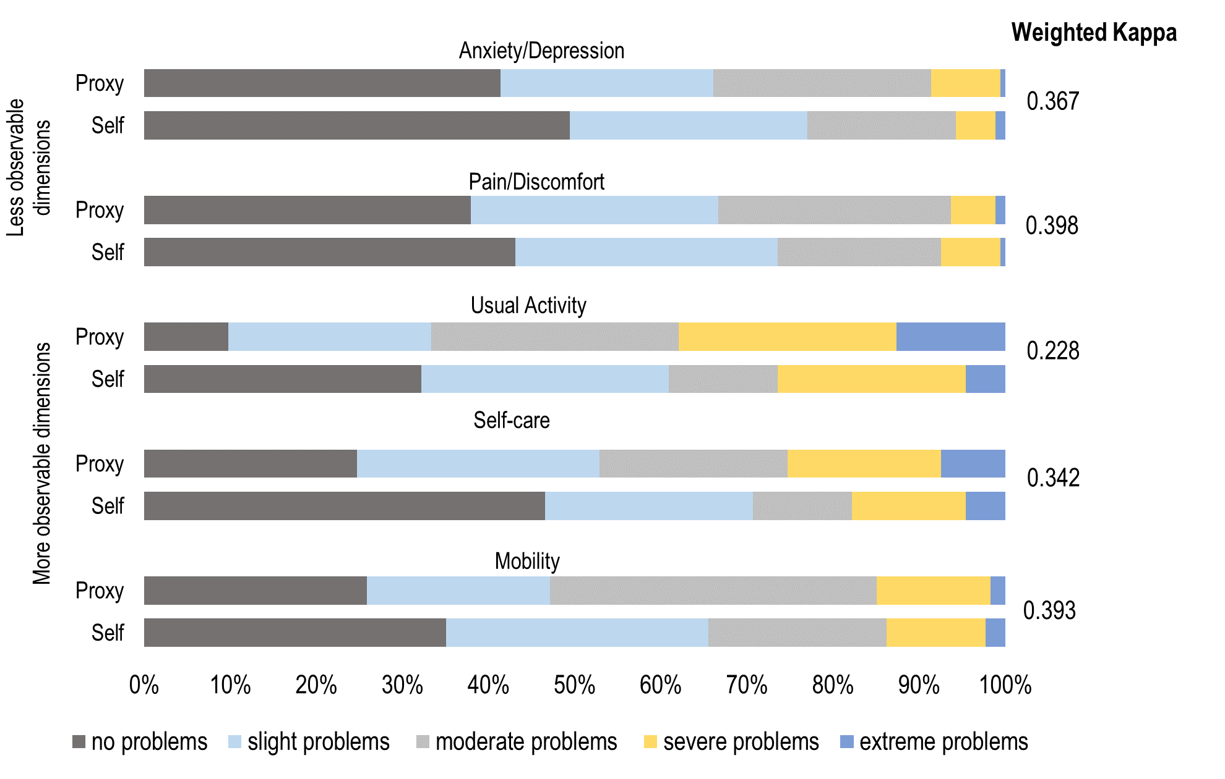
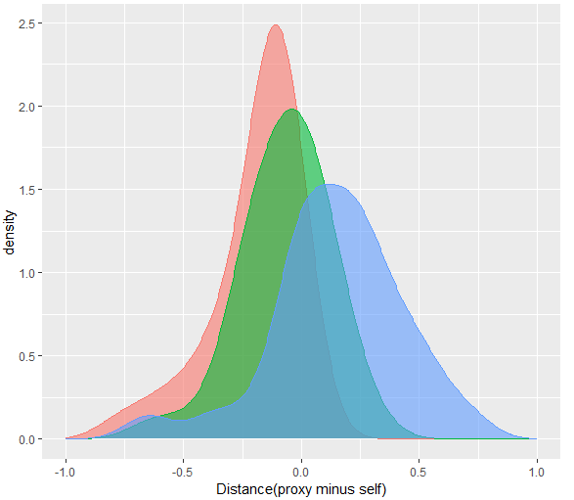
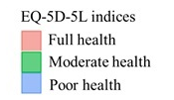
Central Tendency Bias in Proxies – Comparison of EQ-5D-5L Self- and Proxy-ratings in Dementia
Maresa Buchholz¹, Lidia Engel², Niklas Weber¹, Bernhard Michalowsky¹
¹German Center for Neurodegenerative Diseases (DZNE), Rostock/ Greifswald, Germany^{; 2} Monash University Health Economics Group, School of Public Health and Preventive Medicine, Melbourne
O B J E C T I V E
R E S U L T S
Analysis of discrepancies between self- and proxy-rated health in Patients living with Dementia (PlwD) on an individual response level
Figure 1: Distribution of responses to EQ-5D-5L dimensions (self and proxy) and weighted Kappa (agreement between self and proxy)
95% of PlwD rated their health differently than proxies compared to identical ratings in nine dyads (5%)
Discrepancies of one higher or lower EQ-5D-5L response occurred most frequent (35.4%).
Caregivers were two times more likely to report “moderate problems”, suggesting a central tendency bias.
The chance to choose the answer option “moderate problems” is higher for caregivers across all five dimensions: mobility (Odds Ratio (OR) 2.7), usual activities (OR 2.8), self-care (OR 2.2) pain/discomfort (OR 1.6) and anxiety/depression (OR 1.6).
Among PlwD who reported either no or some problems in EQ-5D-5L-dimensions, proxies were more inclined to report greater problems (underestimation) and vice versa (overestimation).
Cognitive decline in PlwD affects the validity of self-rated health, prompting a widespread reliance on proxy-ratings primarily provided by informal caregivers¹.
Studies comparing self- and proxy ratings report that proxies underestimate PlwD health².
Comprehensive analyses of these discrepancies on an individual response level that focus on the EQ-5D-5L dimensions are currently lacking.
In total, n=174 dyads with complete EQ-5D-5L data were analysed
The mean self-rated EQ-5D-5L index and EQ VAS were higher than the proxy-ratings
n=23 PlwD and n=4 caregivers with perfect health (11111) and none with worst health state (55555)
M E T H O D S
Data base:
InDePendent Study – A cluster-randomized controlled intervention study in Germany (ClinicalTrials.gov Identifier: NCT04741932), initiated in 2020.
Sample
Dyads, consisting of community-dweling PlwD and their informal caregivers
The EQ-5D-5L was administered as self- and proxy-proxy-assessment next to sociodemographic and clinical data.
For the analysis of discrepancies,
  we assessed self- and proxy-rated EQ-5D-5L health profiles for response distribution and agreement statistics (weighted Kappa).
  we used the Paretian Classification of Health Change (PCHC), to identify differences between the raters.
  we analysed the degree of inconsistencies between self- and proxy ratings ranging from 0 (identical responses in all dimensions) to 5 (different responses in all five dimensions) and calculated the response distance between the two raters for each dimension.
  we grouped the PlwD into “no problems” and “problems” depending on the EQ-5D-5L dimensions and indices and compared the response distances between PlwD and caregivers.
Table 1: Characteristics of the sample
Figure 2: Density plot of EQ-5D-5L, grouped by health states
 | PlwD | Informal Caregivers
Sex, female, n (%) | 84 (49.1) | 116 (67.8)
Age, M±SD | 80.1±7.3 | 67.9±12.4
MMSE, M±SD | 19.2±6.0
 | Self-report | Proxy-report
EQ-5D-5L, M±SD | 0.75±0.25 | 0.68±0.23
EQ-VAS, M±SD | 61.03±20.34 | 56.33±18.72
CONCLUSION
Our findings indicate a hint for a central tendency bias in proxies, resulting in an over and underestimation when PlwD self-ratings were low or high, respectively.
The central tendency bias in proxy ratings may stem from assessment uncertainties, possible associated with not seeing the patient frequently in their daily life routine.
The central tendency bias and the trend of a contrary response behaviour (over- and underestimation) of both rater types underline the need for further methodological research when using the EQ-5D-5L as a proxy assessment and for a better understanding of its influencing factors
Table 2: Discrepancies according to PCHC and Inconsistency
Worse
Better
Note. “Same”: Identical PlwD and proxy ratings; “Proxy better”: Proxy rating is better on at least one 5L dimension and not worse on any other dimension compared to the self-rating. “Self better”: PlwD rating is better on at least one 5L dimension and not worse on any other dimension compared to the proxy rating. “Mixed”: response differences in both directions (better or worse) between self- and proxy ratings; Inconsistency: A different respond between self and proxy in one dimension, ranged from 0 (identical responses in all dimensions) to 5 (different responses in all five dimensions).
Note. „Worse“: Proxy-rating is worse than self-rating; „Better“: Proxy-rating is better than self-rating. EQ-5D-5L indices based on PlwD (Full health: >0.9; Moderate health: 0.9-0.5; Poor health: <0.5).
Table 3: Distances between self and proxy ratings of EQ-5D-5L items, n (%)
R E F E R E N C E S
¹Moyle W, Mcallister M, Venturato L, Adams T. Quality of life and dementia:The voice of the person with dementia. Dementia 2007;6(2):175-191.
²Hutchinson C, Worley A, Khadka J, Milte R, Cleland J, Ratcliffe J. Do we agree or disagree? A systematic review of the application of preference-based instruments in self and proxy reporting of quality of life in older people. Social Science & Medicine 2022:115046.
Distance: Discrepancy in responses between self and proxy, starting from proxy-perspective; e.g. proxy (“slight problems”= 2) minus self (“no problems” = 1) = 1 (distance between responses); n of observations =174; n of responses=870 (174x5). In the focus of a patient-centred view, we determine positive values as an underestimation and negative values as an overestimation of proxy-proxy perspective.

