Slide 1
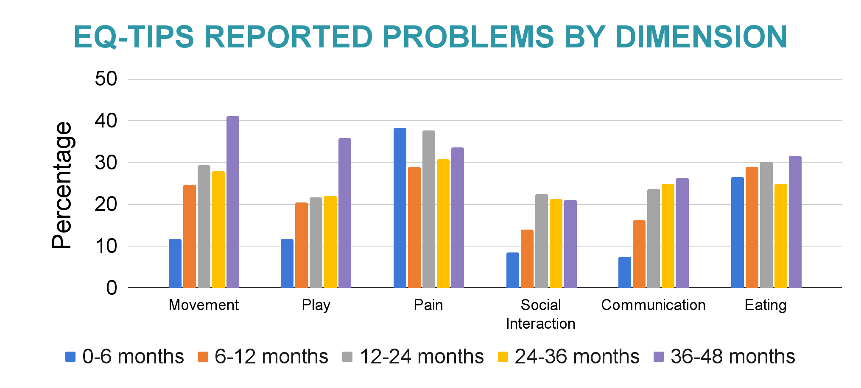
EuroQol Infant and Toddler Populations (EQ-TIPS): Age-related differences in performance
Lasse Herdien¹, Razia Amien², Janine Verstraete¹
¹Department of Paediatrics and Child Health, University of Cape Town; ²Department of Health and Rehabilitation Sciences, Division of Physiotherapy, University of Cape Town
BACKGROUND & OBJECTIVES
The EQ-TIPS was developed based on the EuroQol model to address the lack of age-appropriate instruments designed to measure HRQoL in young children.
The instrument was developed for children aged 0-36 months with a suggested expansion to 48 months considering the improved performance compared to the EQ-5D-Y-3L.
Given the rapid development changes that characterise infancy and toddlerhood, this study investigated whether age-related variations exist in the performance of the EQ-TIPS.
CORRELATION OF EQ-TIPS DIMENSION SCORES ACROSS AGE GROUPS
 | Movement |  |  |  |  | Play |  |  |  |  | Pain |  |  |  |  | Social Interaction |  |  |  |  | Communication
Ages (months) | 0-6 | 6-12 | 12-24 | 24-36 | 36-48 | 0-6 | 6-12 | 12-24 | 24-36 | 36-48 | 0-6 | 6-12 | 12-24 | 24-36 | 36-48 | 0-6 | 6-12 | 12-24 | 24-36 | 36-48 | 0-6 | 6-12 | 12-24 | 24-36 | 36-48
Play |  |  |  |  |  | - | - | - | - | -
Pain |  |  |  |  |  |  |  |  |  |  | - | - | - | - | -
Social Interact. |  |  |  |  |  |  |  |  |  |  |  |  |  |  |  | - | - | - | - | -
Comm. |  |  |  |  |  |  |  |  |  |  |  |  |  |  |  |  |  |  |  |  | - | - | - | - | -
Eating
METHODS
Pooled data from 529 South African children (0-48 months) living with a health condition were analysed. Differences in sample characteristics and dimension responses between age groups were calculated using chi-squared tests. Dimensions were assessed for their equivalence across the age groups through the proportion of those reporting problems and the 95% CIs. Spearman’s rank correlations were computed for dimension scores across age groups.
Strong correlation: .5 < r < 1 (p < .05) Moderate correlation: .3 < r < .49 (p < .05) Weak correlation: .1 < r < .29 (p < .05) Blank squares indicate p > .05
CONCLUSION
Healthcare utilisation varies distinctly across age groups.
Chronic healthcare conditions diagnosed > 12 months
Utilisation of acute healthcare services greater in <12 months
Interdependence of dimensions in development is clearer >6 months
Suggests need to adjust dimension wording for applicably across the age range.
The overlap in proportions of reported problems across age groups indicates the applicability of EQ-TIPS and relevance for assessing HRQoL throughout development.
However, the impact of poor health across age groups requires further exploration through age-specific analyses of homogenous disease groups.
RESULTS
0-6
months
n = 94
6-12 months
n = 93
12-24 months
n = 143
24-36 months
n = 104
36-48 months
n = 95
Sample Characteristics |  |  |  |  |  |  | χ2 | p
Sex | Female | 45% | 39% | 42% | 49% | 46% | 11.19 | .191
 | Male | 55% | 61% | 58% | 49% | 46%
Relationship | Mother | 95% | 91% | 90% | 90% | 88% | 42.06 | .056
 | Other | 4.3% | 9% | 10% | 10% | 12%
Healthcare | Acute | 73% | 62% | 53% | 42% | 48% | 21.50 | < .001
 | Chronic | 26% | 38% | 47% | 58% | 52%
EQ-TIPS | 111111 | 43% | 44% | 35% | 38% | 33% | 4.02 | .403
In the 36-48 month group, reported problems were significantly higher for Movement (χ2 = 26.24, p <.001) and Play (χ2 = 22.13, p =.005) dimensions. In the 0-6 month group, the Communication dimension (n = 87,92.6%) was significantly lower.
95% confidence intervals of any problems reported overlapped across age groups for all EQ-TIPS dimensions.
Funding: EuroQol Research Foundation | EQ426, EQ067-2019, EQ540-2019
Views expressed by the authors in the publication do not necessarily reflect the views of EuroQol.
For further discussion, please contact:
lasse.herdien@uct.ac.za
janine.verstraete@uct.ac.za

