Slide 1
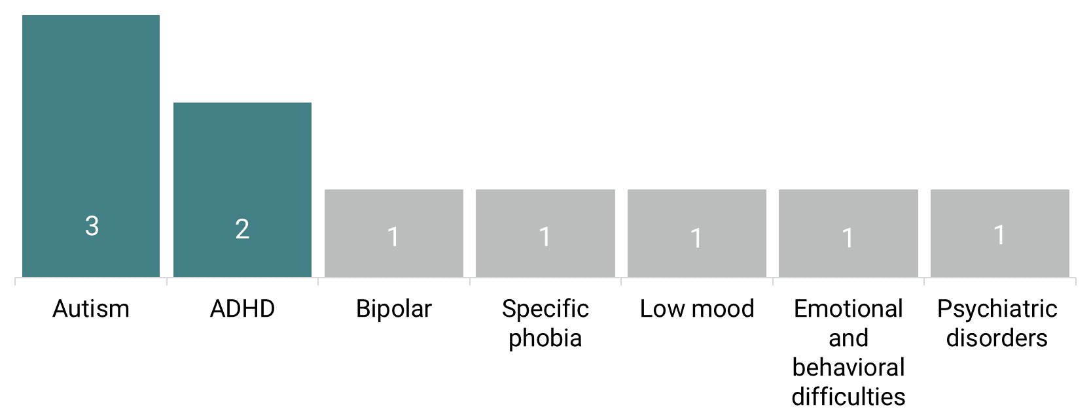
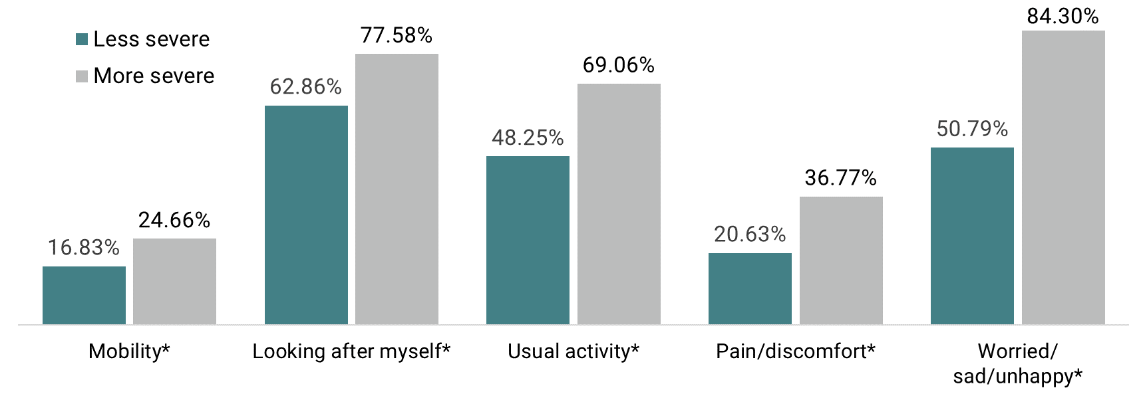
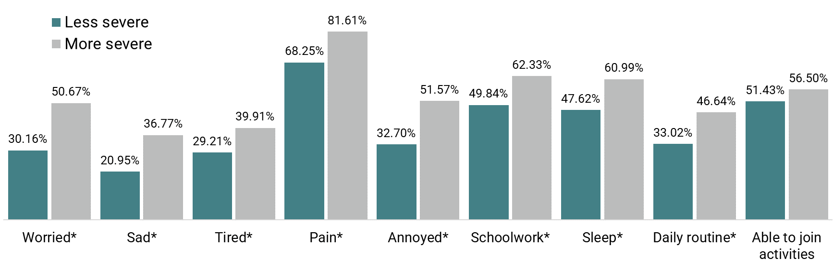
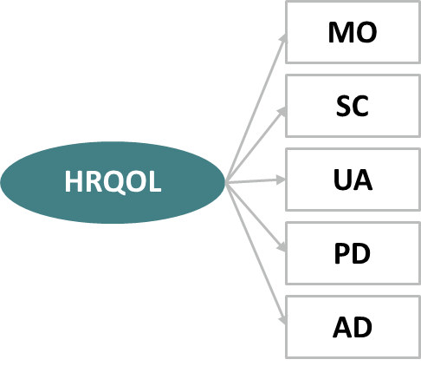
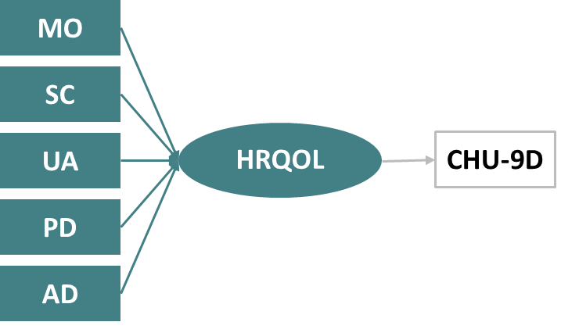
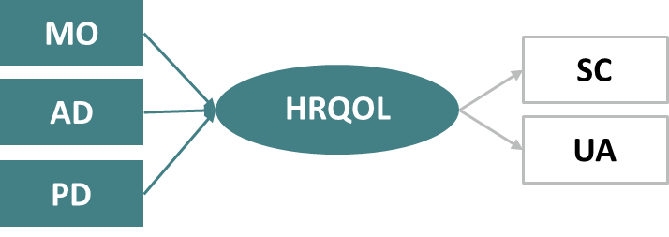
ASSESSING THE INTERNAL STRUCTURE, PSYCHOMETRIC PROPERTIES AND EXPLANATORY POWER OF THE EQ-5D-Y-3L IN CHILDREN WITH MENTAL HEALTH CONDITIONS - AN EXAMPLE FROM AUTISM
Han-I Wang¹, Ling-Hsiang Chuang², You-Shan Feng³, Paul Kind⁴
¹University of York, UK; ²Umea University, Sweden; ³University of Tübingen, Germany; ⁴University colleague of London, UK
3
Explanatory power: EQ-5D-Y-3L explained 8-16% of the variance in the SDQ score, while CHU-9D accounted for less variance.
OBJECTIVES
Address the lack of research on the psychometric properties of EQ-5D-Y in children and young people (CYP) with mental health conditions, using autism as an illustrative example.
TASKS
Reviewing the current utilisation of EQ-5D-Y in mental health.
Exploring the internal structure of EQ-5D-Y-3L.
Comparing the psychometric performance and explanatory power of EQ-5D-Y-3L with CHU-9D.
RESULTS
PSYCHOMETRIC PERFORMANCE
Acceptability: EQ-5D-Y-3L had a 1.21% non-complete rate with 11.24% reporting full health (ceiling effect), while CHU-9D had a 3.75% non-complete rate with 4.62% reporting full health.
Convergent validity: Correlations between EQ-5D-Y-3L and CHU-9D domains are all weak (<0.21). However, the 'feeling worried, sad, or unhappy' domain in EQ-5D-Y shows a strong correlation (>0.50) with the SDQ emotional symptom score and a moderate correlation (≈0.35) with the SDQ total difficulties score, while other correlations with SDQ items are weak.
1
TARGETED REVIEW
10 studies applied EQ-5D-Y (either 3 or 5L) and CHU-9D in CYP with mental health conditions.
Mostly EQ-5D-Y-3L (n=9), with one study used proxy version.
No psychometric evaluations for EQ-5D-Y in CYP mental health.
 | EQ-5D-Y index (NL) | EQ VAS | EQ-5D-Y 5 dimensions | CHU-9D score | CHU-9D 9 items
SDQ | 0.12 | 0.08 | 0.16 | 0.03 | 0.09
SCQ | 0.04 | 0.02 | 0.06 | 0.00 | 0.02
DISCUSSION
First comprehensive study examining the internal structure and psychometric properties of EQ-5D-Y-3L in CYP with autism.
For EQ-5D-Y-3L internal structure, the most fitting model involves all 5 items as reflective factors, differing from the findings observed from adult studies in general population.
Weak correlation between expected EQ-5D-Y-3L and CHU-9D items may stem from self- and proxy-report HRQoL discrepancies, which may also explain the poor external MIMIC model fit.
SDQ was chosen to be the main clinical mental health measure due to the absence of a gold standard, but its representation of quality of life may be debatable.
The study used the NL Y value set in the absence of a UK Y value set; sensitivity analysis with the German Y value set produced consistent results.
EQ-5D-Y-3L and CHU-9D show comparable performance for autistic CYP population. Despite EQ-5D-Y's superior acceptability and better discriminatory ability in distinguishing severity groups defined by SDQ, both instruments exhibit weak responsiveness and explanatory power.
Future research is recommended to compare the internal structure and psychometrics of both self- and proxy-report EQ-5D-Y, and to explore these aspects in other mental health conditions.
METHODS
DATA SOURCE
Data were obtained from the Investigating Social Competence and Isolation in children with Autism participating in LEGO-based therapy clubs In School Environments (I-SOCIALISE) trial (n=284), the largest trial for CYP with autism.
OUTCOME MEASUREMENTS:
EQ-5D-Y-3L (proxy version; Netherland value set), CHU-9D (self-report; UK value set), Strengths and Difficulties Questionnaire (SDQ), and Social Communication Questionnaire (SCQ).
ANALYSES:
Known-group validity: Significant disparities in reporting any problem in each domain between the two groups were prominent based on the SDQ score, but less so based on the SCQ score (data not shown).
2
INTERNAL STRUCTURE
Model 1: Confirmatory factor analysis (CFA) – All 5 items load well, especially usual activity (0.90) and worried/sad/unhappy (0.68).
Model 2: External MIMIC– Model fit statistics were suboptimal.
Model 3: Internal MIMIC – After exploring various model combinations, model with mobility, pain/discomfort, and feeling worried/sad/unhappy as formative indicators and the rest as reflective indicators fits best.
1
Targeted review (conducted in June 2023).
2
Factor analyses (reflective indicators, external MIMIC, and internal MIMIC.
Model 1: CFA
Model 2: External MIMIC
Model 3: Internal MIMC
3
Psychometric performances
Note: *p-value<0.05
Acceptability –Missing utility scores (%), celling and floor effects, and response distribution (%)
Convergent validity – Correlation between EQ-5D-Y-3L and CHU-9D items, and versus SDQ
Known group validity – Groups were defined by SDQ score ( > 22 more vs. ≤22 less severe) and SCQ score (> vs ≤24)
Responsiveness – Change defined by the SDQ score
Explanatory power – Variance of SDQ and SCQ explained by EQ-5D-Y-3L/CHU-9D items
 | EQ VAS | EQ-5D-Y utility (NL) | CHU-9D utility
Less severe (≤ 22) | 83.5 (SD: 16.6) | 0.83 (SD: 0.15) | 0.84 (SD: 0.12)
More severe (>22) | 72.0 (SD: 21.6) | 0.71 (SD: 0.20) | 0.79 (SD: 0.12)
Effect size | 0.58 | 0.71 | 0.45
χ² (df) | 6.35 (df=5)
RMSEA | 0.04
CFI | 1.00
TLI | 0.99
χ² (df) | 119.27 (df=10)
RMSEA | 0.07
CFI | 0.94
TLI | 0.97
χ² (df) | 17.95 (df=6)
RMSEA | 0.09
CFI | 0.85.
TLI | 0.98
Responsiveness: EQ VAS showed responsiveness with a small effect size (≈0.30) based on SDQ data, while neither EQ-5D-Y-3L nor CHU-9D utility scores demonstrated responsiveness.
MO (Mobility); SC (Looking after myself); UA (Usual activity); PD (Pain / discomfort); AD (Worried / sad / unhappy)

