Slide 1
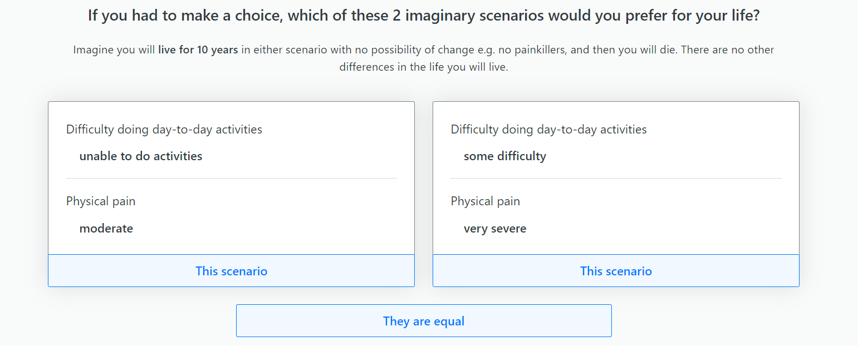
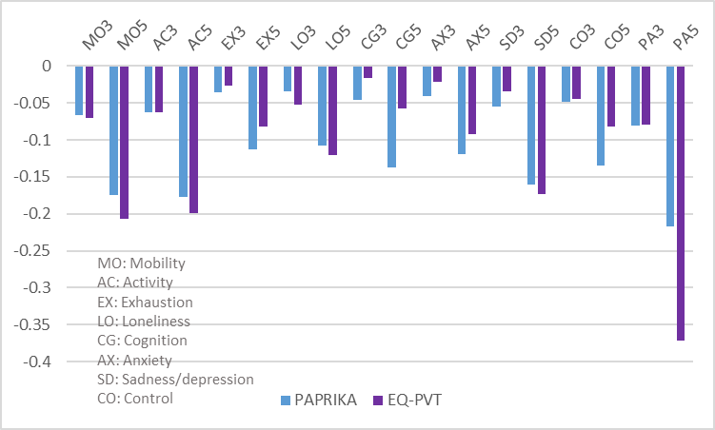
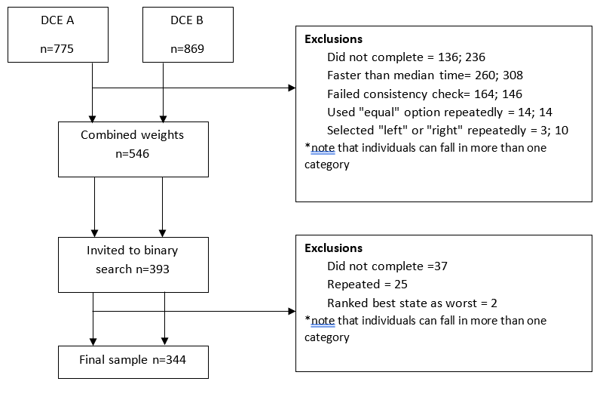
Applying and assessing the feasibility of the Potentially All Pairwise RanKings of all Possible Alternatives
(PAPRIKA) method to valuing the EQ Health and Wellbeing Short (EQ-HWB-S)
Clara Mukuria¹, Trudy Sullivan², Franz Ombler^{2,3}, Emily McDool¹, Tessa Peasgood¹, Paul Hansen^{2,3}
1. University of Sheffield, England, UK, 2. University of Otago, New Zealand, 3. 1000Minds, New Zealand; Contact: C.Mukuria@sheffield.ac.uk
BACKGROUND & OBJECTIVE
The nine-dimension EQ Health and Wellbeing Short (EQ-HWB-S) has been valued using time trade-off and discrete choice experiments (DCE) using EQ Portable Valuation Technology (EQ-PVT). One novel approach to minimising attribute non-attendance for a longer measure is an adaptive DCE using the Potentially All Pairwise RanKings of all possible Alternatives (PAPRIKA) method. PAPRIKA constrains the pairwise choices to two dimensions at a time (Figure 1), presented adaptively to each participant. A separate binary search identifies the location of 'dead’. The objective was to test the implementation and feasibility of using PAPRIKA to value the EQ-HWB-S.
Figure 1. PAPRIKA DCE question for EQ-HWB-S
METHODS
Survey: To minimise burden, two DCEs (DCE_{A} and DCE_{B}) were run based on splitting EQ-HWB-S’s dimensions into two groups of four with one common linking dimension, pain, which was selected for its salience and the expectation that it would have a similar relative importance in each DCE. A second survey using the combined results from the two DCEs was used to identify the location of dead. The DCEs used levels 1, 3 and 5 whereas levels 2 and 4 were interpolated. Think-aloud interviews were used to pilot the DCEs and binary search surveys. Sample: Piloting was done with participants from the University of Sheffield. An agency recruited a representative general population sample from the United Kingdom online for the surveys. Data quality exclusion criteria included inconsistency in one repeated question, straight-lining, answering all the questions using the “they are equal” option and speeding. Analysis: We assessed the time taken to do each DCE, the number of pairwise questions and participants’ feedback. The DCE ranking of dimensions and the utility weights are reported and compared to the EQ-PVT results.
RESULTS
There were 755 and 869 individuals who started the survey and 45% and 42% were excluded for different reasons (Figure 2). Of those included in the DCE surveys 51% were female and 54% were aged 55 years or over. The median time per choice was 9.6 seconds (range 6 to 30.5) and the median time to complete the two DCE surveys was 9 mins 42 secs and 8 mins 56 secs respectively
The majority of the DCE respondents (>70%) agreed that the DCE questions were easy to understand and reflected their preferences in terms of ranking, were confident in their answers, and did not get bored or tired completing the survey. The mean pairwise questions across the two DCEs was 22.3 (Median 23, range 10-35). In the DCEs, pain was most commonly ranked as first (most disliked) whereas activity, mobility, and sadness/depression were second mirroring the ranking from the EQ-PVT study. The worst state had a value of -0.342 compared to -0.384 for EQ-PVT. The mean absolute difference between dimension weights from PAPRIKA and EQ-PVT was 0.005 but differences varied by dimension, e.g., PAPRIKA gave less weight to mobility but more to cognition while pain had a much larger weight in EQ-PVT (Figure 3). Levels 2 (not shown) and 3 had small weights for both PAPRIKA and EQ-PVT.
Figure 3. Comparison of utility decrements (level 3 and 5) for PAPRIKA and EQ-PVT
Figure 2. Flowchart of PAPRIKA participants
DISCUSSION
PAPRIKA was successfully adapted for use with EQ-HWB-S and was found to be feasible based on respondent feedback and the results which are not dissimilar to other approaches. Dimensions such as cognition had relatively larger weights in PAPRIKA which may reflect a reduction in attribute non-attendance. Like other PAPRIKA studies, a large proportion of participants were excluded to ensure data quality. The final sample was older than the general population. Furthermore, participants only saw half of the dimensions in the DCE which assumes preferences were not affected by either present or missing dimensions.
CONCLUSION
This novel approach of splitting the dimensions across two PAPRIKA surveys and combining based on a common linking dimension is a promising method for valuing larger descriptive systems such as the EQ-HWB-S. It could also be applied to the valuation of bolt-ons or even the full EQ-HWB. Further work is required to assess the impact of missing dimensions and response levels.
Acknowledgements
This study was funded by the EuroQol Research Foundation and 1000Minds. Thank you to the study participants and colleagues who provided feedback on the survey.

