Slide 1
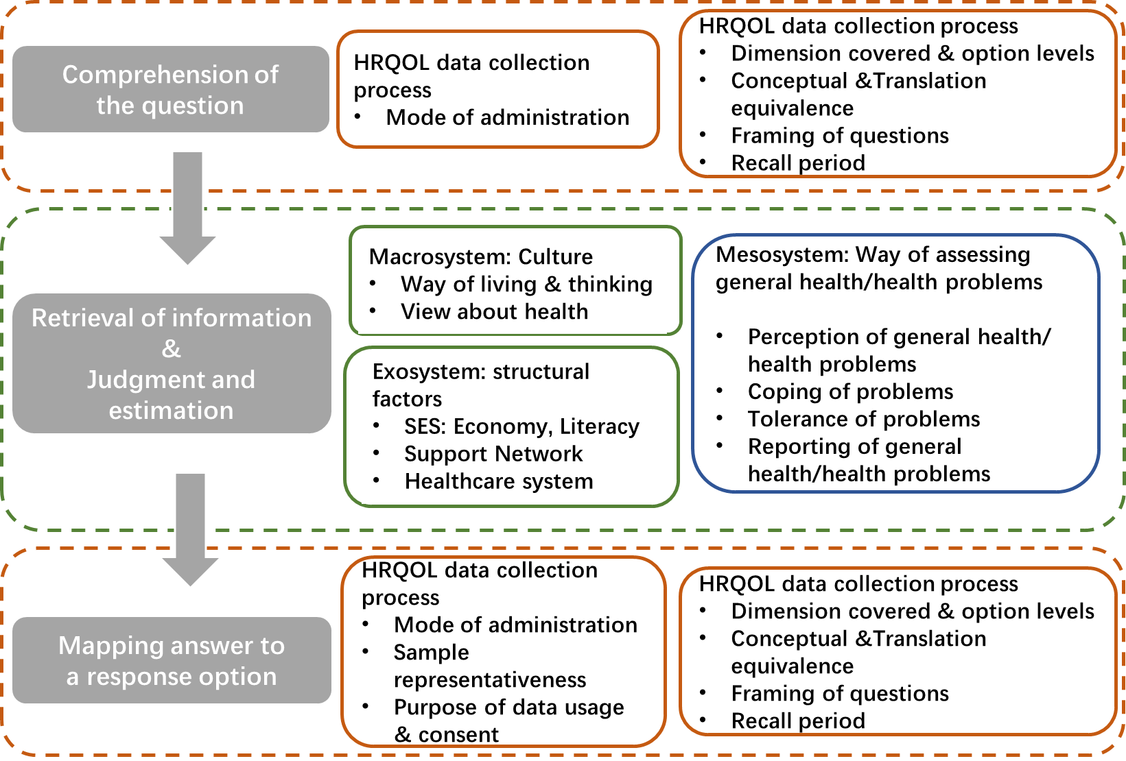
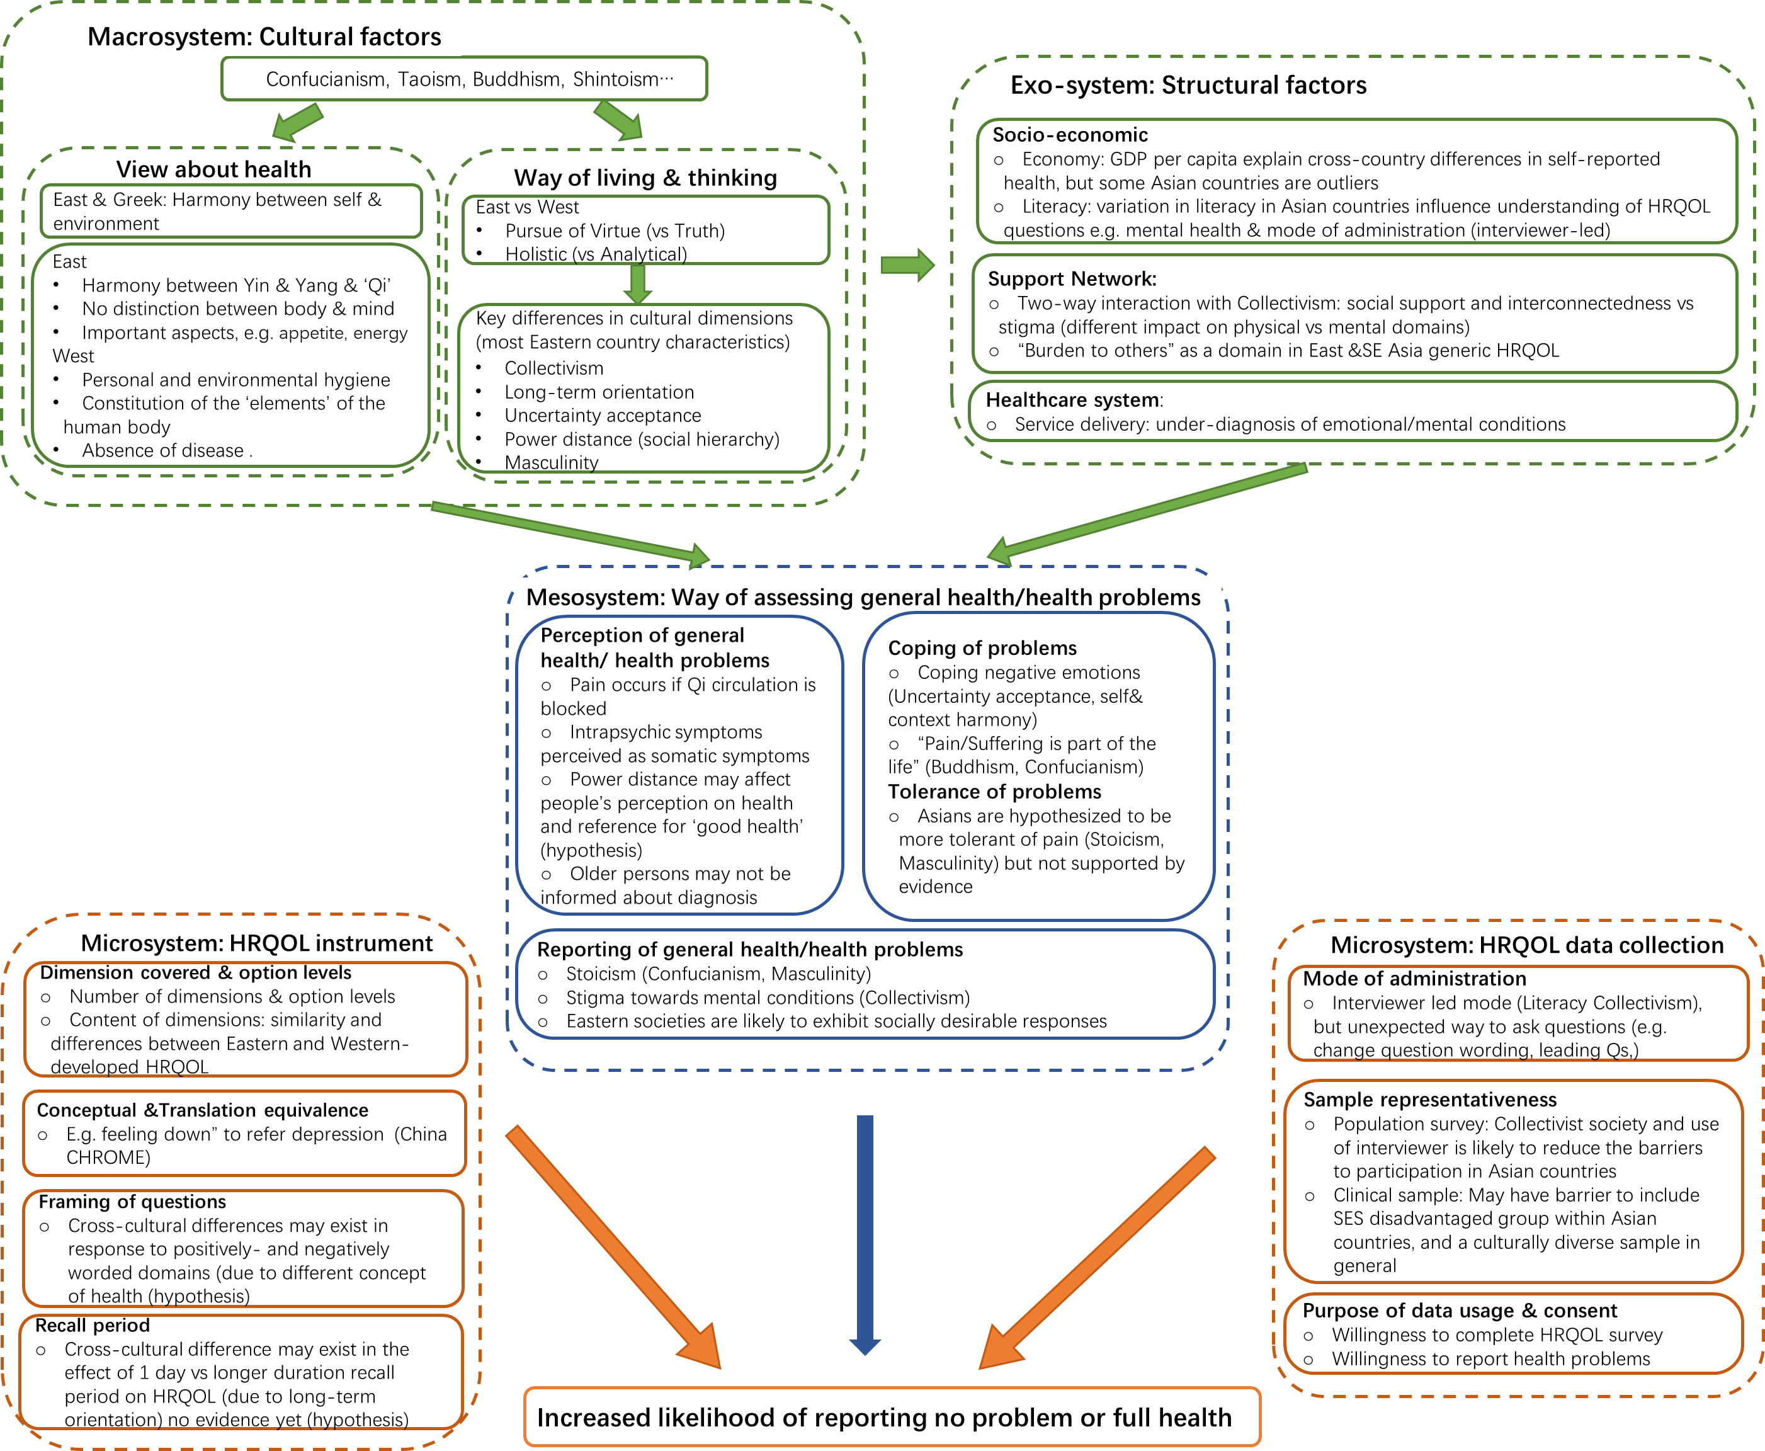
What explains differences in ceiling effects in EQ-5D and other HRQoL instruments between countries?
An investigation into possible reasons, existing evidence, and future research directions and priorities
Yishi Huang¹, Nancy Devlin¹, Nan Luo², Zhuxin Mao³, Melanie Calvert⁴, Jing Wu⁵, Takeru Shiroiwa⁶, Michael Herdman², Erica Lubetkin⁷, Brendan Mulhern⁸, Tianxin Pan¹
1. University of Melbourne 2. National University of Singapore 3. University of Antwerp 4. University of Birmingham 5 Tianjin University 6 National Institute of Public Health Japan 7 The City College of New York 8 University Technology Sydney
BACKGROUND
Cross-cultural studies of HRQoL using EQ-5D instruments have revealed higher ceiling effects (CEs) among Asian compared to Western countries: CEs in East/South-East Asia are 26% higher than in Europe for the EQ-5D-3L and 7% higher for the EQ-5D-5L (Cheng et al 2024). Researchers have proposed various hypotheses regarding potential causes of variations in CEs, including sociocultural factors, translation and cross-cultural validation and mode of administration. To date there has been no systematic attempt to identify these factors or review the evidence relating to them.
THE CONCEPTUAL FRAMEWORK
Fig 1. A conceptual framework to understand ceiling effect phenomenon (from Asian perspective), developed based on Broffenbrenner’s ecological model (1977), which divides environmental influences on behaviour into micro-,meso-,exo- and macrosystem levels of influences.
Fig 2. Explaining how factors influence responses using the Tourangeau’ Cognitive Process Model (1988)
﻿
AIMS
To develop conceptual framework to understand differences in CEs across different national and cultural groups To apply that framework to guide a scoping review to assess available evidence explaining high CEs of EQ-5D instruments in the Chinese population internationally, generate testable hypotheses, and potential strategies to address the issue.
Fig 2 maps the factors and differences to the response process. Our assumption is that HRQoL instrument and HRQoL data collection process mainly influence the Comprehension and Mapping process, whereas Cultural, Structural influences the way people assess their health in the Retrieval and Judgment process.
METHODS
We followed conceptual framework development methods (Jabareen 2009) and using an iterative approach: Conceptual framework development: Map data source & reading: (1) HRQoL studies from Asian countries, in which CEs in adult populations are reported and the phenomenon are discussed; (2) research in psychology and sociology explaining cross-cultural differences; (3) evidence about how such differences influence the way people respond to health problems and HRQoL questionnaires Identifying, deconstructing and categorizing the concepts Synthesis & resynthesis – discussion via advisory meeting Validating the framework Apply the framework to assess available evidence explaining high CEs of EQ-5D instruments in the Chinese population internationally Iteratively refine the conceptual framework
SUMMARY OF FINDINGS
Most of CEs observed and evidence were on EQ-5D descriptive system; though CEs much less observed in other HRQoL instruments, research consistently show Asian tended to report higher HRQoL scores. Preliminary findings from scoping review on evidence explaining CEs of EQ-5D in China suggest the following factors, explained by psychology and sociology theories or supported by empirical evidence: cultural factors (theory), literacy (evidence), way of reporting general health (theory), dimension covered (evidence), conceptual & translation equivalence (evidence), MOA and interviewer effects (evidence).
FUTURE RESEARCH
Qualitative research on the cognitive process in responding to HRQOL questions We also generated some testable hypotheses for future research: People from countries characterized by collectivism, long-term orientation, higher uncertainty acceptance and power distance are more likely to report no problems on EQ-5D dimensions The effects of 1 day vs longer duration recall period on reported HRQOL scores differ between long- vs short-term oriented countries There are cross-cultural differences in response to positively- and negatively worded domains of same concept. One potential strategy to reduce CEs in population surveys in China is to provide training on EQ-5D data collection to interviewers
The framework is developed based on Broffenbrenner’s ecological model (1977). Fig 1 shows a cascade of influence from broad cultural factors regarding how people think and live and how they view health and illness. Cultural factors also influence the structural factors. Cultural and structural factors shape how people assess their general health or health problems, along with the environment in which HRQoL data is collected and the HRQoL instrument itself. All these factors ultimately contribute to the likelihood of reporting no problem or full health to the instrument
Reference:
Bronfenbrenner U. Toward an Experimental Ecologyof Human Development. American Psychologist 1977:513-31
Cheng L. et al. The Ceiling Effects of EQ-5D-3L and 5L in General Population Health Surveys: A Systematic Review and Meta-analysis. 2024(Under Review)
Hofstede G, Hofstede GJ, Minkov M. Cultures and organizations: Software of the mind New York: McGraw Hill; 2010
Jabareen Y. (2009). Building a Conceptual Framework: Philosophy, Definitions, and Procedure. International Journal of Qualitative Methods, 8(4), 49-62.
Tourangeau R, Rasinski KA. Cognitive processes underlying context effects in attitude measurement. 1988. Psychological bulletin.
Funding: EuroQol Research Foundation – EQ-428-RA. Views expressed are those of the authors and are not necessarily those of the EuroQol Research Foundation.

