Slide 1




















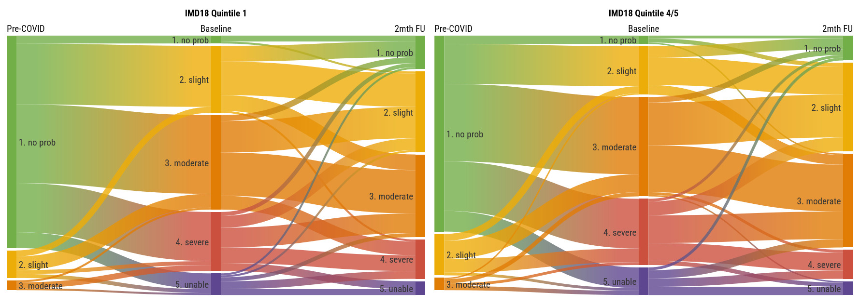










Exploring the inequity of HRQoL in individuals with long COVID symptoms
Daniel Exeter¹, Andrew McCullough¹, Jenene Crossan², Paula Lorgelly^{1,3}
1. School of Population Health, University of Auckland; 2. Lived Experience & Long Covid Support Aotearoa; 3. Department of Economics, University of Auckland
Acknowledgements: Funding has been received from the New Zealand Ministry of Health and EuroQol Foundation. Valuable input into the conduct and design of the project has been received from Te Rōpū Kaitiaki. This study would not be possible without the Registry participants and those who have shared their stories.
Background
Long COVID – COVID-19 symptoms or sequelae that persist for longer than three months – is a significant public health problem. Marginalised and deprived groups have been shown to be at greater risk of COVID-19 infection and severe disease, but little is known about the relationship between deprivation and long COVID. There are significant health inequities in Aotearoa New Zealand and these were exacerbated during the pandemic; Māori and Pasifika and those in more deprived areas experienced a greater burden.
Objective
Greater adoption of the EQ-5D-5L as a measure of population health will be enhanced with evidence of the performance of the instrument against recognised measures of inequality. This analysis seeks to understand the relationship between deprivation and EQ-5D-5L for individuals with long COVID.
Methods
Mātauranga Raranga | Long COVID Registry Aotearoa consists of ten linked survey modules (Figure 1) designed in partnership with people with lived experience of long COVID.
The first module collects socio-demographic information and includes an imbedded module that converts a New Zealand street address into a data zone and attaches a deprivation score and domain ranks (NZ Index of Multiple Deprivation 2018, IMD18).
HRQoL is collected using the EQ-5D-5L, with recall for pre-COVID HRQoL and today with long COVID symptoms. Participants can also complete monthly EQ-5D-5L follow-up surveys.
The registry is underpinned by a Tiriti o Waitangi Framework which seeks to avoid deficit framing. Separate analyses of tangata whenua (Māori) and tāngata tiriti (non-Māori) explore the demographic decomposition of the registry by deprivation quintiles and then EQ-5D-5L values and profiles in the top and bottom quintiles.
Regression analyses explore if demographics and clinical presentation mediate any relationship between EQ-5D-5L and deprivation.
Results
The registry remains open to enrolment; these results are based on a data extract on the 31st January 2024 – 6 months after the opening of the registry. The sample size is N=1,284, 8.7% Māori; 91.3% non-Māori. The demographics of the sample are presented in Table 1. 75% (74%) of Māori (non-Māori) participants are female, and the average age is 46 (50) years old. 15% (23%) of Māori (non-Māori) live in IMD18 quintile 1 (least deprived) and 24% (12%) of Māori (non-Māori) live in quintile 5 (most deprived). Nearly all participants have been vaccinated.
Pre-COVID EQ-5D-5L had a mean value of 0.854 (0.887) for Māori (non-Māori); at enrolment with long COVID symptoms the mean value was 0.486 (0.532). The difference in EQ-5D-5L is significant across those two time points. Analysis of the monthly follow-up data shows the disutility associated with long COVID symptoms persists (see Figure 2).
The relationship between deprivation and HRQoL is as expected; those residing in least deprived areas have higher EQ-5D-5L scores pre-COVID and at baseline than those in the most deprived areas (IMD18 Quintiles 4 & 5 combined). Analyses of the difference in EQ-5D-5L pre-COVID and baseline finds that non-Māori participants in the most deprived areas experienced a significant reduction in HRQoL (mean disutility 0.390).
Exploring the relationship at the dimension level finds that self-care and usual activities are most impacted by long COVID symptoms. Figure 3 provides an example of how participants are self-reporting their usual activities pre-COVID, on entry into the registry and at 2 months follow-up.
The longitudinal follow-up allows for the QALY shortfall to be estimated. Pre-COVID EQ-5D-5L and time in study are used to calculate potential QALYs in the absence of long COVID. The area under the curve method is employed to estimate the QALYs of experiencing long COVID. The QALYs lost due to long COVID range from 0.576 to -0.137, mean QALYs lost is 0.091 (0.094) for Māori (non-Māori). Note that the average time in the study is 128 days (range: 25, 197).
Regression analyses of the QALYs lost (controlling for time in study) find that in univariate analyses sex, age, pre-existing conditions, hospitalisation with COVID, and duration of long COVID symptoms are significant determinants of the QALY shortfall. There is no evidence of a deprivation impact on the QALY shortfall in univariate analyses. Table 2 presents multivariate regressions for Māori and non-Māori controlling for pre-COVID EQ-5D-5L. Many of the univariate associations persist, additionally for Māori (non-Māori) participants the analysis finds that residing in the most deprived areas significantly (marginally) increases the QALY shortfall.
Discussion
A recent systematic review to assess the prevalence and symptomology of long COVID found few studies that considered ethnicity and no studies which considered indices of deprivation. This study addresses that evidence gap and additionally explores the relationship between EQ-5D-5L and deprivation. The results suggest a complex relationship between HRQoL and deprivation which is variable for Māori and non-Māori. The study is currently limited in terms of the representativeness of the sample, particularly with respect to Māori; recruitment is ongoing.
Figure 2: Box plot of EQ-5D-5L over time
Table 2: Multivariate regression – dependent variable QALYs lost
 | Māori (%) |  | non-Māori (%)
 | coeff | t-stat | coeff | t-stat
Pre-COVID EQ-5D-5L | 0.616 | 2.44** | 0.552 | 6.10***
Age | 0.001 | 0.18 | -0.002 | -2.87***
Male | -0.117 | -1.01 | 0.015 | 0.71
Non-binary | -0.099 | -0.54 | 0.101 | 1.57
IMD18 Quintile 2 | 0.117 | 0.89 | -0.025 | -1.00
IMD18 Quintile 3 | 0.146 | 0.98 | 0.017 | 0.67
IMD18 Quintile 4/5 | 0.355 | 2.59** | 0.038 | 1.66*
Hospitalised with COVID | 0.627 | 3.09*** | 0.022 | 0.71
Duration of symptoms (3-6mths) | 0.578 | 2.63** | 0.013 | 0.36
Duration of symptoms (6-12mths) | 0.350 | 2.64** | 0.041 | 1.46
Duration of symptoms (1-2yrs) | 0.401 | 3.10*** | 0.041 | 1.47
Duration of symptoms (>2yrs) | 0.098 | 0.50 | 0.103 | 2.13**
Pre-existing conditions | -0.022 | -1.00 | 0.009 | 1.76*
Figure 1: Schematic of the registry and survey modules
ACCESS TO REGISTRY
https://www.lcregistry.auckland.ac.nz/
DEMOGRAPHICS/WORK
/HEALTH/LIFESTYLE
QUALITY OF LIFE
(repeated monthly)
All include questions about change / pre-(long)covid
LCSA website
Whānau/community
COVID & LONG COVID JOURNEY
LONG COVID EXPERIENCE (repeated 6 monthly)
EQ-5D-5L
Table 1: Demographics of the sample
Registry promoted in social media
Sign up for newsletter, registry promoted
Productivity / employer behaviour
* p-value <0.10; ** p-value <0.05; *** p-value<0.01
Vaccination
 | Māori (%) | non-Māori (%)
Sex
Female | 75.00 | 72.86
Male | 25.00 | 23.22
Non-binary / third gender | ‡ | 2.81
Age (mean) | 45.71 | 49.81
Current household income
$0 - $30,000 | 14.67 | 12.76
$30,001 - $50,000 | 16.00 | 7.68
$50,001 - $100,000 | 22.67 | 29.08
> $100,000 | 41.33 | 39.46
IMD Quintile
1 - least deprived | 14.81 | 23.47
2 | 25.00 | 23.56
3 | 15.74 | 21.84
4 | 20.37 | 19.4
5 - most deprived | 24.07 | 11.73
 | Māori (%) | non-Māori (%)
Highest educational attainment
No formal qualifications | ‡ | ‡
Primary school | ‡ | ‡
High school/secondary | 20.54 | 11.77
Post-school education | 23.21 | 19.62
Bachelor’s degree | 31.25 | 31.31
Bachelor Honours degree | 8.93 | 13.57
Master's degree | 8.93 | 15.11
Doctoral degree | ‡ | 5.45
Essential Worker
Yes | 38.39 | 31.57
of which healthcare worker | 37.21 | 40.00
Vaccinated | 100 | 98.50
Number of comorbidities (mean) | 2.45 | 2.22
Figure 3: Sankey diagram of usual activities pre-COVID, baseline and 2mth follow-up for non-Māori IMD18 Quintile 1 and Quintiles 4&5
Employment/
volunteering
Google login (with reminders)
COVID infection(s)
Symptoms and symptom scales list
Who are you?
Medical history & self rated health
Long COVID dates/diagnosis
Healthcare use / complementary meds /
Rongoā Māori
Participant information sheet & consents
0800 532 150
request telephone interview
Health
Behaviours
Personal/social care
Whānau impact
‡ Cells with fewer than 6 people have been suppressed, with rounding to support secondary suppression.

