Slide 1
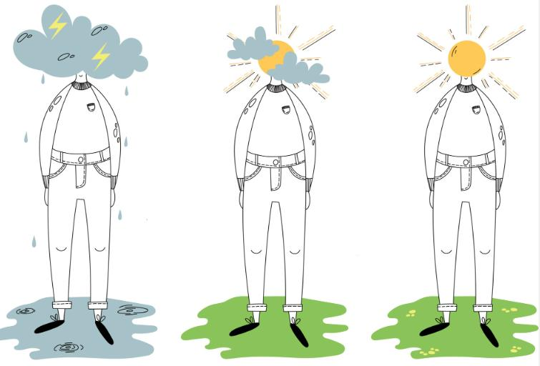
Thinking positively: higher positive mental well-being score lower the odds of reporting problems in EQ-5D-5L
Zhihao Yang, Nan Luo, Yanming Hong
Introduction
Increasing use of patient reported outcome measures (PROMs), like EQ-5D-5L, in clinical trials and health survey etc.
Responses to PROMs rely on patients' self-assessments, which can be influenced by their personal perspectives, emotions, subjective awareness, etc, which lead to variation in the PROM results.
Positive mental well-being surpasses the mere absence of mental health issues and instead signifies the presence of positive psychological functioning.
This study aims to investigate the potential impact of positive mental well-being on responses of EQ-5D-5L.
Results
• Sample: 500 participants completed online surveys , 509 participated in face-to-face interviews; 237 healthy individuals, 430 individuals with physical conditions, 234 with mental conditions, and 108 with both physical and mental conditions.
• For EQ-5D-5L dimension responses: age, SWEMWBS scores, sex, health conditions, data collection method, and caring experience significantly influenced the likelihood of reporting problems in EQ-5D-5L responses; individuals with better SWEMWBS outcomes demonstrated a fewer problems (OR: 0.81 to 0.91) .
• For utility and EQ-VAS: SWEMWBS scores, gender, health conditions, and data collection methods were significant. In particular, SWEMWBS scores exhibited a significant positive correlation with EQ-5D-5L utility values (β: 0.011) and EQ-VAS (β: 1.583).
Methods
• Sample and data collection: online survey and face-to-face interviews to collect data from a sample with or without different health conditions.
Instruments: Short Warwick Edinburgh Mental Wellbeing Scale (SWEMWBS) was used to measure positive mental wellbeing. Outcome measures are EQ-5D-5L responses, utility and EQ-VAS.
Analysis: ordered logistic model and linear regression model were used, controlling for age, gender, education level, health conditions, caring experience, and data collection methods
Discussions
• Individuals with better positive mental well-being results are more likely to report better results in EQ-5D-5L.
Unable to determine causation in this study, in other words, could also be: better HRQoL led to better positive mental wellbeing.
Future study is needed to understand the thought process and to explore strategies to cope with the response heterogeneity that led by the status of mental well-being
Variables | Levels | Mobility | Self-care | Usual activities | Pain/discomfort | Anxiety/depression | EQ-5D Utilities | EQ-VAS
 |  | OR(95%Cl) | OR(95%Cl) | OR(95%Cl) | OR(95%Cl) | OR(95%Cl) | β (95%CI) | β (95%CI)
Age |  | 1.04 (1.02，1.05) | 1.05 (1.03，1.07)
SWEMWBS score |  | 0.89 (0.86，0.92) | 0.91 (0.88，0.94) | 0.88 (0.85，0.91) | 0.88 (0.86，0.90) | 0.81 (0.78，0.83) | 0.01 (0.01, 0.01) | 1.58 (1.39, 1.78)
Sex (Ref: Female) |  | 0.58 (0.42，0.81) |  | 0.53 (0.38，0.73) | 0.65 (0.50，0.84) | 0.61 (0.46，0.79) | 0.04 (0.02, 0.05)
Education level (Ref: College graduate or above) | Primary School or Below
 | Middle or high school |  |  |  |  | 0.49 (0.32，0.74)
Health condition (Ref: Healthy) | Physical conditions | 8.73 (4.80，15.88) | 6.80 (3.52，13.16) | 9.86 (5.45，17.81) | 5.02 (3.42，7.37) | 4.01 (2.67，6.01) | -0.11 (-0.14, -0.09) | -7.43 (-10.22, -4.65)
 | Mental conditions | 4.60 (2.23，9.46) | 5.14 (2.23，11.82) | 5.68 (2.84，11.36) | 2.77 (1.78，4.31) | 6.57 (4.12，10.47) | -0.10, (-0.12, -0.07) | -9.42 (-12.66, -6.18)
 | Both conditions | 6.75 (3.33，13.67) | 6.59 (3.06，14.17) | 10.75 (5.39，21.40) | 7.14 (4.23，12.04) | 5.45 (3.23，9.18) | -0.12, (-0.16, -0.09) | -8.72 (-12.75, -4.70)
Caregiver (Ref: Yes) |  | 1.81 (1.23，2.65) | 1.99 (1.30，3.03) | 1.92 (1.31，2.80)
Data collection method (Ref: F2F survey) |  | 4.72 (2.60，8.55) | 9.38 (4.55，19.34) | 3.18 (1.81，5.59) |  | 2.03 (1.30，3.18) | -0.05 (-0.08, 0.02)

