Slide 1



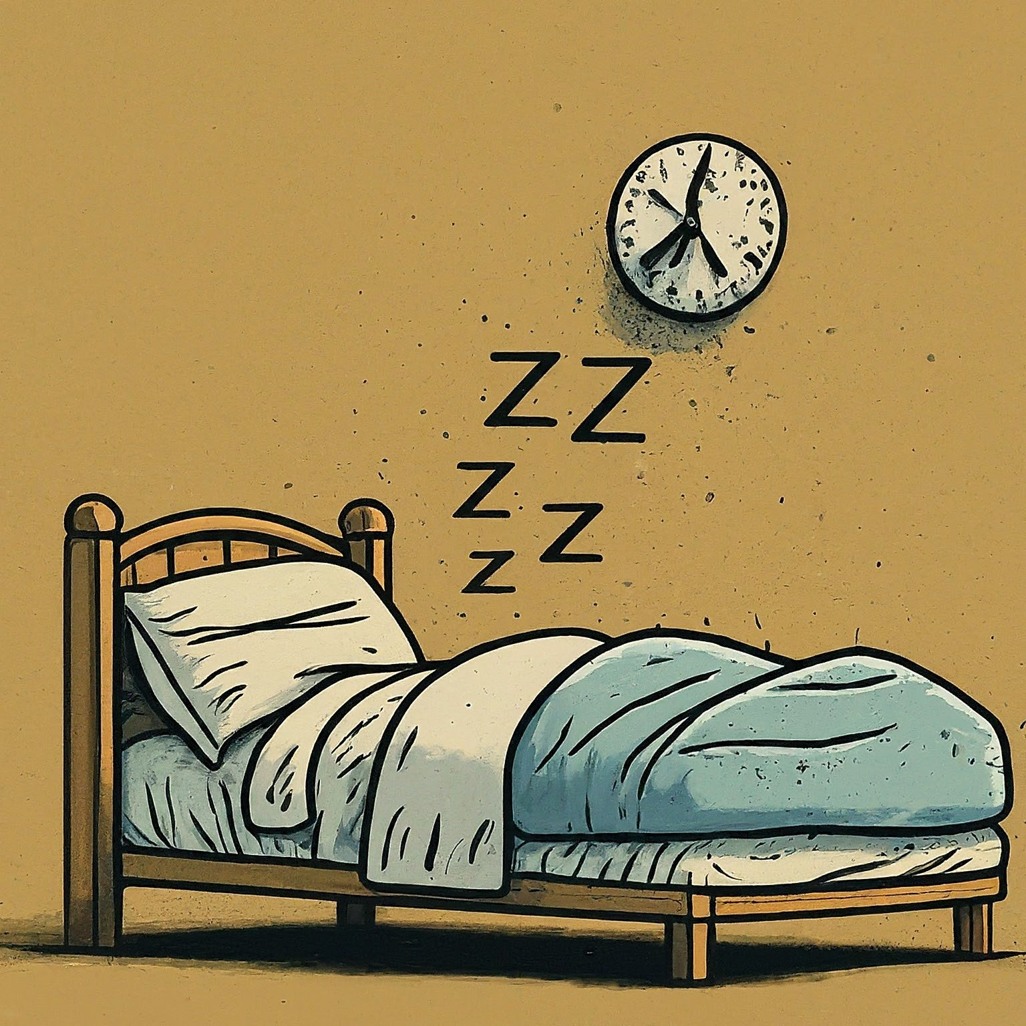

A Direct Comparisons of the Measurement and Conceptual Properties of the EQ-5D-5L and PROMIS®-16 in a US General Population Sample
Benjamin M.Craig¹, Tessa Peasgood², Minh Pham¹, Fanni Rencz³
¹University of South Florida, Tampa, ²School of Medicine and Population Health, University of Sheffield, ³Department of Health Policy, Corvinus University of Budapest, Budapest
OBJECTIVES
RESULT #2
RESULT #3
DISCUSSION I
Introduced in February 2024, the PROMIS®-16 profile is a 16-item generic HRQoL instrument (2 five-level items on 8 domains).
This instrument has the greatest overlap with the EuroQol family of instruments compared to any other PROMIS® profile.
This study compares the EQ-5D-5L and PROMIS®-16 (EQ 304-PHD) in a representative US population. [4]
Good convergent validity was found between the physical function items and between the anxiety/depression items; however, the PROMIS®-16 instrument covers more domains (8 versus 5).
The exploratory factor analysis
revealed distinct constructs captured
by the PROMIS®-16 instrument,
separate from the EQ-5D-5L items.
Lesson #2: Key gaps in the
EQ-5D-5L may be filled by EQ-HWB
or bolt-ons (e.g., missing sleep/fatigue).
The original PROMIS®-16 study [1] included its items alongside others (below left) while our study included its items as a stand-alone instrument (right), which may explain the lower frequency of some level-1 responses in the original study.
EQ VAS was negatively associated with each item decrement, except for the worst decrements on physical function and the two worst decrements of SOC1, COG1, and COG2 (p-value < 0.05).
  Lesson #3: Changing the order of the items may affect the frequencies (e.g., social functioning)
This comparative evidence is from a cross-sectional sample of the U.S. general population with limited health data.
Is it too early for the EuroQol Group to conduct this type of comparative study?
Do studies comparing EuroQol and other instruments (e.g., PROMIS®-16) promote these alternatives and pose a strategic risk?
Given these strategic considerations, should we disseminate this comparative evidence internally? openly? What about EQ-HWB?
METHODS
DISCUSSION II
We compared their properties by item and domain, including ceiling and floor effects, informativity (Shannon’s indices), and validity.
We also conducted an exploratory factor analysis and regressed the item responses on health status (EQ VAS).
Economists want high ceilings and low floors when they inform decisions.
care little about slight/little problems that are not decision relevant
care more about rare problems that are decision relevant (e.g., Unable).
CONCLUSIONS
RESULT #1
Although the PROMIS®-16 instrument has some advantages over the EQ-5D-5L, it is unclear how to mitigate its acquiescence biases and order effects.
These balanced findings are particularly relevant for researchers selecting instruments in population health surveys or interested in improving health measures generally.
PROMIS®-16 items showed more
dispersed distributions compared
to EQ-5D-5L items, with lower
ceilings and higher informativity.
PROMIS® reverse-scored its
two cognitive items, leading to
an excessively high floor
20% of US adults (507/2577)
reported the WORST level on
BOTH cognitive items (right).
Lesson #1: Do not reverse score
items in stand-alone instruments.
Edelen MO, Zeng C, Hays RD, Rodriguez A, Hanmer J, Baumhauer J, Cella D, Reeve BB, Herman PM. Development of an ultra-short measure of eight domains of health-related quality of life for research and clinical care: the patient-reported outcomes measurement information system® PROMIS®-16 profile. Qual Life Res. 2024 Feb 6. doi: 10.1007/s11136-023-03597-6. Epub ahead of print. PMID: 38319489.
Hays RD, Herman PM, Rodriguez A, Slaughter M, Zeng C, Edelen MO. The PROMIS-16 reproduces the PROMIS-29 physical and mental health summary scores accurately in a probability-based internet panel. Qual Life Res. 2024 Apr 23. doi: 10.1007/s11136-024-03662-8. Epub ahead of print. PMID: 38652369.
Hays RD, Herman PM, Qureshi N, Rodriguez A, Edelen MO. Mapping of the PROMIS global health measure to the PROPr in the United States. J Patient Rep Outcomes. 2024 Jan 10;8(1):5. doi: 10.1186/s41687-023-00677-6. PMID: 38196009; PMCID: PMC10776509.
Jumamyradov M, Craig BM, Rivero-Arias O, Jakubczyk M. Child health valuation protocol for a discrete choice experiment comparing paired comparison and kaizen tasks and estimating US EQ-5D-Y-3L values on an experience scale. BMJ Open. 2023 Oct 24;13(10):e077256. doi: 10.1136/bmjopen-2023-077256. PMID: 37879694; PMCID: PMC10603523.
Acknowledgement: We thank the EuroQol Research Foundation for their funding of the data collection (304-PHD), This primary analysis was submitted separately and not funded by Foundation apart from a travel grant for this presentation

