Slide 1
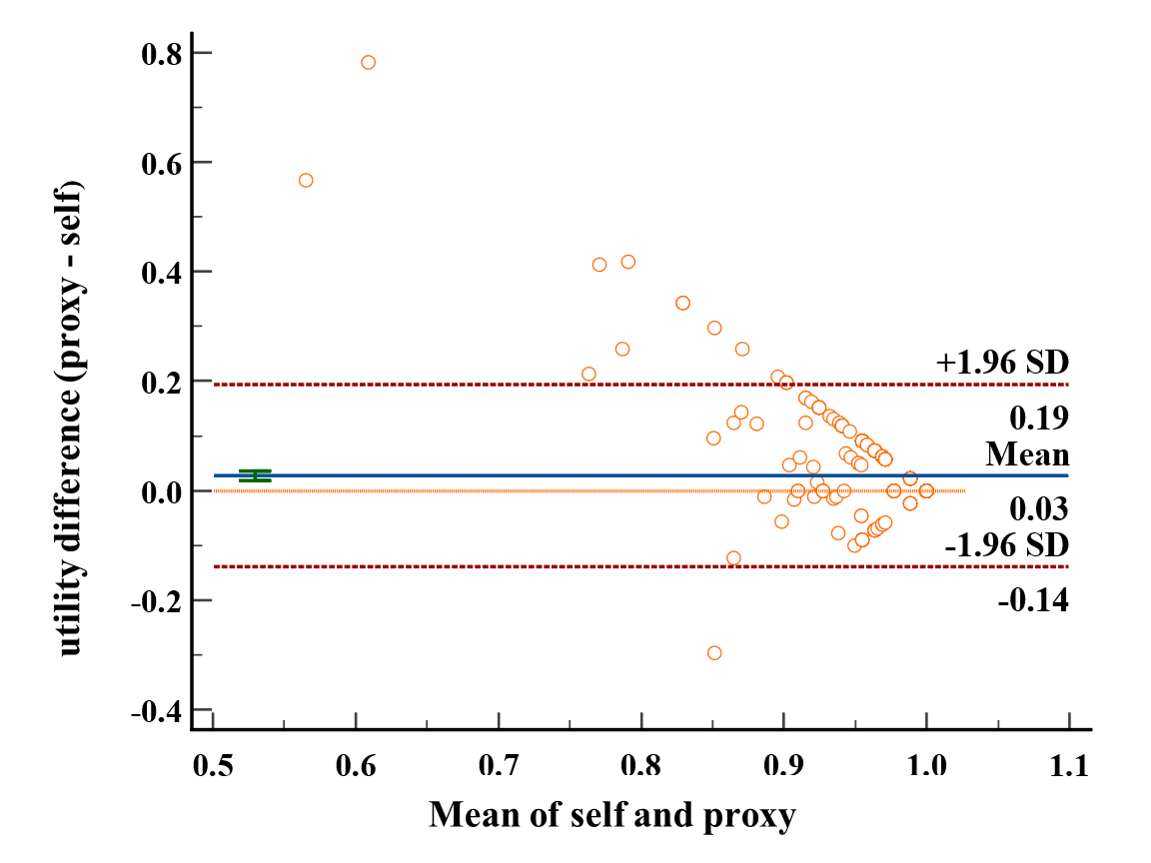
Are Children's Self-reports and Proxy-reports of Health Utility Agreed? A School-based Study in China
Using the EQ-5D-Y and CHU-9D
Yan Li ¹; Yanqiu Chen ¹; Jize Sun ¹; Mingyu Jiang ¹; Aixia Ma ¹; Xuejing Jin ^{2*}; Pingyu Chen ^{1*}
1 School of International Pharmaceutical Business, China Pharmaceutical University, Nanjing, China
2 Centre for Evidence-based Chinese Medicine, Beijing University of Chinese Medicine, Beijing, China
This study investigated a general Chinese child population aged 7-8 years with the EQ-5D-Y and CHU-9D.
To examine the agreement between self-reports and proxy-reports across various dimensions and overall health utility values.
To explore potential factors that may affect the agreement and utility values.
A total of 369 pairs of valid questionnaires were collected from both children and proxies.
Due to the study's focus on a general child population, both EQ-5D-Y and CHU-9D yielded high utility values. (Table 1)
The agreement rates and AC values for various dimensions showed good agreement between children and proxies for physical function dimensions, but poorer agreement for more subjective social and psychological function dimensions. (Figure 1 and Table 2)
BA plots demonstrated that both EQ-5D-Y and CHU-9D proxy-reports significantly overestimated children's utility values compared to self-reports (Figure 2). The ICC values for self-reported and proxy-reported utilities were 0.130 for the EQ-5D-Y and 0.295 for the CHU-9D, indicating poor agreement.
Subgroup analysis revealed that mothers had higher ICC values and better agreement with children compared to fathers. Moreover, children's health conditions, parental marital status, and family's highest education level could also impact agreement results.
OBJECTIVES
RESULTS
Mean Difference：0.03
95%CI：0.02~0.04，p<0.001
Data were collected from 7-8-year-old students in the second grade from four schools in Guangxi and Guizhou provinces, China.
Children and their proxies independently completed their respective versions of the questionnaires, including the EQ-5D-Y, the CHU-9D, and other socio-demographic information.
The agreement between self-reports and proxy-reports in various dimensions was assessed using agreement rate and Adjusted Consistency (AC) value.
For the agreement of utility values, Bland-Altman (BA) plots were generated, Intraclass Correlation Coefficient (ICC) was calculated.
Subgroup analyses of ICC and multiple linear regression analysis were conducted to explore factors influencing the agreement between self-reports and proxy-reports.
Table 1 Results of utility values (n=369)
METHODS
Figure 2 BA plot of differences between self-reported and proxy-reported utility values against the mean of self-reported and proxy-reported utility values (the EQ-5D-Y).
Figure 1 Percentage of agreement between self- and proxy-reports of the EQ-5D-Y. "underestimated" refers to proxies underestimating the health levels of children, while "overestimated" indicates proxies overestimating the health levels of children.
In this study, the agreement between self-reported and proxy-reported utilities is weak, particularly in subjective dimensions, with proxy-reports significantly overestimating children's utility values compared to self-reports.
Self-reports and proxy-reports of health utility should be considered complementary rather than interchangeable. The findings provide valuable insights and references for the development of guidelines for self-reports and proxy-reports of children's utility instruments and for economic evaluations in relevant pediatric populations.
CONCLUSIONS
Table 2 AC value between self-reports and proxy-reports of the EQ-5D-Y
Dimension | Mobility | Looking after myself | Usual activities | Pain/ discomfort | Worried/sad/ unhappy
AC value | 0.961 | 0.887 | 0.869 | 0.857 | 0.817
 | EQ-5D-Y (self) | EQ-5D-Y (proxy) | CHU-9D (self) | CHU-9D (proxy)
Mean | 0.96 | 0.99 | 0.93 | 0.97
SD | 0.0045 | 0.017 | 0.0048 | 0.0031
95%CI | 0.95-0.97 | 0.98-0.99 | 0.92-0.94 | 0.96-0.97

