Slide 1
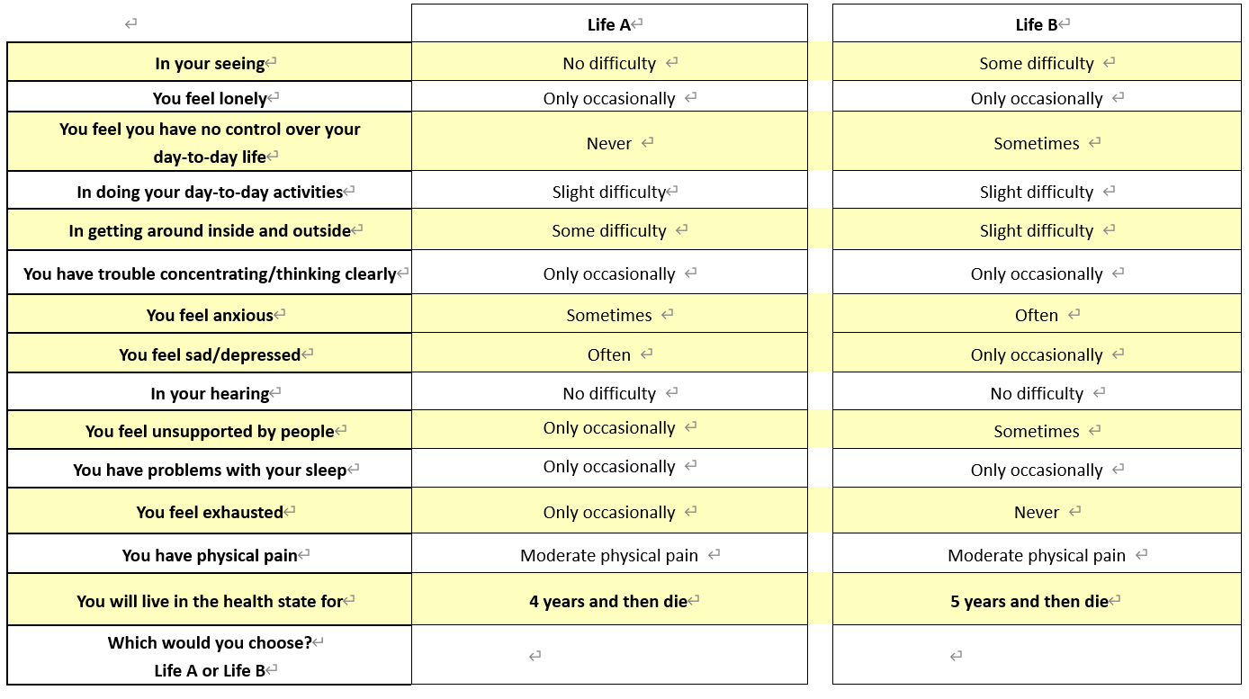
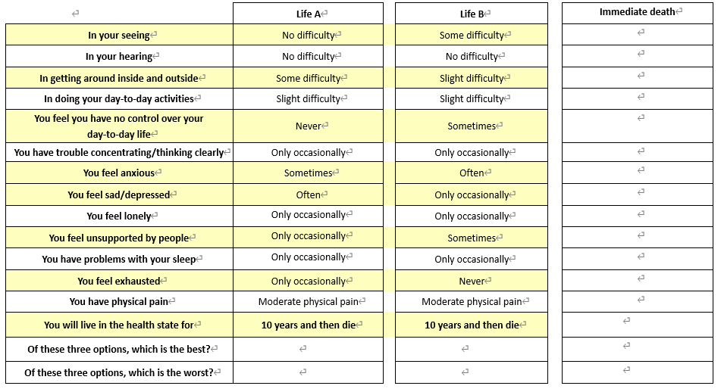
Valuing a long measure of Health and Wellbeing from EQ-HWB using Discrete Choice Experiments：
A feasibility study of two methods with UK and Australia general public samples
Haode Wang¹, Donna Rowen ¹, Clara Mukuria¹, Deborah Street², Richard Norman³
¹ Sheffield Centre for Health and Related Research, University of Sheffield; ² Centre for Health Economics Research and Evaluation, University of Technology Sydney; ³ Curtin School of Population Health, Curtin University
Background
Although originally developed health and wellbeing (HWB) measures EQ-HWB and EQ-HWB-S are published, there has been no valuation protocol developed for EQ-HWB. The Discrete Choice Experiment (DCE) is a highly flexible method that has attracted attention in recent years, in the valuation studies for EQ-5D-5L and SF-6Dv2. The method can be implemented online and is considered to potentially have lower cognitive burden. However, there are limited studies testing the valuation feasibility of using DCE for valuation of a long HWB measure, nor did any study generate empirical evidence with EQ-HWB Aim: To provide qualitative and quantitative evidence on the feasibility of valuing HWB with DCE, and test the effect of information order, different design and different countries.
Figure 1: DCE-TTO design, 7 attributes varied (in yellow) and one duration attribute
Results
Stage 1: Four feasible methods identified
Four DCE methods identified for valuing long health and wellbeing measure: DCE-TTO, triplet comparison, partial comparison and pivot partial comparison
Stage 2: 13 attributes selected
13 attributes were selected after a systematic selection with 7 criteria: Vision, Hearing, Mobility, Daily activity, Sleep, Fatigue, Loneliness, Support, Concentrating, Control, Anxious, Sad/depression, Pain severity. All EQ-HWB attributes remained
Methods
Stage 1: Literature review
A comprehensive updated search of health state valuation study using DCE method was conducted from January 2018 to December 2022.
Stage 3: DCE is feasible
13 attributes were overall understood well
DCE can be completed with clear instruction
Preference for DCE-TTO and triplet (with dead state/no varied duration) design (kept for the large-scale survey) Mixed evidence with the information order, multiple decision strategies (consider all, only varied, only health/time) identified.
Figure 2: Triplet DCE design, 7 attributes varied (in yellow) and duration fixed at 10-years
Stage 2: Attribute selection
Select the EQ-HWB attributes for DCE valuation, by considering dimensionality, collinearity, E-QALY Patient and Public Involvement consultation and EQ bolt-on studies.
Stage 3: Qualitative consultation
Conduct focus group consultation with the target respondent (general public) to ask their preference for different designs, presentation strategies and information understanding.
Stage 4: DCE is feasible
2017 UK and 2000 Australian participants completed one of the surveys.
Both DCE-TTO and triplet design were able to generate a value set on 0 (dead) – 1 (full health) QALY scale;
DCE-TTO and triplet design generated varied health state values, where the triplet design utility was lower, with smaller insignificant/non-monotonic attribute levels.
Many attribute levels (30% on average) insignificant (5% sig level) or non-monotonic or positive disutility, especially with the wellbeing attributes, sleep, and attributes with frequency levels.
Stage 4: DCE survey and data analysis
Implement the DCE survey online, with various DCE designs, in both UK and Australia with around 2000 people in each country and conduct data analysis with homogeneity (conditional logit) and heterogeneity (latent class, mixed logit) models.
Conclusions
Overall, DCE is feasible for the valuation of a large number of attributes derived from EQ-HWB
The study has benefited from qualitative research to inform the DCE surveys and conducting the surveys across two different countries. The results indicate that both DCE-TTO and triplet tasks were feasible though there are some impacts on results from using the different tasks.

