Slide 1


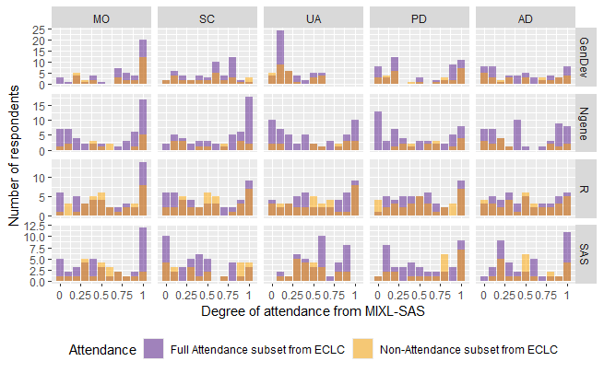
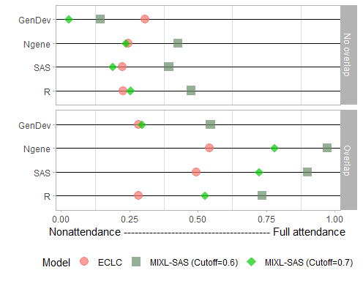
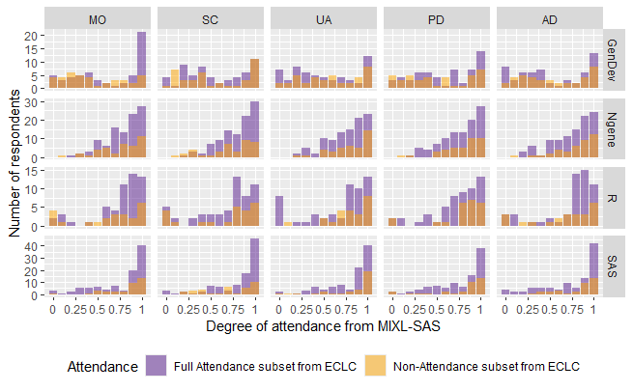
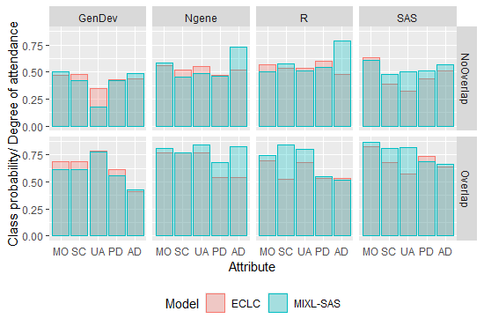
Assessing attribute non-attendance in EQ-5D-5L valuation: A comparison of models
Authors: Peiwen Jiang¹, Bram Roudijk², Deborah Street¹, Richard Norman³, Rosalie Viney¹, Mark Oppe⁴, Brendan Mulhern¹
Affiliations: ¹Centre for Health Economics Research and Evaluation, University of Technology Sydney; ²EuroQol Research Foundation;
³School of Population Health, Curtin University; ⁴Department of Psychiatry, Erasmus University
OBJECTIVES
Discrete choice experiments (DCEs) are becoming increasingly popular for developing EQ-5D-5L value sets. However, DCEs can present challenges, including the use of heuristics that could result in attribute non-attendance (ANA) to simplify decision-making. This study contrasted results from two ANA models, the equality constrained latent class (ECLC) model¹ and the mixed logit model with stochastic attribute selection (MIXL-SAS)² using data generated from eight commonly-used design strategies.
Comparison III: Distribution of degree of attendance from MIXL-SAS in full attendance and nonattendance groups identified by ECLC
MIXL with stochastic attribute selection²
ANA is represented by a vector that is multiplied with the preference parameter
Coding: 1 if the attribute level is attended to; 0 if it is ignored
Designs with no overlap
RESULTS
Comparison I: Comparison of full attendance rates
METHODS
This study used data from 1,432 Australian respondents who participated in a multi-arm latent class DCE to value EQ-5D-5L. Both the ECLC model and the MIXL-SAS were fitted to each of these eight study arms.
Designs with overlap
 | Overlap | Construction
1 | Y | Generator-developed design
2 | Y | Ngene (modified Fedorov)
3 | Y | SAS (modified Fedorov)
4 | Y | R (Bayesian D-efficient design)
5 | N | Generator-developed design
6 | N | Ngene (modified Fedorov)
7 | N | SAS (modified Fedorov)
8 | N | R (Bayesian D-efficient design)
Comparison II: Attendance to each attribute
Equality Constrained Latent Class¹
32 (2⁵) possible ANA behaviours
Individuals are categorised into classes based on their ANA behaviours
Eg. if MO is ignored, then β_{MO2=}β_{MO3}=β_{MO4}=β_{MO5}=0
CONCLUSION
The two models showed significant variations, and this study cannot determine which one is superior. Further examination is required.
Attribute level overlap improves attribute attendance.
No design method has been consistently proven optimal; thus, all methods can be considered based on specific research questions.
References: [1] Scarpa, R., Zanoli, R., Bruschi, V., & Naspetti, S. (2013). Inferred and stated attribute non-attendance in food choice experiments. Journal of Agricultural Economics. 95(1), 165–180. doi: 10.1093/ajae/aas073; [2] Jonker, M., Donkers, B., de Bekker-Grob, E. & Stolk, E. (2018). Effect of level overlap and color coding on attribute non-attendance in discrete choice experiments. Value in Health, 21. doi: 10.1016/j.jval.2017.10.002
FUNDING: This study was partially supported by a grant from the EuroQol Research Foundation (2016260). PJ’s doctoral scholarship was funded by Australian Research Council (DP210102021).

