Slide 1
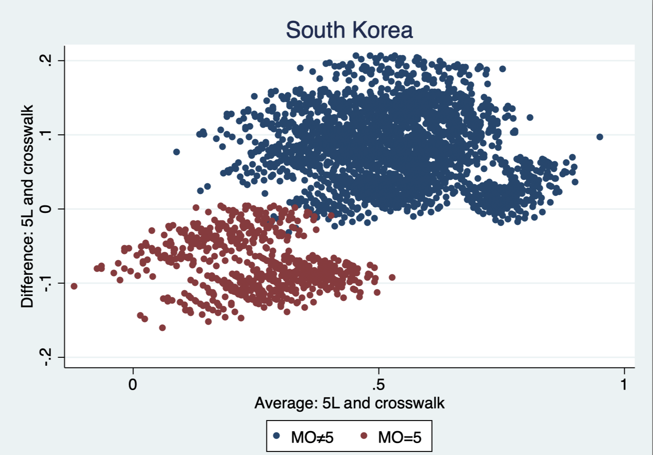
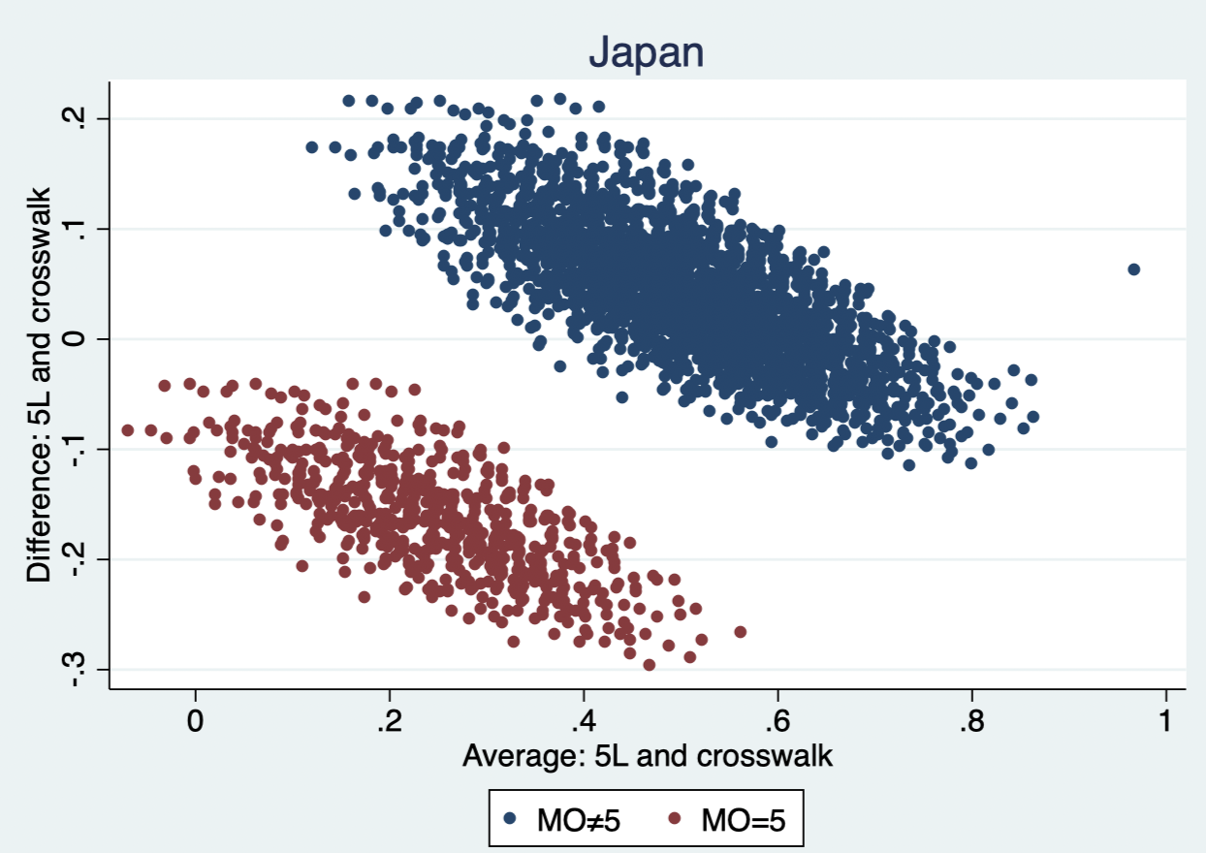
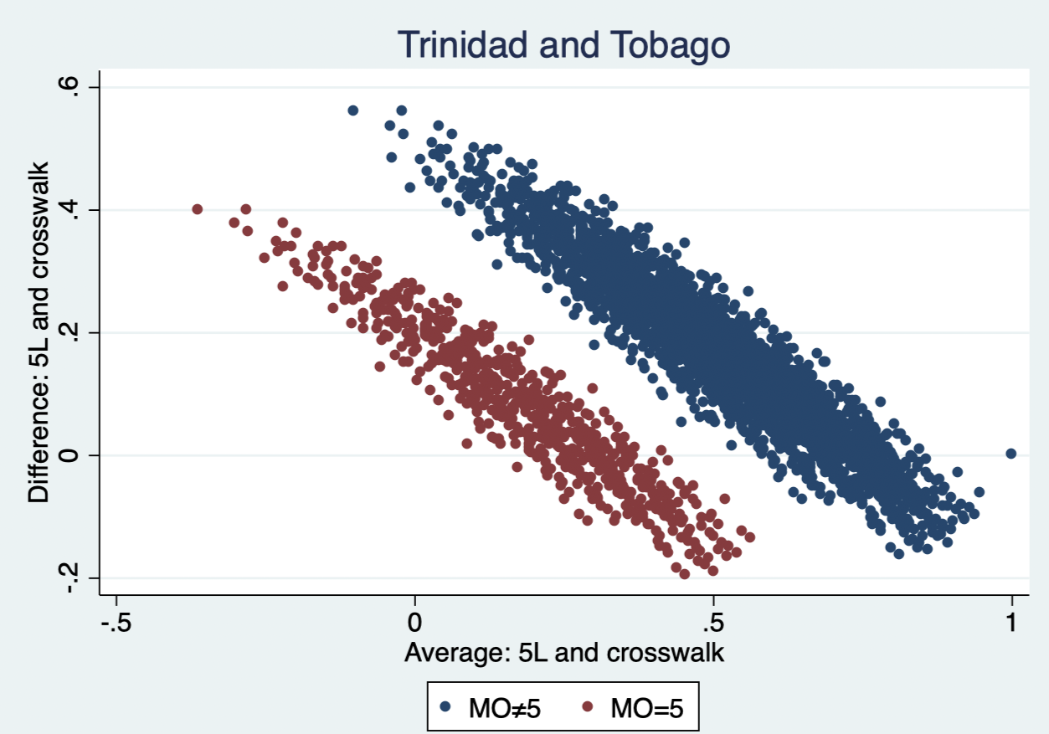
A head on comparison of EQ-VT and crosswalk-based EQ-5D-5L value sets.
H. Bailey¹, B. Roudijk²
1 The University of the West Indies, St Augustine Campus, Trinidad and Tobago 2 EuroQol Research Foundation
OBJECTIVE
RESULTS
Table 1: Comparison of valuation vs crosswalk sets.
No systematic country-level comparison has been undertaken between crosswalk and EQ-VT derived value sets. Crosswalk values can differ from EQ-VT-based 5L value sets due to the intermediate levels in the 5L instrument, societal change during the time lag between 3L and 5L valuation studies, methodological differences between 3L studies serving as input for the crosswalk and EQ-VT, and the change in the label of the highest level on mobility (‘confined to bed’ vs ‘unable to walk about’) which may influence the way that respondents consider states with mobility at the highest level. This study aimed to explore differences between 5L crosswalk and EQ-VT value sets at country level, including the impact of the change in the label of the highest level of mobility.
Spearman correlation between the crosswalk and valuation sets ranged from 0.8306-0.9894 being below 0.9 in 10 countries. Lin’s concordance coefficient ranged from 0.556-0.978. The difference in the percentage of negative values ranged from +22.5% to –18.8% and the difference in the ranges of the two value sets ranged from +42.7% to –18.4%. Average MAD of values (crosswalk vs EQVT) was 0.1455. No country preserved its ranking of importance of the 5 dimensions in moving from crosswalk to EQVT values. The mobility dimension’s rank decreased in 10 countries and increased in 1 country. In 14 countries, Bland-Altman plots showed that the health states with mobility at level 5 were a clearly distinguishable group which in 8 cases comprised a separate band. Applying the values to the MIC data showed that for all 18 value sets, the population mean differed significantly between crosswalk and EQ-VT (no consistent direction). For severe states (LSS>15), the difference in mean ranged between –0.24 and 0.43. The t-tests for comparing the means produced p values of 0.000 except for Japan (all states) which was 0.116.
METHODS
Eighteen countries have both TTO or DCE+TTO based 3L value sets and EQ-VT based 5L value sets. For each of these 18 EQ-5D-3L value sets, 5L crosswalk sets were developed, allowing comparison with the corresponding national EQ-5D-5L value sets using correlation analysis, Lin’s concordance, Bland-Altman plots. Three countries had EQ-5D-3L and EQ-5D-5L valuation data for the same respondents. These 3 cases were analyzed separately as they provide a ‘true’ test of differences between the two value sets, eliminating any differences in methods or population. Furthermore, we applied the crosswalk and original value sets to the MIC dataset, to detect possible differences in (mean) values in a mixed patient population.
CONCLUSION
Poor agreement was found between some crosswalk and EQ-VT value sets, suggesting that these should not be used interchangeably. Furthermore, the “confined to bed” label seems to be valued differently from “unable to walk”, which is reflected in the difference between crosswalk and EQ-VT value sets, which the crosswalk insufficiently takes into account. This has implications for transferability between 3L and 5L, the use of crosswalk sets, and for comparability of HTA results based on the two instruments.
Fig 1: Bland Altman Plots for EQ-VT vs crosswalk for 6 countries
* Indicates EQ-5D-3L and EQ-5D-5L valuation data for the same respondents
Notes:
July 4th update

