Slide 1
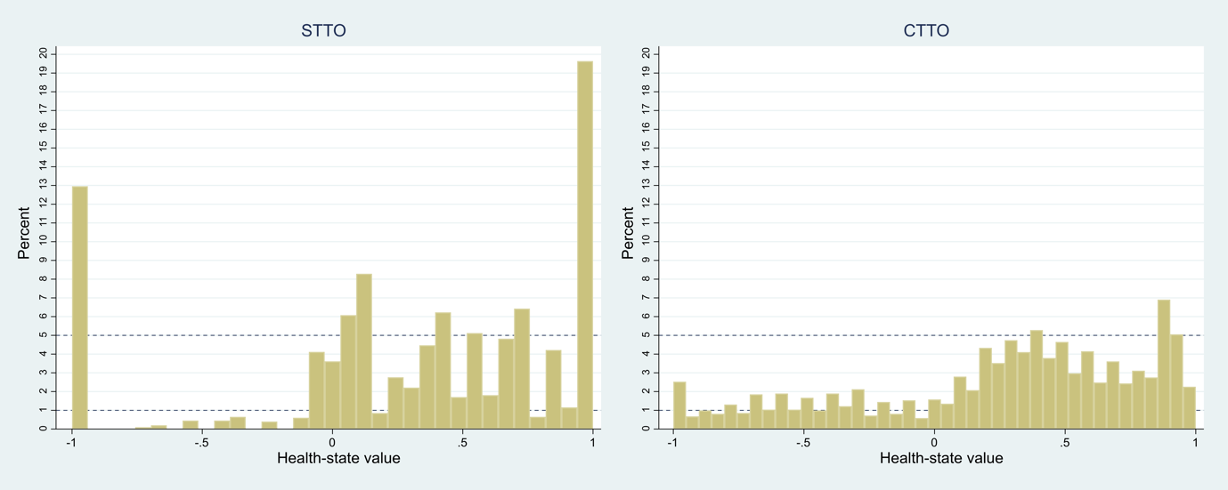
Exploring self-administered time trade‑off valuation of EQ‑5D‑5L health states: Is it feasible and how is it compared with cTTO?
Xin Zhang,¹ Zhihao Yang,² Nan Luo¹
¹National University of Singapore, Singapore; ²Guizhou Medical University, China
Objectives
Our earlier study of two non-iterative TTO methods (open TTO or oTTO and non-stopping TTO or nTTO) suggested that EQ-5D health states can be valued using methods posing less administration burden to both interviewers and interviewees compared to cTTO. Inspired by recent exploration of online cTTO, we developed a self-administered TTO method without the assistance of interviewers, hereafter referred to as sTTO) by combining the two non-iterative TTO methods to firstly use oTTO to determine boundaries of the indifference interval and then use nTTO to identify the indifference point in a valuation task. The aim of this study was to assess the feasibility of sTTO by comparing it with cTTO in a general population sample.
Methods
Thirty EQ-5D-5L health states selected from an orthogonal array were valued by a general population sample recruited from Guizhou Province, China. A computer-based tool similar to EQ-VT was developed for the valuation of EQ-5D heath states using sTTO. Instead of using an interviewer, a pre-recorded video was displayed to participants to explain the valuation task before they were asked to complete 11 sTTO tasks without interviewer assistance and without practicing. For comparison with cTTO, data collected in a previous study following EQ-VT protocol was utilized in this study. We compared the administration burden, logical consistency, value distribution, and modelling performance of the two methods.
Results
Demographics In total, 324 participants contributed data to this study, with 143 using cTTO method and 181 using sTTO method. Demographic characteristics were comparable between participants using the two methods, including gender, age, education, self-reported health state, disease experience. Administration burden, logical inconsistency, value distribution, and model performance The time for completing sTTO based survey and one single valuation task was 26 mins and 1.5 mins shorter, respectively, compared to cTTO (Table 1). Logical inconsistency was observed among 78% participants using sTTO, with 51% showing severe logical inconsistency. Those proportions were 1.4% and 14% for the cTTO (Table 1). The mean health-state value of sTTO (0.293) was slightly higher than that of cTTO (0.256). The cTTO values presented a smoother (less spikes) and more continuous (less gaps) distribution compared to the sTTO values (Figure 1), with more unique values and wider range. The cTTO outperformed the sTTO in modelling performance in all criteria including face validity of coefficients, model fit, and prediction performance (Table 2).
Results
Table 1 Administration burden, logical inconsistency, and value distribution
TTO performance measure | sTTO (N=181) | cTTO (N=143) | P value
Administration burden
Real task time (minutes) (Mean, SD) | 5.18, 4.81 | 31.11, 9.87 | <0.001
Time completing a single TTO task, (Mean, SD) | 0.47, 0.44 | 2.01, 0.63 | <0.001
Logical inconsistencyª
Respondents made any inconsistent valuation (> 0), (N, %) | 141, 78.90 | 20, 13.99 | <0.001
Respondents made severe inconsistent valuation (> 0.5), (N, %) | 93, 51.38 | 2, 1.40 | <0.001
Value distribution
Mean observed value, (Mean, SD) | 0.293, 0.613 | 0.256, 0.550 | 0.042
Percentage of negative value, (N, %) | 397, 19.94 | 576, 26.00 | <0.001
Mean number of unique values provided by respondent, (Mean, SD) | 5.89, 2.11 | 12.06, 2.35 | <0.001
Deviation^{b} of the actual mean number of unique values provided by respondent compared to the expected mean number | 5.11 | 3.43 | NA
Mean value range by respondent, (Mean, SD) | 1.13, 0.56 | 1.61, 0.31 | <0.001
a. Logical inconsistency occurs when participants give a higher value to a worse health state. Difference exceeding 0 is considered inconsistency, with severe inconsistency defined as differences greater than 0.5. b. Deviation = the expected mean number of unique values provided by respondent – the actual mean number of unique values provided by respondent. The expected mean number of unique values provided by respondent for the sTTO is 11 (each respondent valued 11 states in the sTTO) and 15.49 for the cTTO (each respondent valued 15 to 16 states in the cTTO, the average number is 15.49). The smaller the deviation, the greater the diversity of the unique values by respondent.
Table 2 Modelling results and performance
 | sTTO (N=181) |  | cTTO (N=143)
Model coefficients*, standard errors
Constant | 0.763, 0.043 | 0.763, 0.043 | 0.928, 0.022 | 0.928, 0.022
MO# | -0.120, 0.031 | -0.120, 0.031 | − 0.349, 0.020 | − 0.349, 0.020
SC | -0.143, 0.030 | -0.143, 0.030 | − 0.236, 0.019 | − 0.236, 0.019
UA | -0.120, 0.029 | -0.120, 0.029 | − 0.326, 0.019 | − 0.326, 0.019
PD | -0.092, 0.027 | -0.092, 0.027 | − 0.468, 0.020 | − 0.468, 0.020
AD | -0.129, 0.030 | -0.129, 0.030 | − 0.300, 0.019 | − 0.300, 0.019
L2 | 0.904, 0.129 | 0.904, 0.129 | 0.088, 0.028 | 0.088, 0.028
L3 | 0.960, 0.136 | 0.960, 0.136 | 0.259, 0.024 | 0.259, 0.024
L4 | 1.466, 0.151 | 1.466, 0.151 | 0.718, 0.024 | 0.718, 0.024
Model performance
AIC | 3529.174 | 3529.174 | 1454.01 | 1454.01
BIC | 3579.542 | 3579.542 | 1505.337 | 1505.337
MSE | 0.343 | 0.343 | 0.112 | 0.112
Adjusted R2 | 0.087 | 0.087 | 0.628 | 0.628
*All coefficients are significant at 0.01 level.
Respondents feedback On a 5-point Likert scale (strongly agree=1, somewhat agree=2, neutral=3, somewhat disagree=4, and strongly disagree=5), the mean (SD) feedback scores of sTTO for the three questions were 2.01 (1.10) for “easy to understand”, 2.10 (1.07) for “easy to differentiate”, and 2.27 (1.14) for “difficulty to decide”. In the study for generating new EQ-5D-5L China value set (unpublished), the mean (SD) feedback scores of cTTO were similar as sTTO for the first two questions which were 2.02 (0.66) and 2.08 (0.70); but higher than sTTO for the third question which was 3.25 (0.96).
Conclusion
The sTTO method was substantially time-efficient for EQ-5D-5L health-state valuations, implying acceptable administration burden. However, the sTTO data exhibited inferior quality compared to the cTTO data collected using trained interviewers. Respondent feedback suggested that sTTO presents moderate challenge to respondents, which is slightly less acceptable compared to cTTO as revealed in other studies. These findings suggest that the sTTO in its current design is not feasible for valuation of EQ-5D health states. Future research may test its feasibility for use in group interviews and explore other novel designs that allow self-administration of TTO valuation.
Figure 1 Histogram of TTO values by Method
Notes:
Clean version 2

