Slide 1



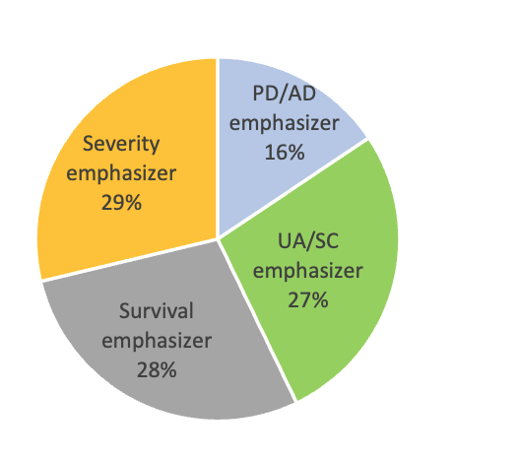
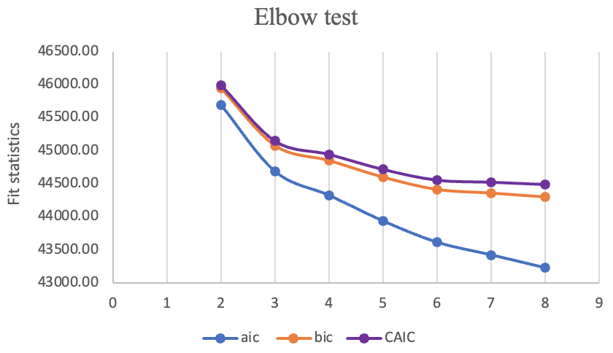
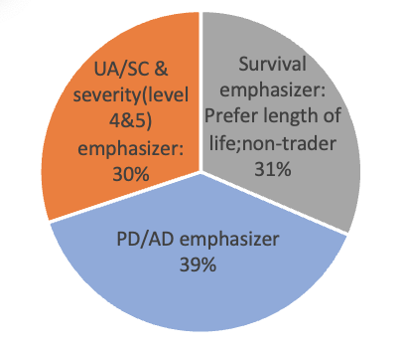
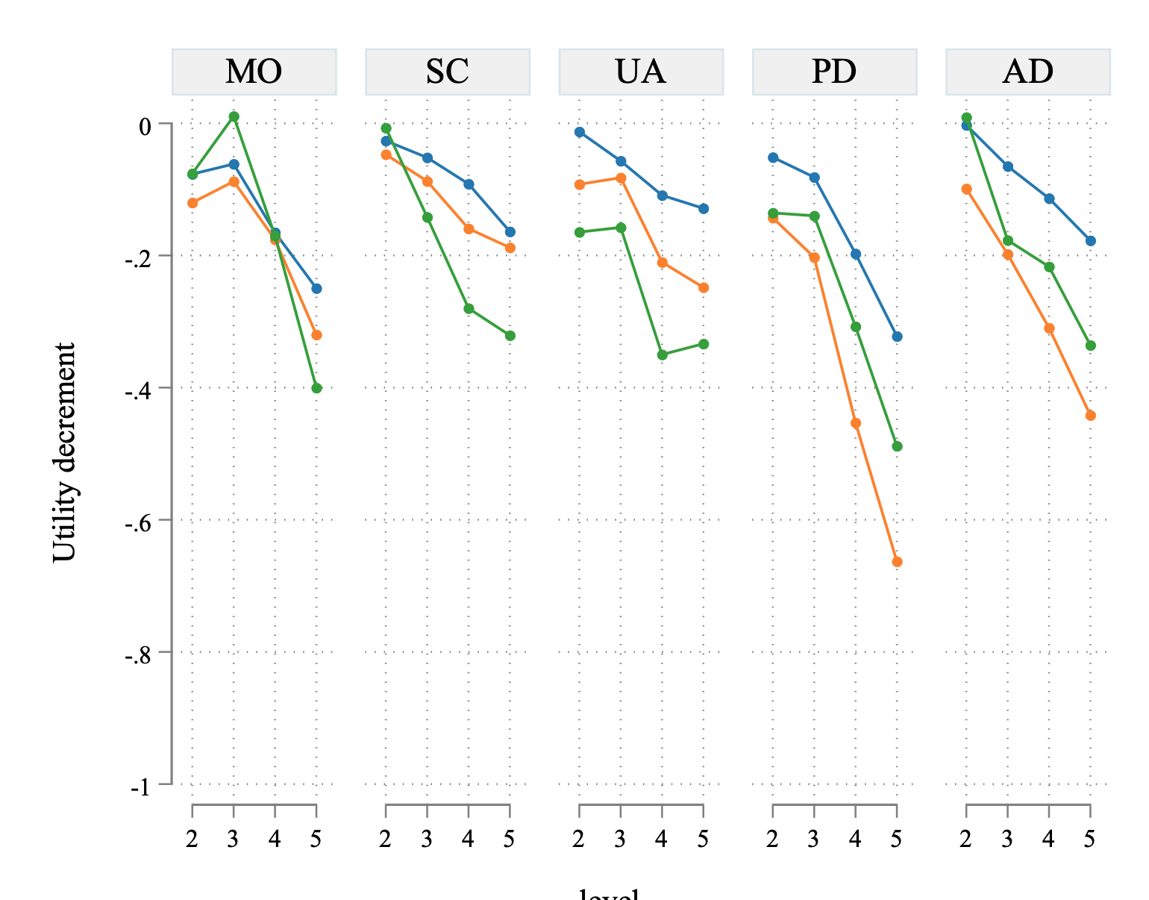
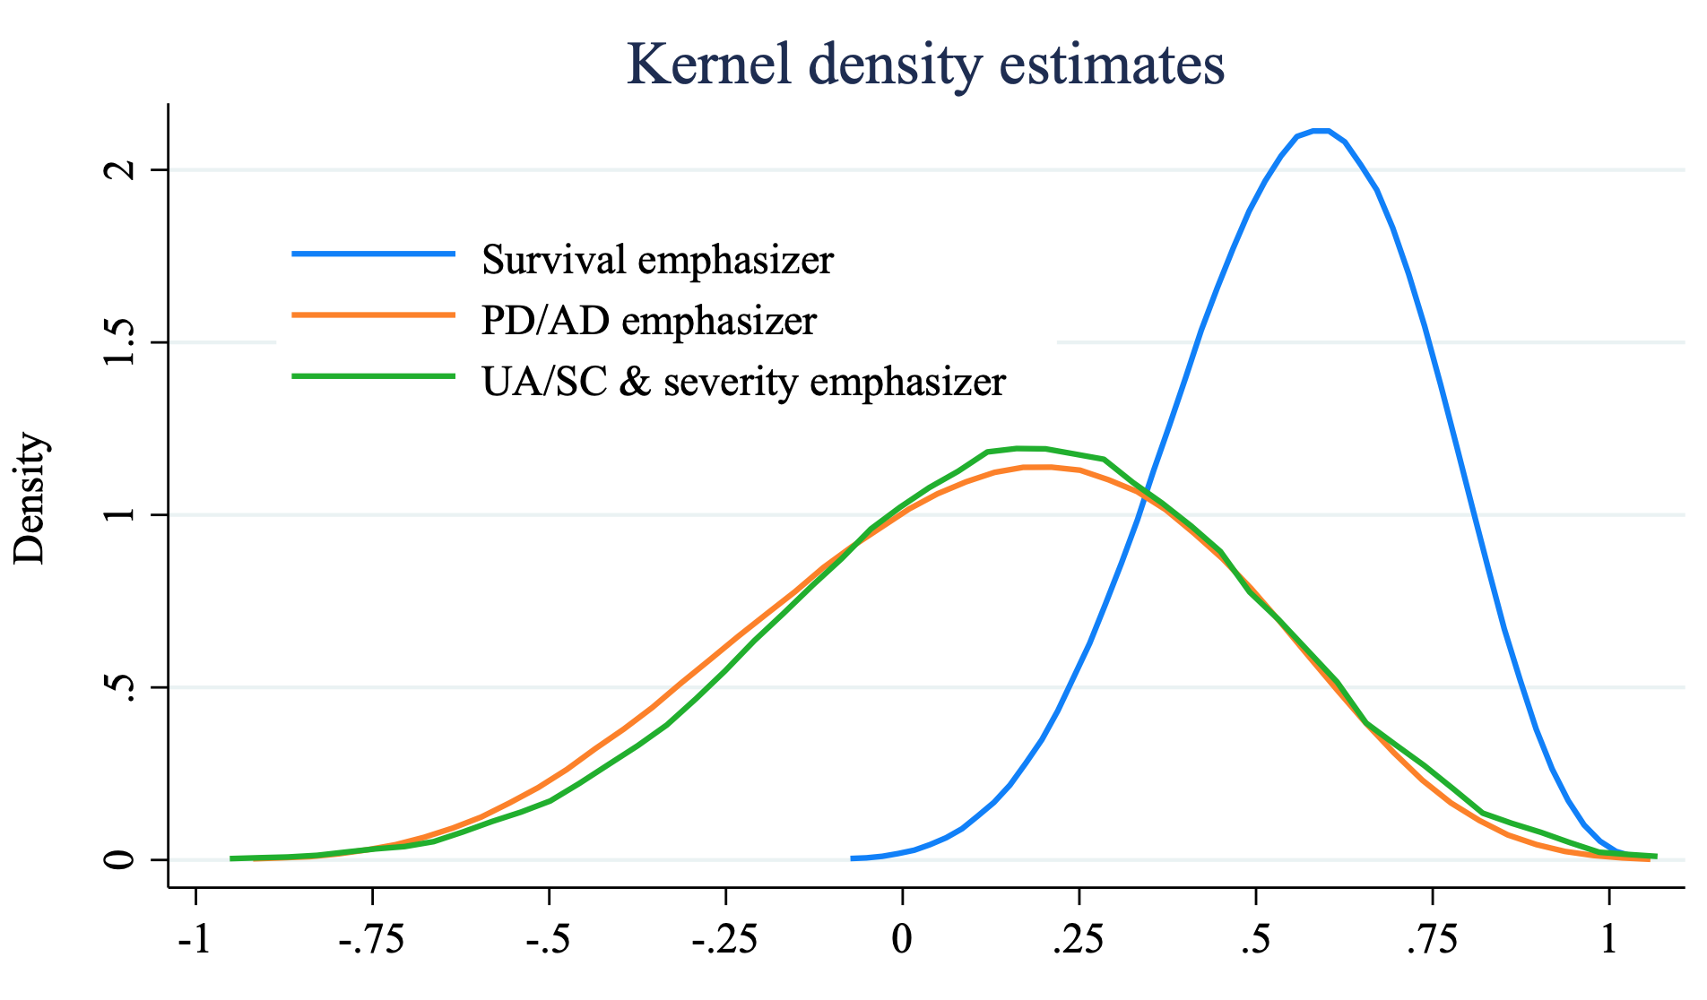
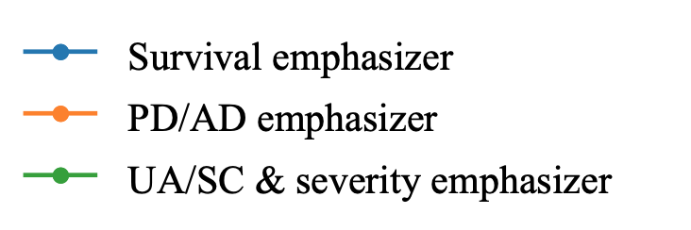
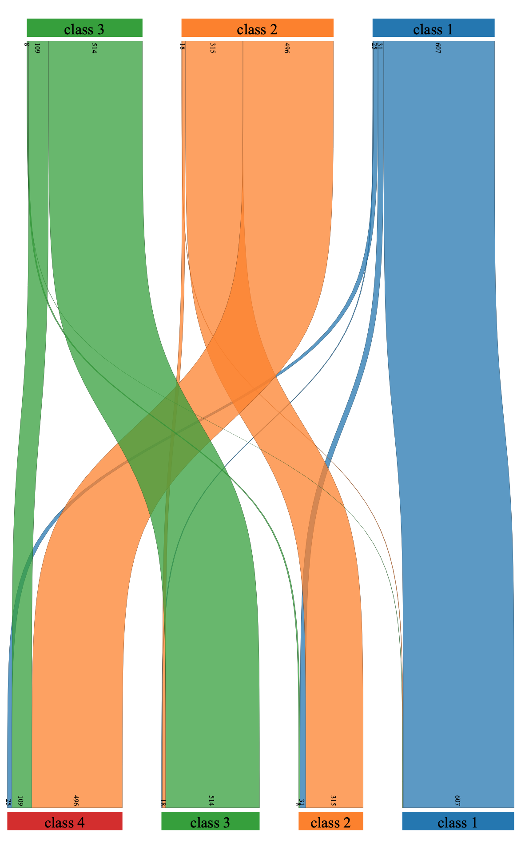
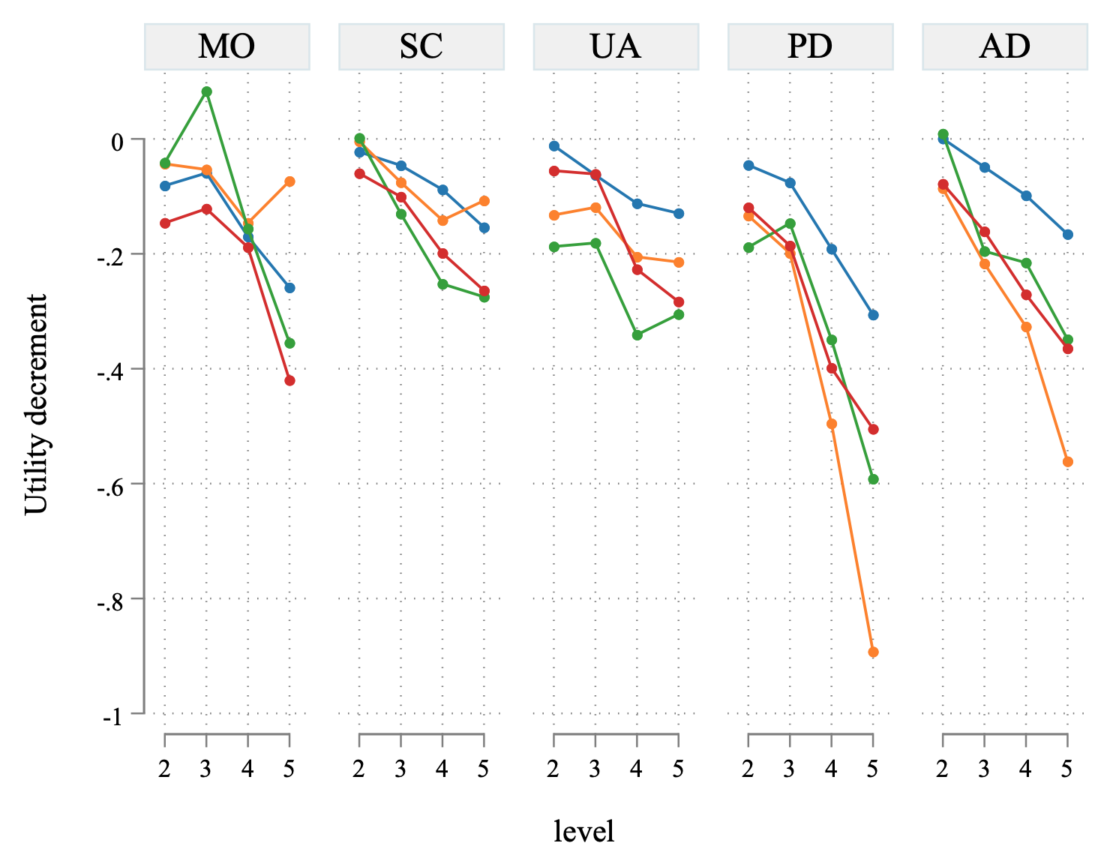
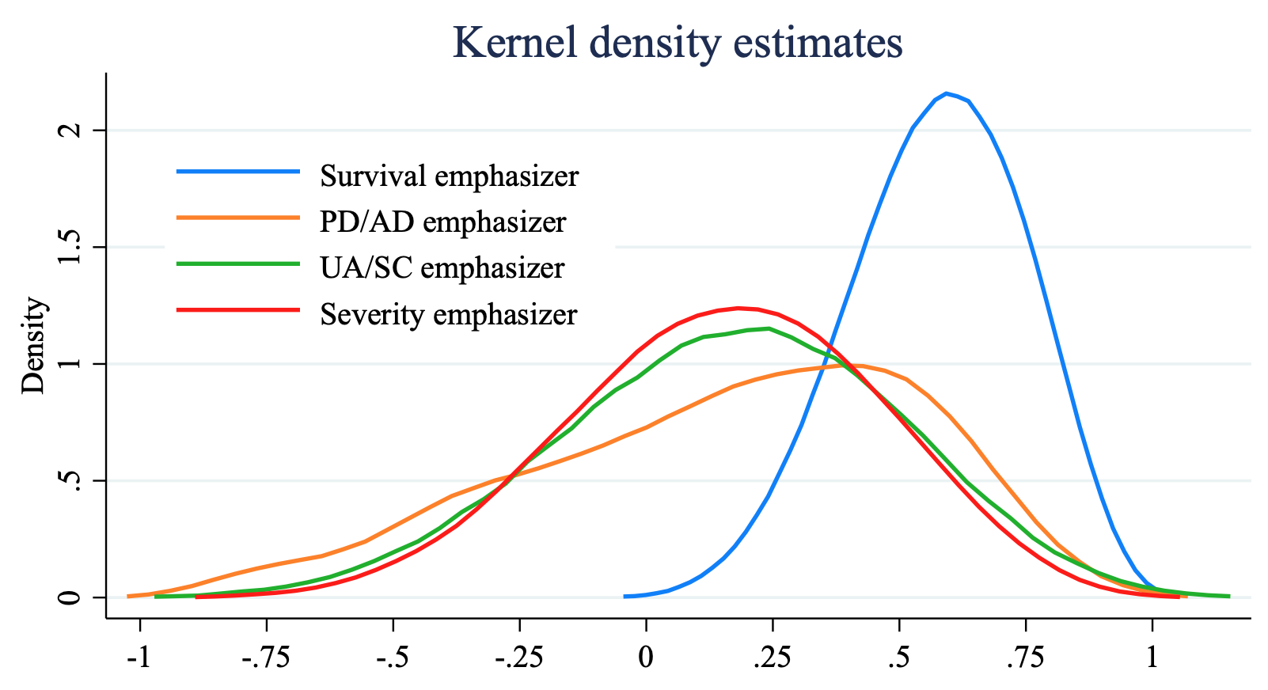
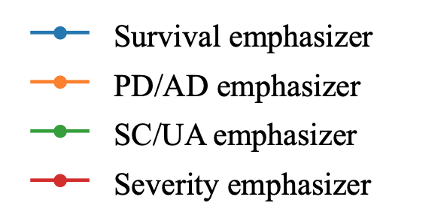
Do adults and adolescents value EQ-5D-Y-5L differently? A quantitative exploration using DCE
Yiting Luo¹, Brendan Mulhern¹, Richard Norman², Deborah Street¹, Rosalie Viney¹ on behalf of the Quality of Life in Kids: Key Evidence for Decision Makers in Australia (QUOKKA) Team
¹ Centre for Health Economics Research and Evaluation (CHERE), University of Technology Sydney, ² Curtin School of Population Health, Curtin University
OBJECTIVES
RESULT 1. DESCRIPTIVE STATISTICS
RESULT 2. LCA class identification
An important hurdle for the development of value sets for EQ-5D-Y-5L is the largely unaddressed normative and methodological questions regarding whose preferences, which elicitation techniques, and which perspectives should be used. This study investigates the impact of perspectives on preferences in adult and adolescent populations using both latent DCE and DCE with duration (DCE_{TTO}) and its preference heterogeneity.
 |  | latent DCE |  | DCE_{TTO} | DCE_{TTO}
 |  | self | 10yo | self | 10yo
Adult sample |  | Adult sample
 | n=504(%) | n=504(%) | n=504(%) | n= 507(%) | n=505(%)
Age (in years)
18-44 | 246(48.81) | 246(48.81) | 247(49.01) | 253(49.90) | 247(48.91)
45-64 | 152(30.16) | 152(30.16) | 154(30.56) | 148(29.19) | 153(30.30)
65+ | 106(21.03) | 106(21.03) | 103(20.44) | 106(20.91) | 105(20.79)
Adolescent sample |  | Adolescent sample
 | n=513(%) | n=513(%) | n= 517(%) | n=545(%) | n=576(%)
Age (in years)
12-14 | 256(49.90) | 256(49.90) | 261(50.48) | 281(51.56) | 292(50.69)
15-17 | 257(50.10) | 257(50.10) | 256(49.52) | 264(48.44) | 284(49.31)
Class Share
3-class model and 4-class model were selected
METHODS
3-class model
4-class model
Design 250 DCE_{TTO} choice sets and 100 latent DCE choice sets were designed. A four-arm study was conducted for both adult and adolescent samples. In each arm, each respondent was presented with 20 choice sets (Table 1).
Online survey to a representative sample of the Australian adult population and paediatric population aged between 12-17 years old
with respect to age, gender and region
Analysis
Conditional logit models were used to estimate utility weights for the latent DCE and the DCE_{TTO} (results can be provided upon request).
Latent class models were used to assess the preference heterogeneity. Demographic covariates including age, gender, and perspectives were used on pooled data.
RESULT 3. Values by class
 | Classes description | 55555 value | Predictors
 | class: Survival emphasizer | -0.042 | 10yo persp
3-class model | class: PD/AD emphasizer | -0.861 | 10yo persp, age 15-17, age 40+, female
 | class: UA/SC & severity emphasizer | -0.879 | reference
4-class model | class: Survival emphasizer | -0.014 | 10yo persp, age 12-14, male
 | class: PD/AD emphasizer | -0.849 | 10yo persp
 | class: UA/SC emphasizer | -0.876 | age 12-14, male
 | class: Severity emphasizer | -0.837 | reference
3-class model
UA/SC & severity
emphasizer
PD/AD
emphasizer
Sankey diagram
Survival emphasizer
UA/SC emphasizer
Severity
emphasizer
Table 1. 4 arms in each of the sample
PD/AD
emphasizer
Arm | Task format | Perspective
1 | DCE latent | a 10-year-old child perspective
2 | DCE latent | Self-perspective
3 | DCE_{TTO} | a 10-year-old child perspective
4 | DCE_{TTO} | Self-perspective
4-class model
_{Conclusion}
This study is one of the first EQ-5D-Y-5L valuation studies in both adult and adolescent samples. Preference heterogeneity was identified in the pooled data. Variation in values and preference patterns can be driven by the age (sample), gender, and perspectives used. Overall, ”non-trader” respondents were more likely valuing from a 10-year-old perspective.

