Slide 1
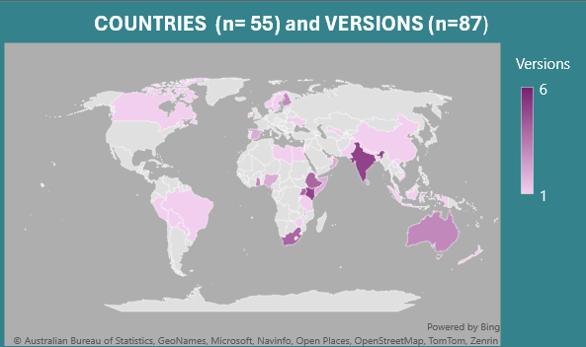
Could you please speak more clearly? ( “Alternative Wordings for the EQ-5D descriptive systems: Optimising Measurement Excellence”(AWESOME) project.) Jennifer Jelsma, Sarah Derrett, Mike Herdman, Bas Janssen, Brendan Mulhern, Fanni Rencz, Valentina Rupel
OBJECTIVE
RESULTS
This poster presents preliminary results of the first stage of the AWESOME project. We aimed to identify common linguistic challenges encountered during the translation process by reviewing Cognitive Debriefing (CD) reports included in translation projects of EuroQol instruments.
47% of respondents gave atypical responses to one or more of the probing questions. Of these 2572 inappropriate or unclear responses, 2044 (80%) could be assigned to one of the 4 pre-identified categories.
Examples
NHC: A lot of problems with MOB “a baby who is learning to walk maybe”.
Interpretation: PD Discomfort: “That you don’t feel sure, that you don’t feel you fit in, that you are shy.” AD: “Extremely anxious is you are so happy; you cannot be happier”
Dual Wording: One component ignored: e.g. Leisure ignored in UA and only work referenced. No distinction made e.g., Y AD: “Unhappy is no different from sad; If someone is sad then he is an unhappy.”
Qualifier: “it is difficult to explain the exact degree of intensity between some and a lot.” “it’s not easy to come up with a 100% equivalent to “some” in Arabic, especially one that children would understand.”
METHODS
Figure 3
Analysis of CD reports from January 2018 to March 2023: CD data were transcribed, and responses were categorized into the following predetermined categories by 2 independent researchers.
Not-health centred (NHC) examples
Interpretation of the concept
Challenges with composite or dual wording
Level Qualifier issues
Most challenges were in the AD dimension, followed by SC (Fig 2). Within dimensions, AD had the highest % of challenges categorised to NHC, SC to Interpretation, PD to Dual Wording and SC to Qualifier(Fig. 3)
DISCUSSION AND CONCLUSIONS
Different dimensions present different challenges. Certain concepts may be “too nuanced” and thus interpreted differently across cultures and contexts. The “health centred” aspect of the EQ-5D is often neglected and could be emphasised more.
The results will inform the next phase of AWESOME and possibility lead to the development of a “simplified” English source version that retains core concepts while reducing non-essential, potentially confusing information.
SAMPLE
642 respondents
87 reports
5 countries
54% Y- version
14300 probing questions responses
.
ACKNOWLEDGEMENTS
EURO-QOL Research Foundation for funding EQ Project 1713-RA
VMC Office for assisting in accessing reports
Respondents and translators for sharing their thoughts and ideas.
Figure 1
Figure 2

