Slide 1
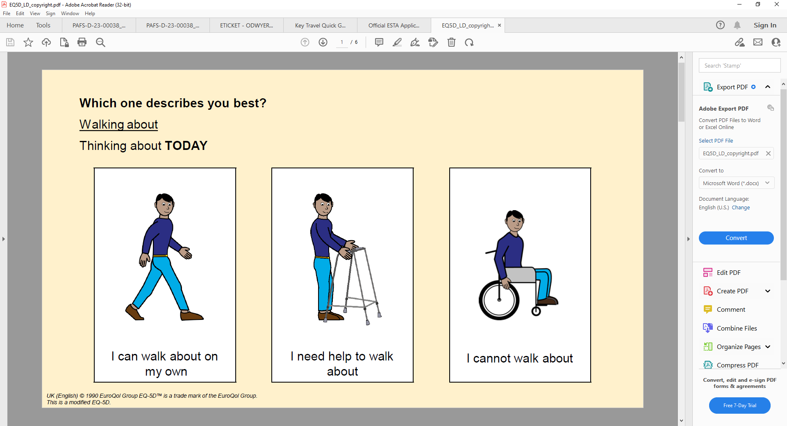
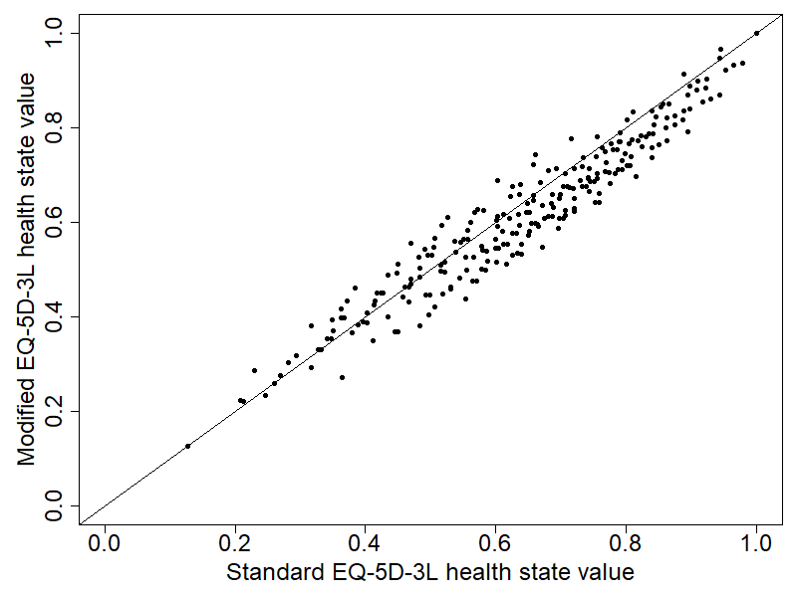
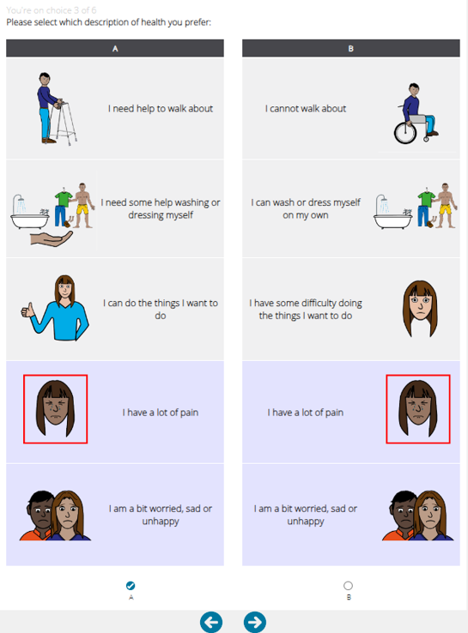


Valuing Health States in Adults with Learning Disabilities: A Discrete Choice Experiment with a Modified EQ-5D-3L
John L. O’Dwyer¹, Edward J.D. Webb¹, Claire Hulme², Louise Bryant¹, Paul Kind³, David Meads¹
¹ Leeds Inst. of Health Sciences, University of Leeds; ² Dept. of Health & Community Sciences University of Exeter Medical School; ³ Dept. of Applied Health Research, University College London
Phase 1:
Development of a modified EQ-5D-3L to improve accessibility, reliability, and inclusivity, facilitating self-completion for adults with learning disabilities.
E.g. Walking about (Mobility)
Results
Scatterplot of Values of Standard EQ-5D-3L and Modified EQ-5D-3L Health States
No statistically significant differences were observed in utility values between the modified and standard versions.
The logical ordering of coefficients supports validity and reliability of the model.
Participants showed strong preferences for avoiding severe pain, discomfort, and mobility limitations.
VAS anchoring successfully mapped DCE responses onto a 0–1 scale.
The modified EQ-5D-3L produced lower utility values, particularly for severe health states, indicating that participants rated these conditions as worse compared to the standard version.
Phase 2:
Establish feasibility, reliability and validity
Phase 3: Valuation Study
Objective
Assess, using an online DCE with a representative UK sample, whether the modified EQ-5D-3L produces comparable utility values to the standard version.
Methods
Attributes: EQ-5D-3L dimensions for standard and adapted formats.
Explicit partial profiles with six blocks of six choice sets to reduce burden.
Identical choice tasks using both standard and modified EQ-5D-3L versions.
Participants assigned to either standard or modified DCE first to control order effects.
Piloted to ensure clarity, feasibility, and comprehension before the main roll-out. Dominance test for invalid responses; time threshold for engagement.
Example Choice Task
Conclusion
The modified EQ-5D-3L was successfully valued using a DCE-VAS approach.
The modified version maintains comparable utility values to the standard EQ-5D-3L, with strong preferences for avoiding severe health states.
Next steps include further refinement and validation for broader policy application.
Funded by the NIHR Doctoral Research Fellowship programme (DRF 2017-10-159). The views expressed are those of the authors and not necessarily those of the NIHR or the Department of Health and Social Care. All Intellectual Property Rights in connection with the modified EQ-5D-3L for adults with mild to moderate intellectual disabilities are vested in EuroQol. Ethical Approval: University of Leeds School of Medicine Research Ethics Committee Ref: MREC 19-081.
Anchoring: VAS task anchored DCE responses onto a 0–1 scale.
Statistical Analysis: Mixed logit models estimated and compared utility values.
Contact: j.odwyer@leeds.ac.uk

