Slide 1
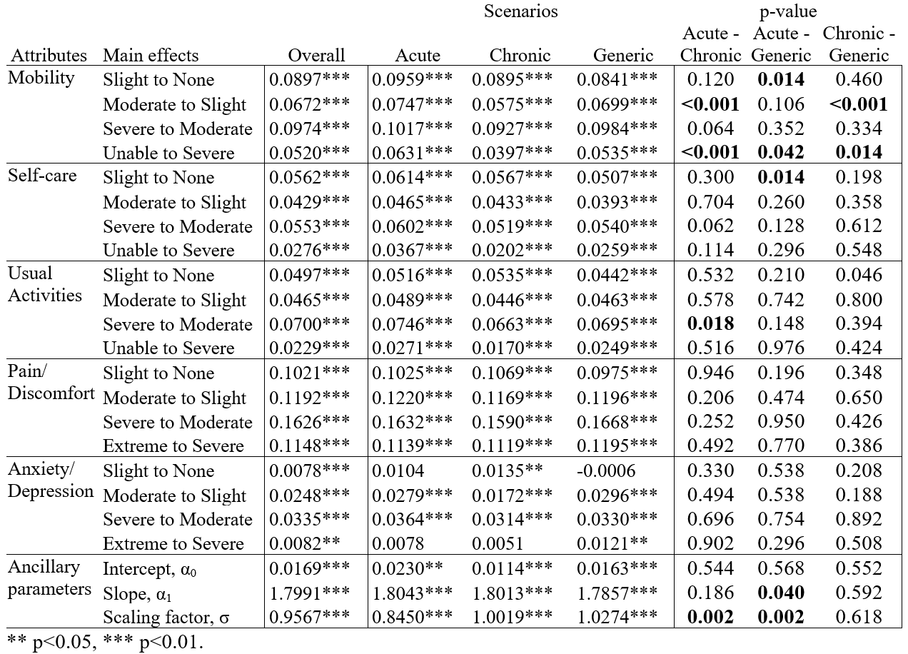
Does the end matter?
US EQ-5D-5L values for acute, chronic and generic episodes
Benjamin M. Craig, University of South Florida, Tampa
The 9th EuroQol Academy, 2025, March 11, Barcelona, Spain
OBJECTIVES
Warm-up kaizen task
RESULT #2
DISCUSSION
To examine how preferences over chronic episodes (i.e., ending in death) differ from those of acute episodes (i.e., when a person recovers) or when the episode is not described (generic).
The value of generic episodes are unstable.
In this study, the DCEs with generic episodes either occurred before or after the DCE with acute or chronic episodes.
Generic main effects differ significantly
depending on its predecessor, but the
acute and chronic main effects did not.
LESSON #2 : This evidence suggests that
choices during latent-scale tasks differ
when they occur before and after the
cTTO because respondents infer the
chronic scenario from the prior tasks.
Should a chronic scenario be added to the latent-scale tasks?
Yes. However, which episode should they have? Likely a 10-year chronic episode (e.g., cTTO).
Should we conduct more dual-DCE surveys with kaizen tasks?
Yes. They shows promise, but they also have their limits. For example, kaizen tasks rely on paired comparisons for scaling.
METHODS
Warm-up paired comparison
In 2024, 6018 US respondents completed an online survey with two discrete choice experiments (DCEs) back-to-back. Their sequence was randomized, creating six arms.
Each DCE included 15 kaizen tasks and 5 paired comparisons.
Main-effects conditional logit with bootstrapped SE, p-values, & 95% CI.
Effects are on an experience scale, where 1 is full health and 0 is no experience (i.e., “being in a coma”)
Table 1. Main effects by Scenario
RESULT #3
CONCLUSIONS
Dual-DCE surveys with kaizen tasks are a cost-effective way to compare scenarios.
Each of the 6 arms contained 5 single-block designs with 2 DCEs back-to-back (6 x 5 x 2 = 60 5L value sets).
In this study, we found no block effects. This capability of producing high-quality value sets with small samples facilitates testing of different scenarios, descriptive systems, and perspectives, instead of using a one-size-fits-all approach.
For example, 100 respondents may complete a DCE on Y-3L then one on Y-5L, allowing comparison of preferences.
LESSON #3 : This evidence
opens the door to a range of
empirical discoveries that
were previously unaffordable
due to the constraints of the
preference elicitation tasks.
This study shows how the values of some dimensions depend on the ending. For the EQ-5D-Y, EQ-TIPS, and bolt-ons, the end may matter.
Excluding description from a scenario causes the choices to become unstable.
If interested in dual-DCE surveys or kaizen tasks, contact me and we can collaborate on a EuroQol proposal.
Craig BM, Health valuation protocol for dual discrete choice experiment (dual-DCE) surveys to estimate the effects of different scenarios and attributes on main effects, BMJ Open, forthcoming
RESULT #1
Few differences in main effects among the three episodes (Table 1)
Differences are not significant, except for mobility
Acute losses in mobility have a higher value that chronic ones, because death implies no need to adapt (futility of adaptation).
The value of generic losses reside between acute and chronic ones.
LESSON #1 :
The value of mobility
seems to depend on
whether the person
recovers or dies
in the end.
Skip PT
ACKNOWLEDGEMENT
This study was funded by the EuroQol Research Foundation (464-RA).

