Slide 1
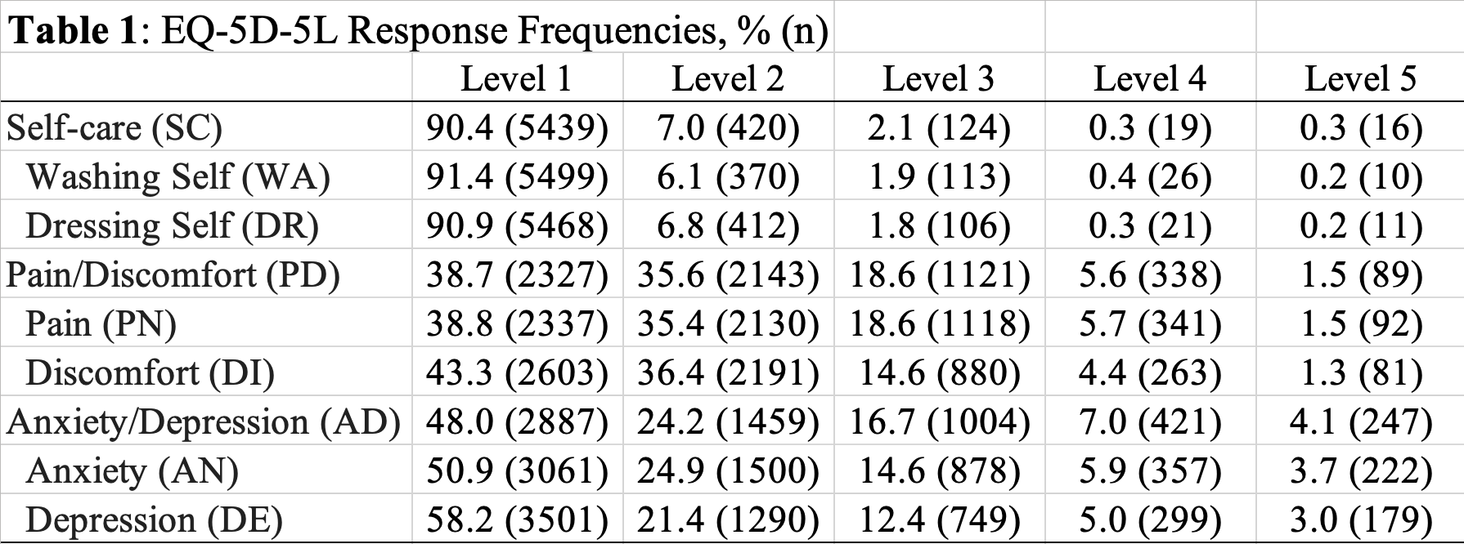
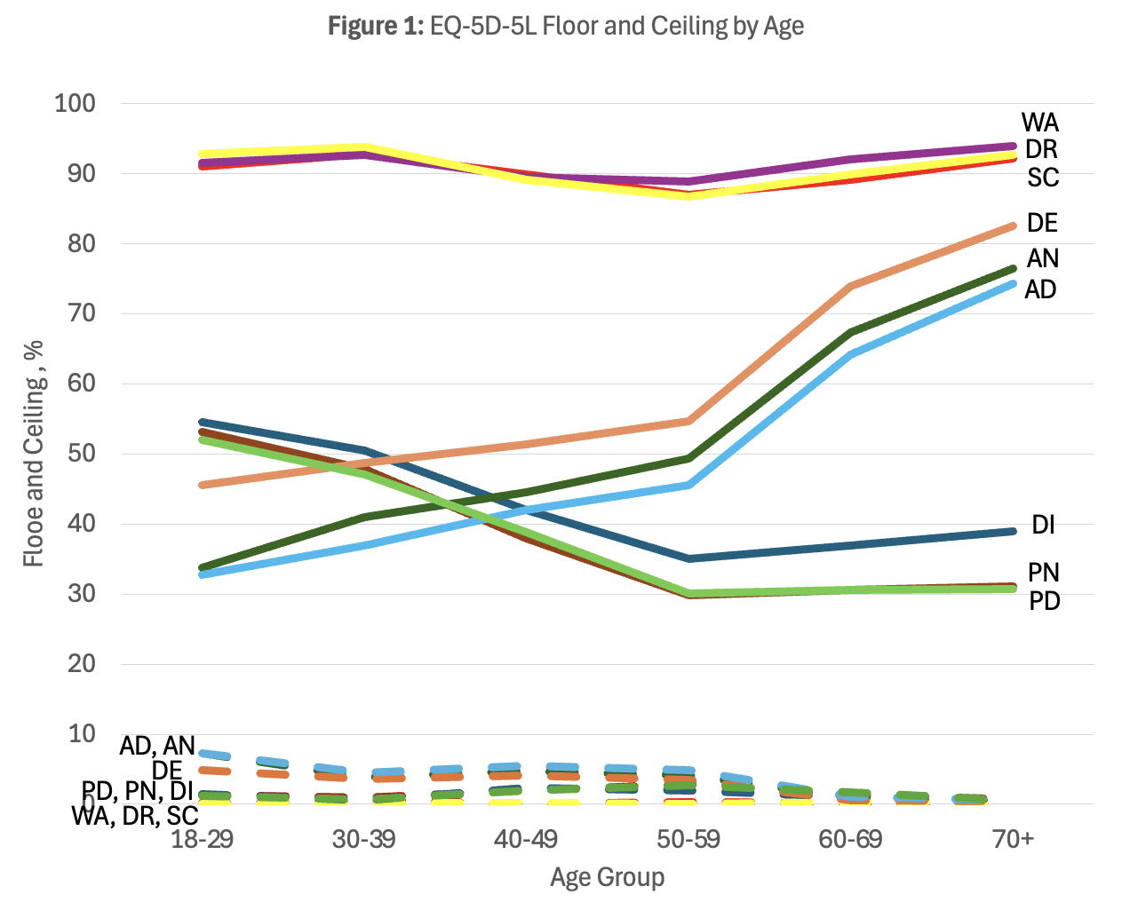
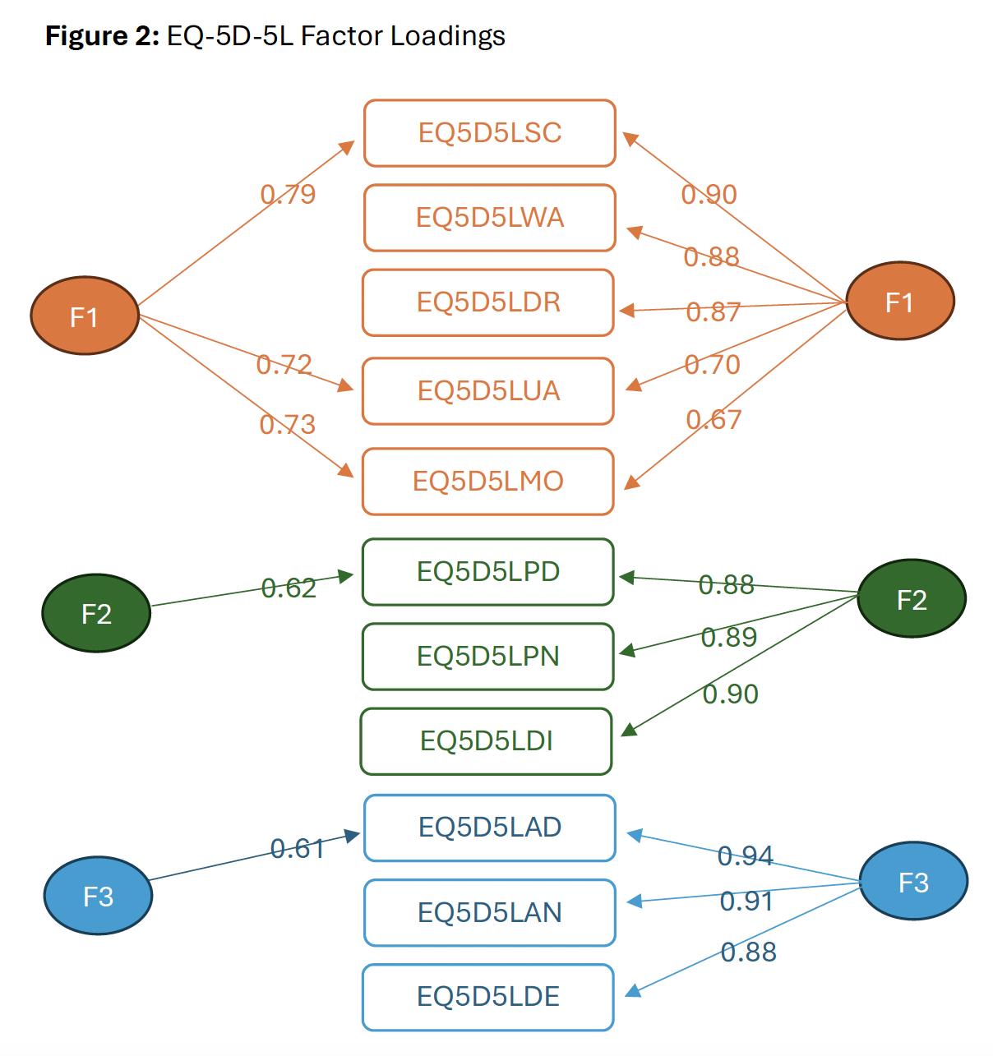
The Psychometric Performance of Six EQ-5D-5L Dimension-Specific Components Overall and by Age Group
Minh Pham¹, Benjamin M.Craig¹, Fanni Rencz²
¹University of South Florida, Tampa, ²Department of Health Policy, Corvinus University of Budapest, Budapest
The 9th EuroQol Academy, 2025, March 11, Barcelona, Spain
OBJECTIVES
RESULT #2
DISCUSSION
This psychometric analysis compares the performance of : washing self (WA), dressing self (DR), pain (PN), discomfort (DI), anxiety (AN) and depression (DE), in a general population sample (n = 6018), of US adults, age 18+.
Dimensionality of Components:
Figure 2 shows strong alignment between components and composites.
Correlations between AD and PD composites and their components slightly increased with age, while SC showed a more pronounced increase.
Across the six age groups, the same three factors emerge with or without components.
LESSON #2: The EQ-5D-5L constructs are consistent with or without components, both in the overall sample and by age groups.
Should we develop the two SC components further? No. Among the items, the SC components are less informative. Instead, we may explore expanding SC by adding more activities, such as “eating” and “using the toilet”.
METHODS
We assessed each component by floor and ceiling, informativity (Shannon’s indices), convergent validity (rho), and structural validity, exploratory factor analysis)
We first conducted these analyses on the full sample then by age.
Frequency of Level 1 responses
CONCLUSIONS
The strong performance of the the AD and PD components may motivate their inclusion in an expanded version of the EQ-5D-5L, particularly when surveying older adults.
Although this is a general population study, SC components don’t have potential as deep dive items. Instead, it is recommended expanding SC activities beyond washing and dressing.
Regardless, any changes should not alter the EQ-5D-5L factor structure, overall or by age group.
“Components and composites have similar relationships with age”
Without components
With components
RESULT #1
Descriptive Characteristics of Components
Table 1 shows more problems in the composites than their components
Shannon indices range from 0.523 (WA) to 1.838 (PN), with relatively lower values observed for WA and DR.
The floors (dash lines, Figure 1) decreases with age.
LESSON #1 :
The AD and PD
components have
potential as deep
dive items.
Frequency of Level 5 responses
ACKNOWLEDGEMENT
This study is funded by the EuroQol Research Foundation (1970-RA).

