Slide 1
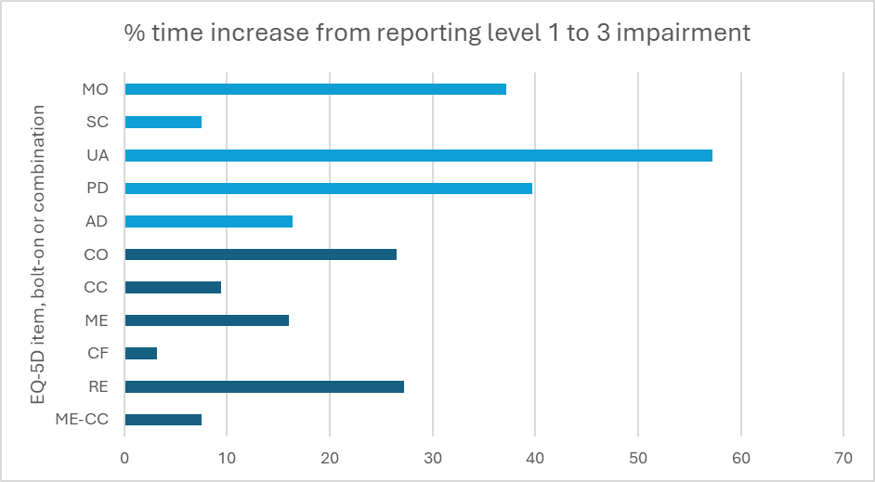
Memory and Concentration Are Two or More EQ-5D-5L Bolt-On Items Better Than One Composite Cognition Item?
Objectives:
Over 50 different bolt-on items exist for cognition, but few studies have assessed the measurement properties of multiple cognition bolt-ons for the EQ-5D-5L.
This cross-sectional study evaluates the psychometric performance of five bolt-ons (a composite: Cognition (CO) and four components: Concentration (CC), Memory (ME), Confusion (CF), and Reasoning (RE))
and whether their contributions justify the added response time burden.
Results:
Item-Level Performance: J' values ranged from 0.403 (RE) to 0.629 (ME), highlighting diverse response distributions. Correlations with EQ-5D-5L items were moderate, with the highest (CC-Anxiety/Depression: 0.722). Correlations between the bolt-ons were all >0.7, suggesting overlap between items.
Instrument-Level Performance: R² values ranged from 0.0855 (RE) to 0.1575 (CC). Incremental R² increases were highest for CO (+0.0045). EQ-5D-5L ceiling was at 25.31%; adding bolt-ons reduced this by up to 3.01 percentage points (ME). Two-item modules (ME-CC) showed the best performance, reducing the ceiling by 3.63 percentage points and adding ~13 seconds.
EFA Findings: Identified three factors: cognitive items, functioning items, and Pain/Discomfort-Anxiety/Depression.
Pain/Discomfort cross-loaded with functioning, while Anxiety/Depression overlapped with cognitive items – indicating a link between cognitive impairment and Anxiety/Depression.
Response Burden: EQ-5D-5L alone = 44 seconds, increasing to 68 seconds with all four bolt-ons.
ME-CC adds ~13 seconds, similar to adding CO (9 seconds).
Methods
Design: Cross-sectional online survey with 6,018 respondents representing the U.S. general population. Bolt-ons were presented in a fixed order after EQ-5D-5L dimensions (CO, CC, ME, CF, RE). CO was phrased as: "Cognition (e.g., concentration, memory, confusion, reasoning). I have no problems concentrating, remembering things, understanding things, or making decisions”, with response levels ranging from no problems to extreme problems.
Assessments:
Item-Level Properties: Informativity (Shannon's evenness index, J'), ceiling reduction, and divergent validity (polychoric correlations with EQ-5D-5L items).
Instrument-Level Properties: R² values predicting EQ VAS, comparing the explanatory power of individual items and multi-item modules (2-, 3-, and 4-item combinations), and exploratory factor analysis (EFA) to evaluate item fit within the EQ-5D-5L framework.
Response Burden: Median response times (seconds) for items and modules to estimate additional burden.
Variable | Factor 1 | Factor 2 | Factor 3 | Uniqueness
CO | 0.8450 | 0.1466 | 0.2484 | 0.2029
CC | 0.8237 | 0.1159 | 0.3176 | 0.2072
ME | 0.7802 | 0.1704 | 0.2428 | 0.3033
CF | 0.8388 | 0.2058 | -0.0079 | 0.2539
RE | 0.8085 | 0.1795 | -0.0488 | 0.3117
MO | 0.0589 | 0.8413 | 0.2452 | 0.2285
SC | 0.2348 | 0.8218 | -0.1370 | 0.2508
UA | 0.2269 | 0.7970 | 0.2762 | 0.2371
P/D | 0.1380 | 0.5468 | 0.6801 | 0.2195
A/D | 0.5450 | 0.0597 | 0.6362 | 0.2946
ME-CC shows less time increase compared to the composite bolt-on and EQ-5D items |
Factor Loadings for EQ-5D Dimensions and bolt-ons (Minimum Eigenvalue = 0.7)
Conclusion:
The ME-CC module demonstrated better performance than the composite bolt-on (CO) in reducing the ceiling, with greater informativity and explanatory power, while adding minimal burden. These findings suggest targeted cognitive items could offer an effective enhancement to EQ-5D-5L, potentially without redundancy. Future qualitative research could explore the content validity of these dimensions to ensure alignment with patient experiences.
Hannah Hussain (Office of Health Economics, London; hhussain@ohe.org), Benjamin M. Craig (University of South Florida),
Fanni Rencz (Corvinus University of Budapest), Nan Luo (National University of Singapore), Bernhard Michalowsky (German Center for Neurodegenerative Disease (DZNE)

