Slide 1
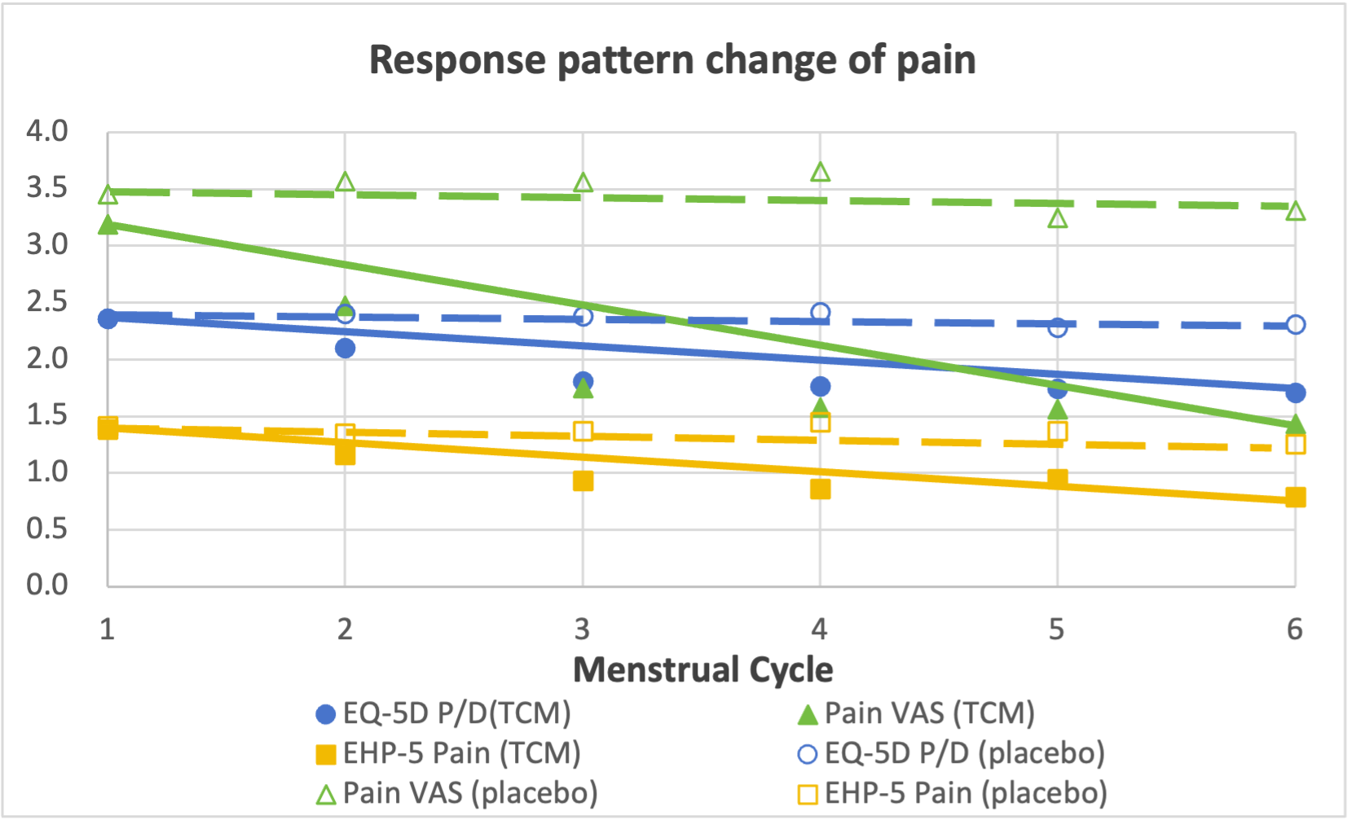
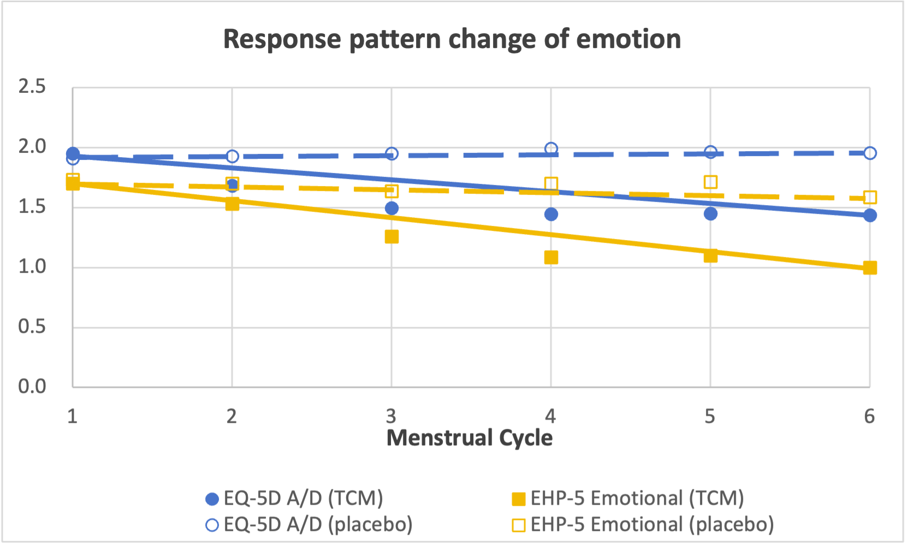
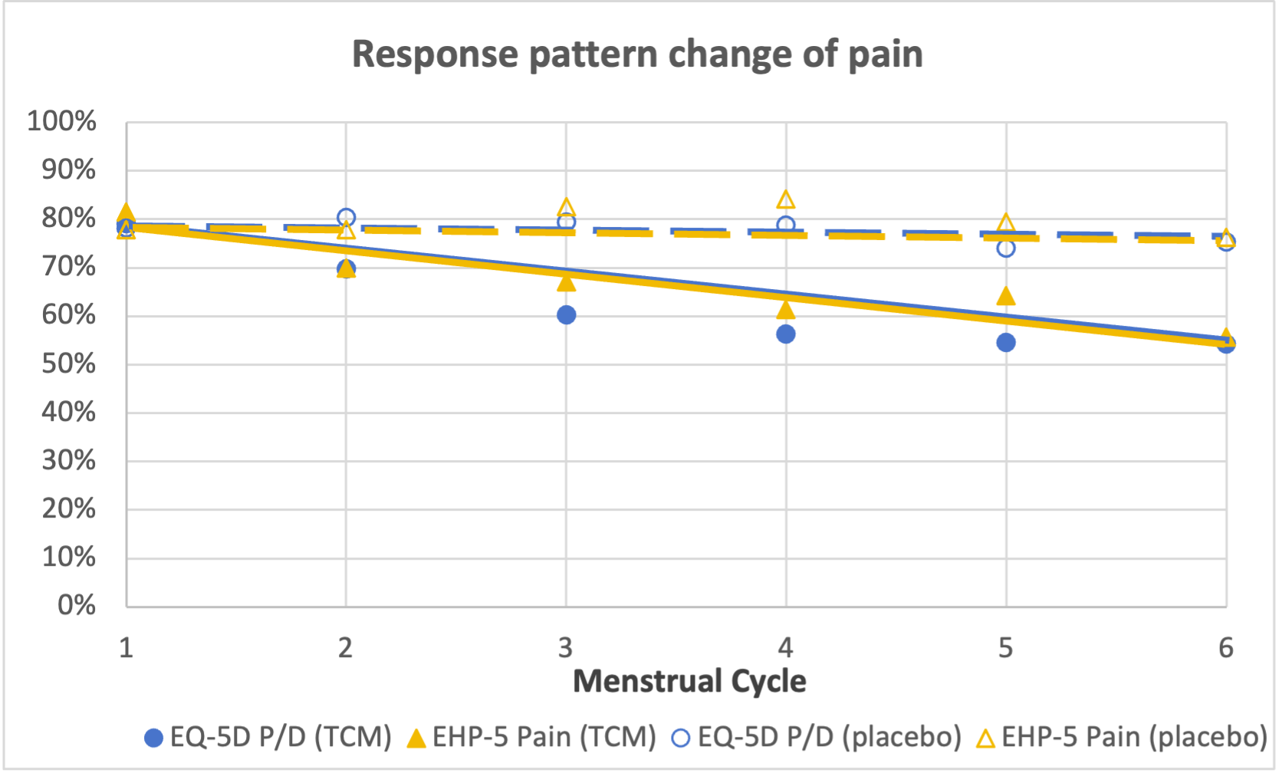
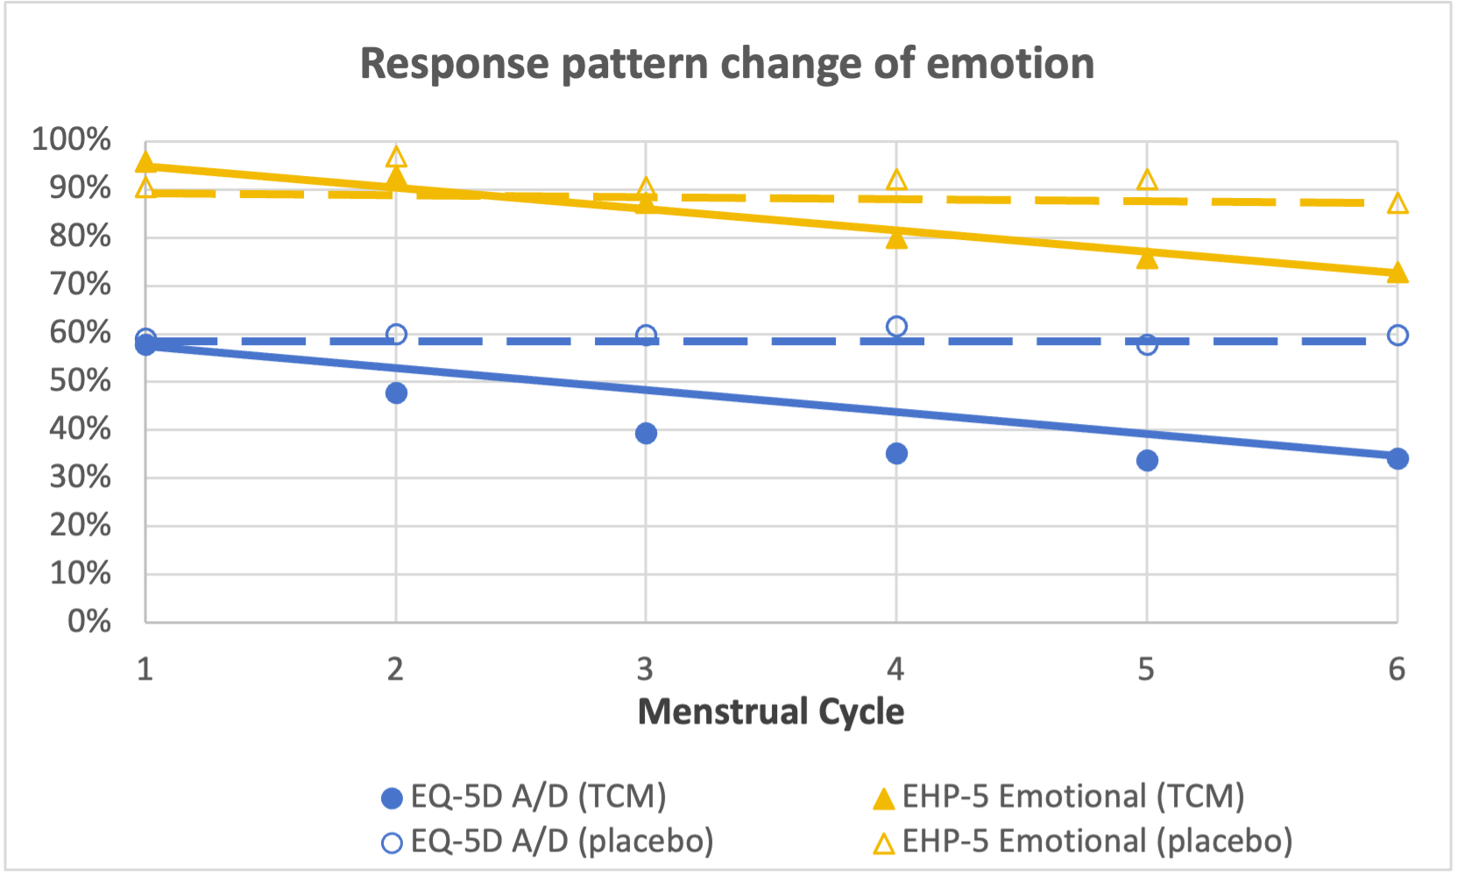
What is the difference between a 1-day recall period and a 4-week recall period for the measurement of cyclical pain like endometriosis dysmenorrhea?
Yusi Suo and Xuejing Jin*
Center for Evidence-Based Chinese Medicine, Beijing University of Chinese Medicine
Background: Endometriosis is a chronic gynecological disorder characterized by the presence of endometrial-like stroma and/or epithelium outside the uterine cavity. The primary clinical manifestation is pain, such as dysmenorrhea. Patients with endometriosis typically experience pain beginning 1–2 days before menstruation.
Objectives: To compare the differences between instruments with 1-day and 4-week recall periods in the measurement of the pain level of cyclical endometriosis-dysmenorrhea.
Methods
Results
Study Design
Six menstrual cycles (MC) RCT on endometriosis-dysmenorrhea in China
Traditional Chinese Medicine (TCM) (n=70) VS. Placebo (n=63)
Measures
EQ-5D-5L (recall period: today/1-day)
Index score: Chinese 5L value set
Pain VAS (recall period: today/1-day)
Range from 0 (No pain ) to 10 (The worst pain)
Endometriosis Health Profile-5 (EHP-5) (recall period: last 4-week)
Disease specific PROM for endometriosis-dysmenorrhea
Core questionnaire: for all patients, 5 items (pain, control, emotional, social support, self image), 5 levels (0~4, never ~ always)
Modular questionnaire: for specific patients, not used in this study
Overall score (transformed): 0-100 (higher, worse)
Patients Characteristics
Variable | TCM (n=70) | Placebo (n=63) | p value
Age, years, mean ± SD | 37.8±6.5 | 37.1±5.3 | 0.840
Duration, years, mean ± SD | 5.7±3.7 | 5.8±3.5 | 0.666
History of surgery, % | 30.0% | 39.7% | 0.241
History of intercourse, % | 88.7% | 90.5% | 0.721
EQ-5D index (Baseline) | 0.524±0.264 | 0.574±0.255 | 0.185
Pain VAS score (Baseline) | 6.5±1.2 | 6.0±1.6 | 0.058
EHP-5 overall score (Baseline) | 38.3±18.4 | 33.4±16.4 | 0.111
MC: menstrual cycle; EHP-5: Endometriosis Health Profile-5.
Correlation Among EQ-5D, Pain VAS, EHP-5
 | Analysis I |  |  | Analysis II
 | rho1 | rho2 | rho3 | rho4 | rho5 | rho6
MC1 | 0.74 | 0.51 | 0.45 | 0.81 | 0.28 | 0.18
MC2 | 0.71 | 0.45 | 0.44 | 0.81 | 0.36 | 0.25
MC3 | 0.77 | 0.47 | 0.52 | 0.79 | 0.39 | 0.33
MC4 | 0.81 | 0.48 | 0.49 | 0.82 | 0.38 | 0.33
MC5 | 0.79 | 0.52 | 0.54 | 0.81 | 0.46 | 0.36
MC6 | 0.83 | 0.52 | 0.52 | 0.79 | 0.44 | 0.39
MC: menstrual cycle; EHP-5: Endometriosis Health Profile-5; rho1: each MC average Pain VAS VS. each MC average EQ-5D P/D; rho2: each MC average Pain VAS VS. each MC EHP-5 Pain; rho3: each MC average EQ-5D P/D VS. each MC EHP-5 Pain; rho4: D5 Pain VAS VS. D5 EQ-5D P/D; rho5: D5 Pain VAS VS. each MC EHP-5 Pain; rho6: D5 EQ-5D P/D VS. each MC EHP-5 Pain.
Correlation analysis
Rho is stronger between instruments with the same recall period than between those with different recall periods.
Hypothesis I: Confirmed
All rho1> All rho2
All rho1> Allrho3
Hypothesis II: Confirmed
All rho4>All rho5
All rho4>All rho6
Response pattern change plot
To compare the ability of different recall periods to capture changes by observing the slope of the line connecting the results from MC1 to MC6.
A larger slope indicates that the corresponding recall period (and instrument) is more capable of reflecting the therapeutic advantage.
Analysis
Spearman correlation analysis
Each MC average Pain VAS VS. Each MC average EQ-5D P/D & Each MC EHP-5 Pain
D5 Pain VAS VS. D5 EQ-5D P/D & Each MC EHP-5 Pain
Response pattern change in scatter plot
EQ-5D P/D D1-D5 average score VS. Pain VAS D1-D5 average score VS. EHP-5 Pain D30
EQ-5D A/D D1-D5 average score VS. EHP-5 Emotional D30
Schedule of Assessment
Measures | MC1 |  | MC2 |  | MC3 |  | MC4 |  | MC5 |  | MC6
 | D1-D5 | D 30 | D1-D5 | D 30 | D1-D5 | D 30 | D1-D5 | D 30 | D1-D5 | D 30 | D1-D5 | D 30
Pain VAS | ● |  | ● |  | ● |  | ● |  | ● |  | ●
EQ-5D | ● |  | ● |  | ● |  | ● |  | ● |  | ●
EHP-5 |  | ● |  | ● |  | ● |  | ● |  | ● |  | ●
MC: menstrual cycle; D1-D5: day 1 to day 5 of menstruation; D30: day 30 of menstruation; EHP-5: Endometriosis Health Profile-5.
Correlation Analysis I
Average score of EQ-5D P/D & Pain VAS
Trends
Pain VAS (1-day recall period) is more sensitive in capturing pain changes in endometriosis-dysmenorrhea over time.
EQ-5D and EHP-5 show similar results.
Limitation
Different results may be due to variations in scale design, construction, the number of levels, and the different assessment time.
Hypothesis: rho1>rho2, rho1>rho3
EHP-5 Pain
EQ-5D P/D D1-D5 average % of patients with problem VS. EHP-5 Pain D30 % of patients with problem
EQ-5D A/D D1-D5 average % of patients with problem VS. EHP-5 Emotional D30 % of patients with problem
rho3
rho2
$$\overline{EQ−5D P/D}$$
rho1
$$\overline{Pain VAS}$$
Each MC
D1
D2
D3
D4
D5
……
D30
EQ-5D P/D
rho4
Pain VAS
rho5
rho6
EHP-5 Pain
Correlation Analysis II
Only D5 EQ-5D P/D & Pain VAS
Hypothesis: rho4>rho5, rho4>rho6
MC: menstrual cycle; D1-D5: day 1 to day 5 of menstruation; D30: day 30 of menstruation; EHP-5: Endometriosis Health Profile-5.
Conclusions: Recall period may influence the ability of different instruments to capture changes in pain and quality of life, warranting further exploration.

