Slide 1
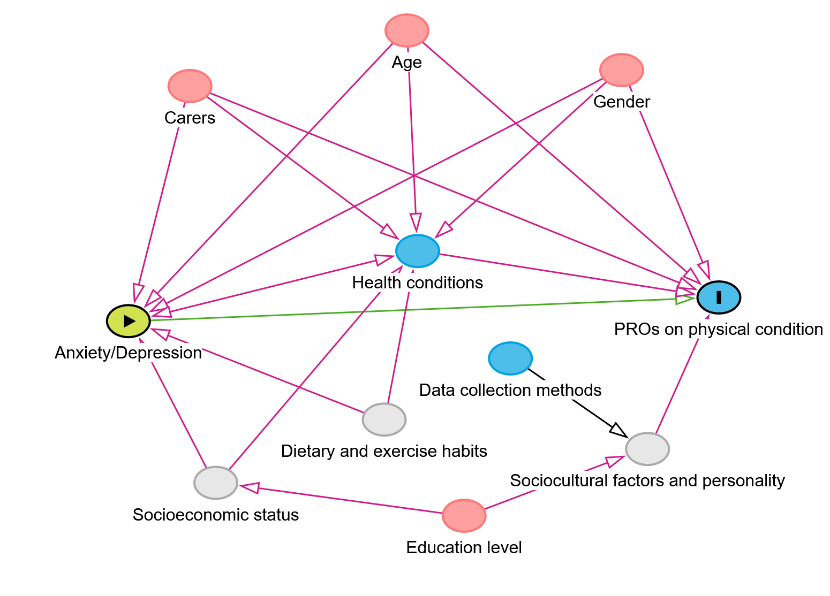
Revealing the interaction effect within EQ-5D-5L data: reporting problems in anxiety/depression dimension could lead to higher odds of reporting problems in the other four dimensions Yanming Hong¹ , Nan Luo² , Zhihao Yang³
¹The Third Affiliated Hospital of Sun Yat-sen University, Guangzhou, P.R. China; ²Saw Swee Hock School of Public Health, National University of Singapore, Singapore; ³Health Services Management School, Guizhou Medical University, Guiyang, P.R. China; Medical Psychiatry and psychotherapy, Erasmus Medical Center, Rotterdam, the Netherlands
Introduction
Pink circles represent ancestors of the exposure and outcome (ie, confounders).
Blue circles represent ancestors of the outcome (ie, causal determinants of the outcome).
Gray circles represent unobserved (ie, latent) variables.
Green lines represent causal paths.
Red lines represent biasing paths.
Results
Our previous study has shown that individuals with poor positive mental well-being (measured by the Short Warwick-Edinburgh Mental Well-being Scale, SWEMWBS) tend to report more problems on the EQ-5D-5L.
Another study has shown that the anxiety/depression item of the EQ-5D-5L and all items of SWEMWBS loaded onto the same factor in an exploratory factor analysis, suggesting they measure the same construct.
This study aims to analyze the potential impact of anxiety/depression on responses to the four physical health dimensions of the EQ-5D-5L.
Sample: 500 participants completed online surveys , 509 participated in face-to-face interviews; 237 healthy individuals, 430 individuals with physical conditions, 234 with mental conditions, and 108 with both physical and mental conditions.
According to graphical rules applied to theDAG, the final minimally sufficient adjustment set comprised age, carers, education level, gender, health conditions.
Generalized ordered logistic regression indicated that individuals with higher levels of anxiety/depression were more likely to report problems in the four physical health dimensions.
Multiple linear regression analysis demonstrated that anxiety/depression was significantly associated with EQ-5D utility values and EQ-VAS scores, with individuals experiencing high levels of anxiety/depression reporting lower values for both measures.
Figure1.Directed acyclic graph (DAG)
Methods
Table1. The odds ratios of generalized ordered logistic regression and beta coefficients of multiple linear regression analysis.
• Sample and data collection: online survey and face-to-face interviews to collect data from a sample with or without different health conditions.
Generalized ordered logistic regression was employed to examine the influence of anxiety/depression on responses to the four physical health dimensions of the EQ-5D-5L (Table 1).
Multiple linear regression analysis was conducted to explore the effects of anxiety/depression on EQ-VAS and utility values.
A directed acyclic graph (DAG) was used to identify the minimum set of variables required to adjust for confounding (Figure 1).
Variables | Mobility | Self-care | Usual activities | Pain /discomfort | EQ-VAS
 | OR | OR | OR | OR | β
Age | 1.02 | 1.03 | 1.00ª | 1.01ª | 0.021ª
Gender (Ref: Female) | 0.63 | 0.75ª | 0.57 | 0.76 | -0.851ª
Education level (Ref: College graduate or above)
Primary School or Below | 0.54ª | 0.49 | 0.64ª | 0.71ª | -9.113
Middle or high school | 0.49 | 0.29 | 0.49 | 1.05ª | -3.88
Health status (Ref: Healthy)
Physical condition | 6.32 | 4.86 | 6.66 | 3.4 | -4.431
Mental condition | 1.57ª | 1.37ª | 2.04 | 1.64 | -7.627
With both conditions | 4.79 | 4.35 | 7.06 | 4.23 | -5.944
Carer (Ref: Yes) | 1.50 | 1.55 | 1.64 | 0.83ª | 2.788
Anxiety/Depression (Ref: Level_1 )
Level_2 | 2.53 | 3.65 | 3.19 | 3.98 | -6.865
Level_3 | 5.85 | 5.67 | 10.02 | 14.77 | -18.192
Level_4 | 12.96 | 6.55 | 20.66 | 24.56 | -32.009
Level_5 | 29.23 | 24.73 | 29.34 | 130.88 | -45.449
Discussions
These results underscore the interconnectedness of mental and physical health, highlighting the importance of a holistic approach to health assessment and care.
Mental health conditions, particularly anxiety and depression, may lead to heightened perceptions of problems in physical health dimensions, potentially biasing self-reported health data.
Addressing anxiety and depression in clinical and therapeutic settings may not only improve mental health outcomes but also positively influence perceived physical health.
A limitation: the observed association could also suggest that poor physical health leads to increased anxiety/depression. Future research is needed to establish causal relationships.
[1] Yang Z, Luo N, Hong Y. The effect of positive mental well-being on patient reported outcome (PRO): finding from a cross-sectional multi-disease study in China. Health and quality of life outcomes. 2024;22(1):100.
[2] Hong Y, Jiang X, Zhang T, Luo N, Yang Z. Examining the relationship between the Short Warwick-Edinburgh Mental Well-being Scale (SWEMWBS) and EQ-5D-5L and comparing their psychometric properties. Health and quality of life outcomes. 2023;21(1):25.
ª p value >0.05 were not significant

