Slide 1
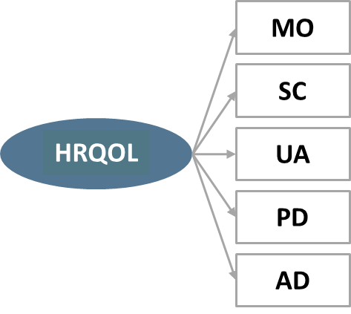
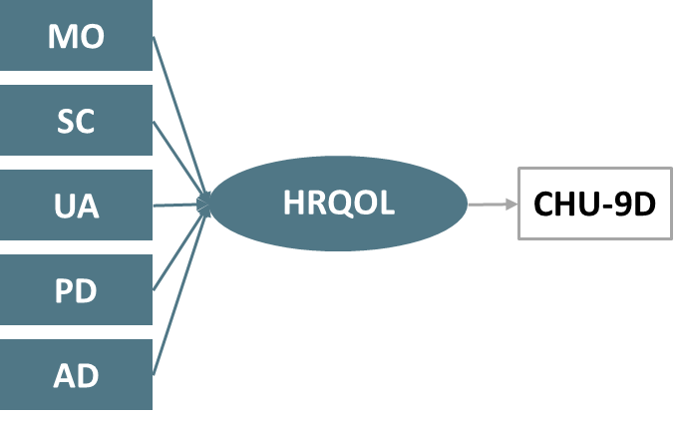
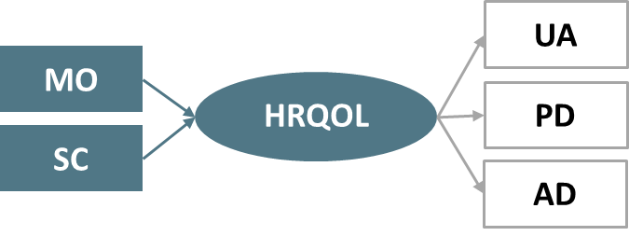
COMPARING INTERNAL STRUCTURE, PSYCHOMETRIC PROPERTIES, AND EXPLANATORY POWER OF SELF-COMPLETED EQ-5D-Y AND CHU-9D IN CHILDREN WITH MENTAL HEALTH CONDITIONS – INSIGHTS FROM A SPECIFIC PHOBIAS STUDY
Han-I Wang¹, Ling-Hsiang Chuang², You-Shan Feng³, Paul Kind⁴
¹University of York, UK; ²Umea University, Sweden; ³University of Tübingen, Germany; ⁴University colleague of London, UK
OBJECTIVES
Address the research gap in evaluating the performance of EQ-5D-Y in children and young people (CYP) with mental health conditions, using specific phobias as a case study.
AIMS:
RESULTS
Both EQ-5D-Y-3L and CHU-9D utility scores showed strong correlations with RCADS-C item scores (>0.5), with CHU-9D slightly higher. Correlations with RCADS-P items were moderate, and both instruments had weak correlations with ADIS..
Explanatory power: EQ-5D-Y-3L explained 18-34% of the variance in the RCADS-C score, while CHU-9D accounted for higher variance (45-54%).
1
INTERNAL STRUCTURE
Model 1: CFA – The model demonstrated good fit. All dimensions showed strong loadings (> 0.30), with ‘worried/sad/unhappy’ having the highest (0.79) and ‘looking after myself’ the lowest (0.40).
Model 2: External MIMIC– Model fit statistics were suboptimal.
Model 3: Internal MIMIC – After exploring various model structures, model with ‘mobility’ and ‘looking after myself’ as formative indicators and the rest as reflective indicators fits best.
 | EQ-5D-Y index (NL) | EQ VAS | EQ-5D-Y 5 dimensions | CHU-9D score | CHU-9D 9 items
RCADS-C | 0.31 | 0.18 | 0.34 | 0.45 | 0.54
RCADS-P | 0.19 | 0.08 | 0.18 | 0.19 | 0.22
ADIS | 0.01 | 0.00 | 0.00 | 0.00 | -0.01
Known-group validity: Significant disparities in reporting any problem in each domain between the two groups were prominent based on the RCADS-C score, but less so based on the ADIS score (data not shown).
1
Exploring the internal structure of self-completed EQ-5D-Y-3L.
Comparing the psychometric performance and explanatory power of EQ-5D-Y-3L with CHU-9D.
2
EQ-5D-Y-3L
DISCUSSION
First comprehensive study examining the internal structure and psychometric properties of EQ-5D-Y-3L in CYP with a full range of specific phobias.
For EQ-5D-Y-3L internal structure, the most fitting model involves all 5 items as reflective factors, differing from the findings observed from adult general population study (internal MIMIC model) and proxy youth autism study (external MIMIC model).
This study highlights the self- vs proxy-reported issue: EQ-5D-Y and CHU-9D utility scores correlate more strongly with RCADS-C (self-reported) than RCADS-P (parents/guidance completed).
RCADS-C was selected as the primary clinical measure due to the lack of a gold standard, though its representation of quality of life may be debated.
The study used the NL Y value set in the absence of a UK Y value set; sensitivity analysis with the German Y value set produced consistent results.
EQ-5D-Y-3L and CHU-9D demonstrate comparable performance in CYP with specific phobias. While EQ-5D-Y has superior acceptability, both instruments show strong convergent validity, good ability to distinguish severity groups (defined by RCADS-C) and moderate responsiveness and explanatory power on RCADS-C, with CHU-9D performing slightly better.
Future research is recommended to compare the internal structure and psychometrics of both self- and proxy-report EQ-5D-Y in other mental health conditions.
METHODS
DATA SOURCE
Data were obtained from the Alleviating Specific Phobias Experienced by Children Trial (ASPECT, n=267), the first trial for CYP aged seven to 16 years and diagnosed with a full range of specific phobias.
OUTCOME MEASUREMENTS:
HRQoL outcomes: EQ-5D-Y-3L (self-report; Netherland value set), CHU-9D (self-report; UK value set)
Clinical outcomes: Revised Children’s Anxiety and Depression Scale for Children/Parents (RCADS-C/P) and the Anxiety Disorder Interview Schedule (ADIS)
ANALYSES:
Model 1: CFA
Model 2: External MIMIC
Model 3: Internal MIMC
CHU-9D
χ² (df) | 16.97 (df=5)
RMSEA | 0.06 (reasonable)
CFI | 0.98 (good fit)
TLI | 0.96 (good fit)
χ² (df) | 63.75 (df=10)
RMSEA | 0.14 (poor fit)
CFI | 0.80 (poor fit)
TLI | 0.58 (poor fit)
χ² (df) | 17.04 (df=9)
RMSEA | 0.06 (reasonable)
CFI | 0.93 (reasonable)
TLI | 0.98 (good fit)
MO (Mobility); SC (Looking after myself); UA (Usual activity); PD (Pain / discomfort); AD (Worried / sad / unhappy)
Note: *p-value<0.05
Effect size | EQ VAS | EQ-5D-Y utility (NL) | CHU-9D utility
ADIS | 0.09 | 0.25 | 0.35
RCADS-C (total anxiety score) | 1.16 | 1.14 | 1.66
RCADS-P (total anxiety score) | 0.49 | 0.90 | 0.95
2
1
Factor analyses: confirmatory factor analysis (CFA), external MIMIC, and internal MIMIC.
PSYCHOMETRIC PERFORMANCE
Acceptability: EQ-5D-Y-3L had a 0.4% non-complete rate with 27.4% reporting full health (ceiling effect), while CHU-9D had a 0.8% non-complete rate with 7.2% reporting full health.
Convergent validity: Correlations between EQ-5D-Y-3L and CHU-9D domains are moderate to weak. However, stronger correlations were observed between EQ-5D-Y’s "worried/sad/unhappy" and CHU-9D’s "worried" (0.59) and "sad" (0.57), "pain/discomfort" and "pain" (0.56), and "doing usual activities" and "daily routine" (0.41).
2
Psychometric performances
Responsiveness: Both EQ-5D-Y-3L and CHU-9D utility scores demonstrated responsiveness to RCADS-C (total anxiety score) with moderate to large effect size; but small effect size with the ADIS score
Acceptability –Missing utility scores (%), celling and floor effects, and response distribution (%)
Convergent validity – Correlation between EQ-5D-Y-3L and CHU-9D items, and versus RCADS-C/P
Known group validity – Groups were defined by RCADS-C/P score ( >65 more vs. ≤65 less severe) and ADIS score (> vs ≤4)
Responsiveness – Change assessed via RCADS-C/P and ADIS.
Explanatory power – Variance of RCADS-C/P and ADIS explained by EQ-5D-Y-3L and CHU-9D items
Effect size | EQ VAS | EQ-5D-Y utility (NL) | CHU-9D utility
RCADS-C (total anxiety score) | 0.00 | 0.68 | 0.90
ADIS score | 0.03 | 0.07 | 0.30

