Slide 1
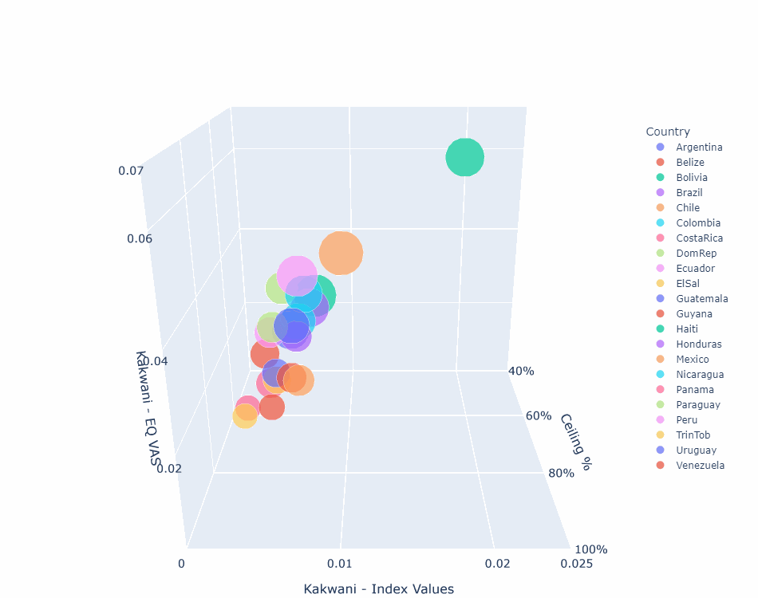
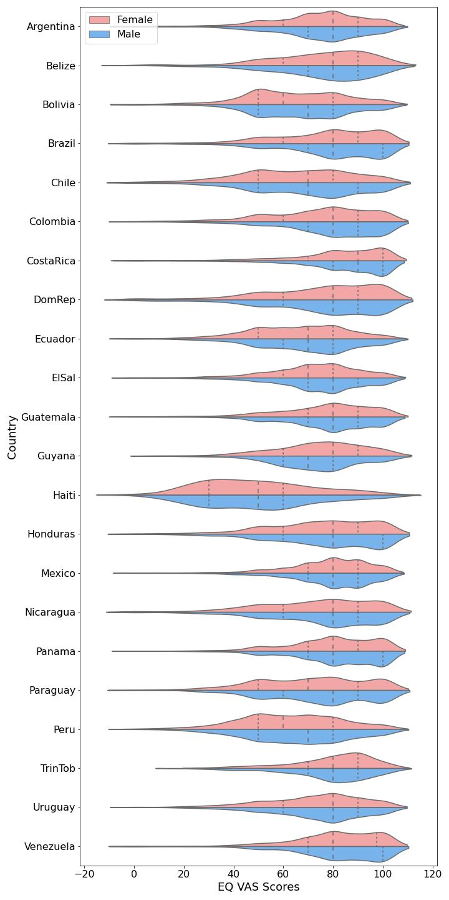
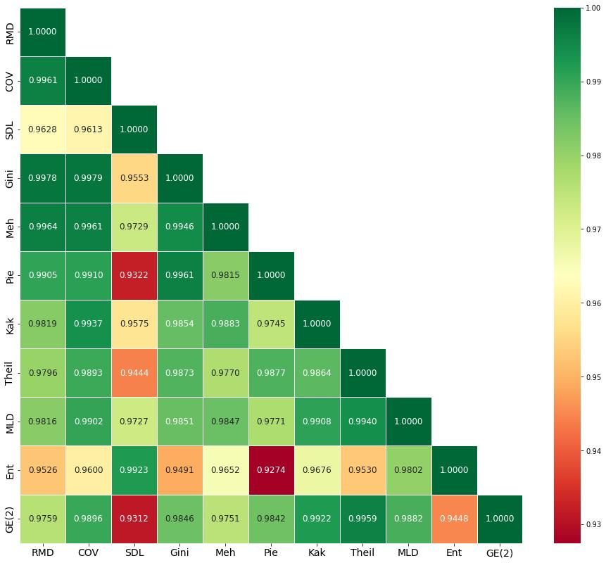
Applying Advanced Data Visualization to Explore Health Inequality Using EQ-5D Measures.
N. Aminnejad¹, H. Bailey², M. Janssen³
1. York University, Toronto, Canada.
2. The University of the West Indies, St Augustine Campus, Trinidad and Tobago
3. EuroQol Research Foundation
OBJECTIVE
RESULTS
Data visualization translates complex datasets into clear, meaningful insights, providing policymakers and researchers with innovative methods to discern patterns in data. The aim of this poster is to illustrate the potential of data visualization tools that offer clear insights into health inequality using EQ-5D on a large data set.
Heatmaps efficiently display values for many variables using colour gradients to reveal patterns and differences. The heatmap in Figure 3 shows correlations among 11 different inequality measures for the 22 countries. These patterns can be linked to the structures of the inequality measures.
METHODS
Several data visualization tools were applied to data from a 2007 Gallup survey which included 37,152 respondents from 22 countries in Latin America and the Caribbean. The EQ-5D related variables were the EQ-5D-3L dimensions and a variant of EQ VAS. Trinidad & Tobago EQ-5D-3L index values were used for all 22 countries. The analysis incorporated 11 well known measures of health inequality applied to the data set. Python’s data visualization libraries were used to design the visual tools that facilitate understanding of health inequality patterns, and the performance of the 11 inequality measures. These included violin plots, heatmaps, and 3D bubble plots.
Figure 2. 3-D Bubble Plot
The 3-D bubble plot in Figure 2 shows 4-dimensional data using 3 axes (Kakwani index for EQ-5D-3L index values, EQ VAS scores and Ceiling percentages with bubble size for an inverse Cowell-Flachaire index for level sum scores). Rotation facilitates closer inspection of features of interest, allowing easy detailed multi-country, multi-measure comparisons by rotating and focusing on key parts of the display. Figure 2 shows rotation on one plane, but this type of display can be rotated on any plane to facilitate visualization and analysis from any angle.
Figure 3. Correlation Heatmap
CONCLUSION
RESULTS
The findings of this study have implications for the analysis of EQ-5D data in studies of inequality and communication of findings, as well as for the choice of inequality measures when working with EQ-5D data. These tools help researchers identify EQ-5D inequality patterns across regions, pinpoint demographic groups experiencing significant disparities and communicate results effectively to stakeholders.
Violin plots quickly and easily show the distributions of EQ-5D data between demographic groups within countries and facilitate comparison of many countries simultaneously in a single, cohesive view. Figure 1 shows that in countries like Mexico, distributions are nearly symmetrical for male and female, whereas in Guyana, the EQ VAS distributions are different.
Figure 1. Violin Plot for EQ VAS Scores

