Slide 1
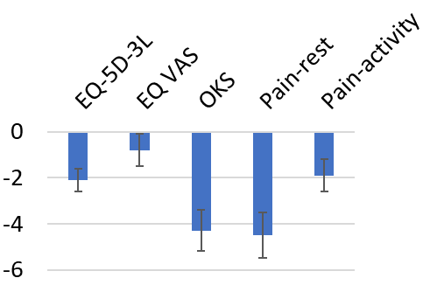
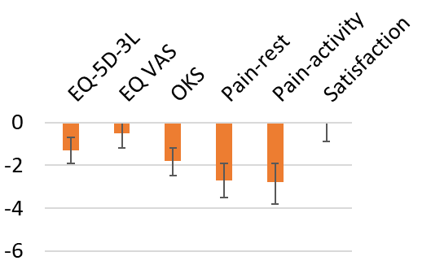
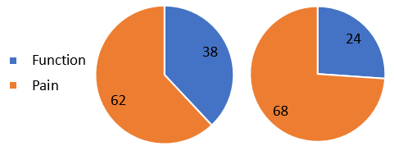
Socioeconomic Inequalities in Patient-Reported Outcome Measures among Total Hip and Knee Arthroplasty Patients: A Comprehensive Analysis of Instruments and Domains JM Bonsel¹ (email: j.bonsel@erasmusmc.nl), M Reijman¹, E Macri¹, JAN Verhaar¹, LN van Steenbergen², GJ Bonsel³ ¹Orthopedics & Sports Medicine, Erasmus MC; ²Landelijke Registratie Orthopedische Interventies; ³EuroQol
Objectives
Results (TKA n=45,882)
Total Hip and Knee Arthroplasty (THA/TKA) patients with low socio-economic status (SES) have worse preoperative and 12-month follow-up PROMs. This study explored which PROMs and domains were most affected.
1. Linear regression: adjusted differences for most vs. least deprived
Methods
Data: Dutch Arthroplasty Registry 2014-2022 Outcomes: * PROMs rescaled to 0-100 with 100=best * Generic: EQ-5D-3L (and -5L), EQ VAS * Disease-specific: Oxford Hip and Knee Score (OHS/OKS) * 1-item numerical rating scales: pain, satisfaction after surgery
Exposure: area-based SES indicator categorized into quintiles
Analysis: 1. Linear regression to contrast most vs. least deprived SES quintiles with adjustment for patient/surgical characteristics. 2. Contribution of the individual domains to these differences, expressed in %.
Preoperative
12-month fup
2. Contribution of domains to these differences; EQ-5D-3L (left) & OKS (right)
Preoperative
12-month fup
Preoperative
12-month fup
Conclusions
THA/TKA patients with low SES have worse health, pain and functioning. Yet, EQ VAS and satisfaction were hardly affected. The question is if this represents ‘true’ differences across PROMs or if the latter were biased by reporting heterogeneity.

